Slide 2
Modern Climate Change: A Result and Determinant of the Global Order
Our perception depends on the distance we have …
Hans-Peter Plag
Old Dominion University
Norfolk, VA, USA

Slide 4
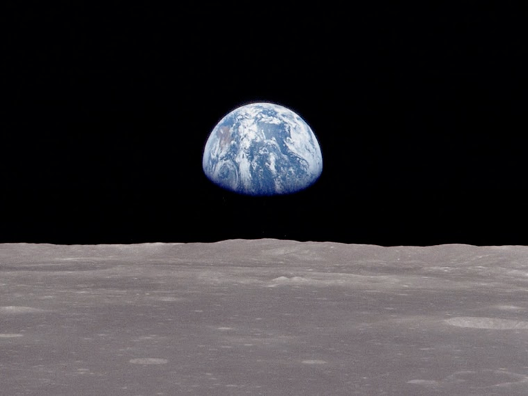
Physiology of the Planetary Life-Support System: Homeostasis
Global Essential Variable: Energy Imbalance: Incoming Energy minus Outgoing Energy
“Healthy Life-Support System”:
Earth’s Energy Imbalance (EEI) due to photosynthesis on the order of 10⁻¹⁰ to 10⁻⁹
Imbalance today: 300-320 TW, i.e., on the order of 3x10⁻³
(e.g., Stephens et al., 2012; Trenberth et al., 2014, Cheng et al., 2016)
(1) Why did the Earth’s Energy Imbalance increased so dramatically?
(2) Where, and in what form, is the energy stored?

Slide 5
Modern Climate Change: A Result and Determinant of the Global Order
Modern Climate Change: A Symptom of a
Single-Species High-Energy Pulse

Slide 6
(1) Why did the Earth’s energy imbalance increased so dramatically?
(2) Where, and in what form, is the energy stored?

Slide 7
Why did the Earth’s energy imbalance increased so dramatically?
Answer: Because atmospheric Greenhouse Gases increased and Earth’s albedo
changed
(2) Where, and in what form, is the energy stored?
(1) Why did the Earth’s energy imbalance increased so dramatically?
(2) Where, and in what form, is the energy stored?

Slide 8
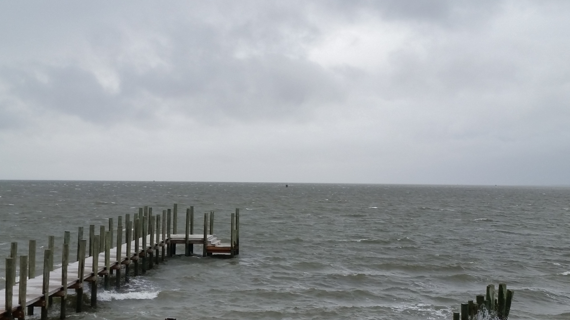
Modern Climate Change: A Symptom of a
Single-Species High-Energy Pulse
Contents
The Baseline: Past Climate Changes
The Syndrome: Modern Climate and Global Change
The Diagnosis: A new Economy and Global Order
The Prognosis: Leaving the “Safe Operating Space” and into the Unknown
The Therapy: A new Ethics, Economy, and Global Governance
Hans-Peter Plag
February 9, 2016

Slide 9
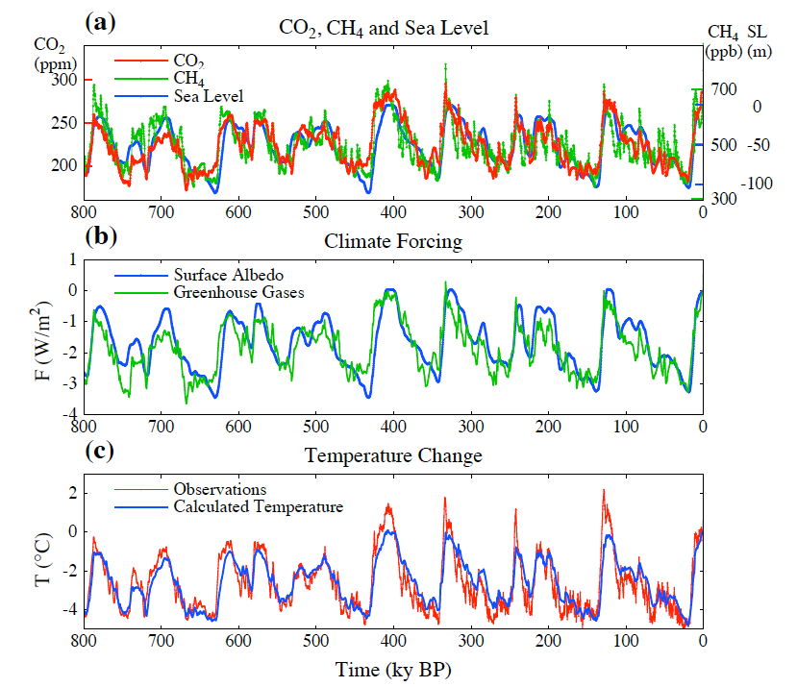
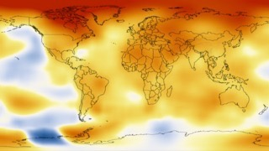
The Baseline: Past Climate and Global Change
Climate Change is a long-term shift in the statistics of weather:
averages
frequency and magnitude of extremes.
Climate is determined by:
incoming radiation (sun, distribution)
reflected radiation (albedo)
retained heat (Greenhouse gases)
Warm period
“Inter-glacial”
Correlation between CO2 and T
Cold period
Ice age
“glacial”
Climate can change from local to global scales.
Temperature anomaly 2008-2012 compared to 1900
Climate can change a lot over time.
Temperature difference:
4ºC - 5ºC

Slide 10
The Baseline: Past Climate and Global Change
Greenhouse Gases and Air Temperature
1895

Slide 11
The Baseline: Past Climate and Global Change
Greenhouse Gases and Air Temperature
Francis Molena
1912
Popular Mechanics, March 1912, 393-342
“It is largely the courageous, enterprising, and ingenious American whose brains are changing the world. Yet even the dull foreigner, who burrows in the earth by the faint gleam of his miner's lamp, not only supports his family and helps to feed the consuming furnaces of modern industry, but by his toil in the dirt and darkness adds to the carbon dioxide in the earth's atmosphere so that men in generations to come shall enjoy milder breezes and live under sunnier skies.”

Slide 12
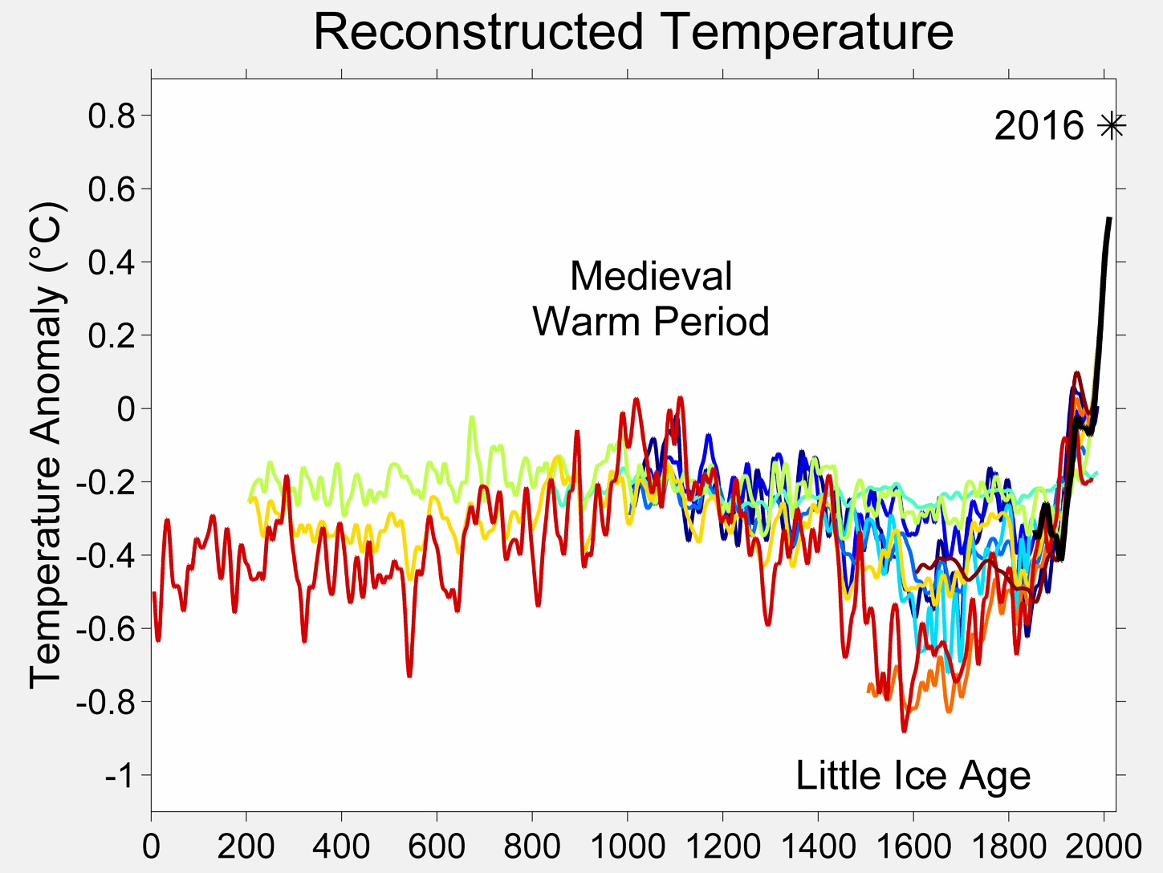
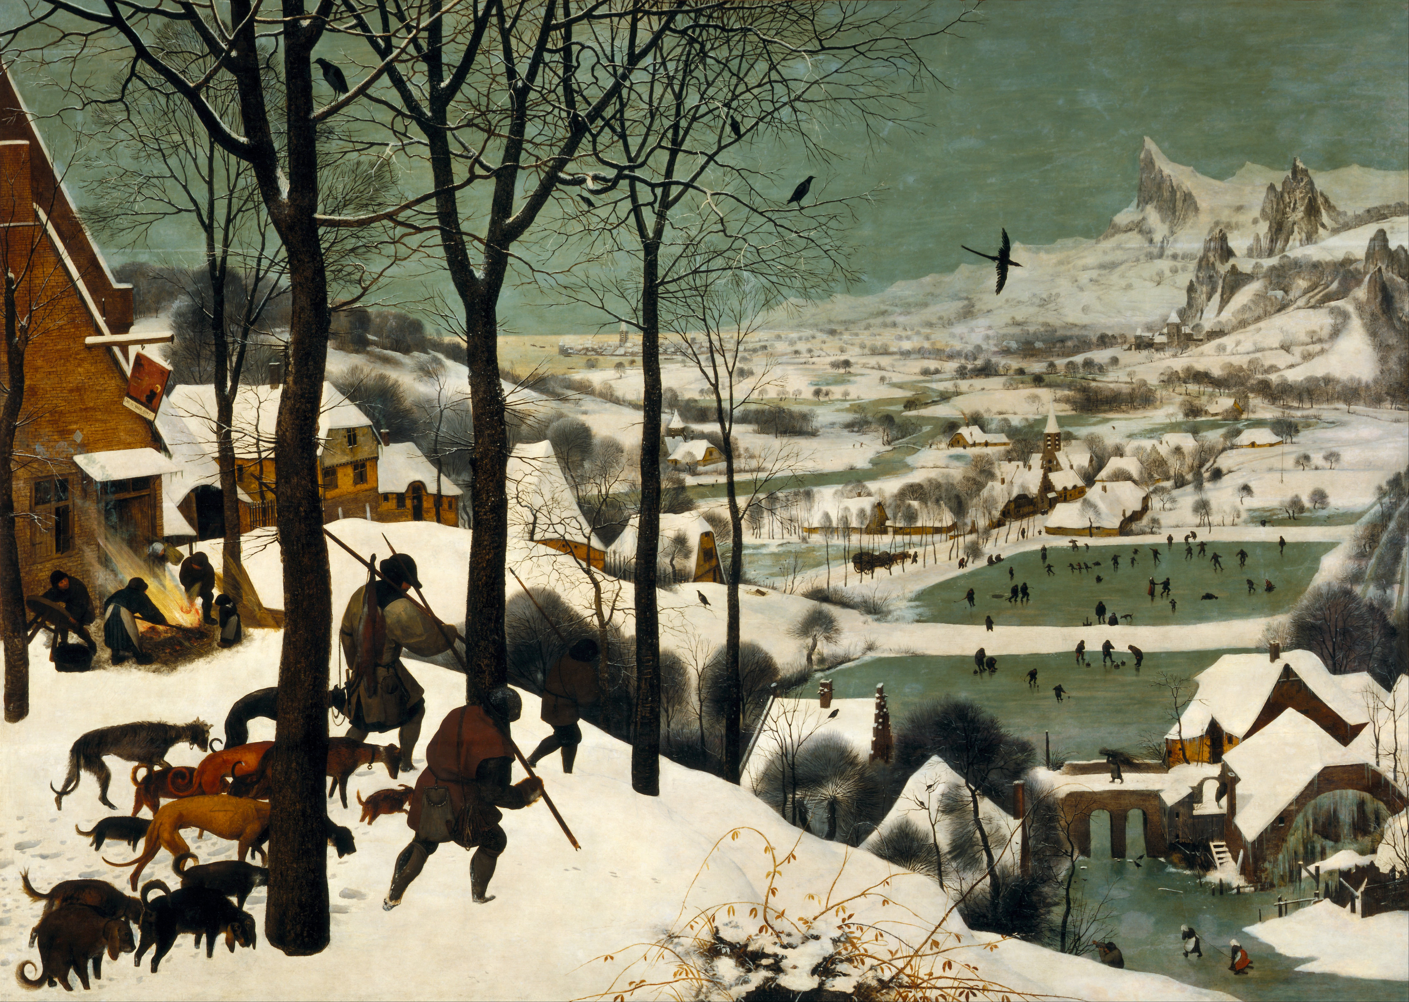
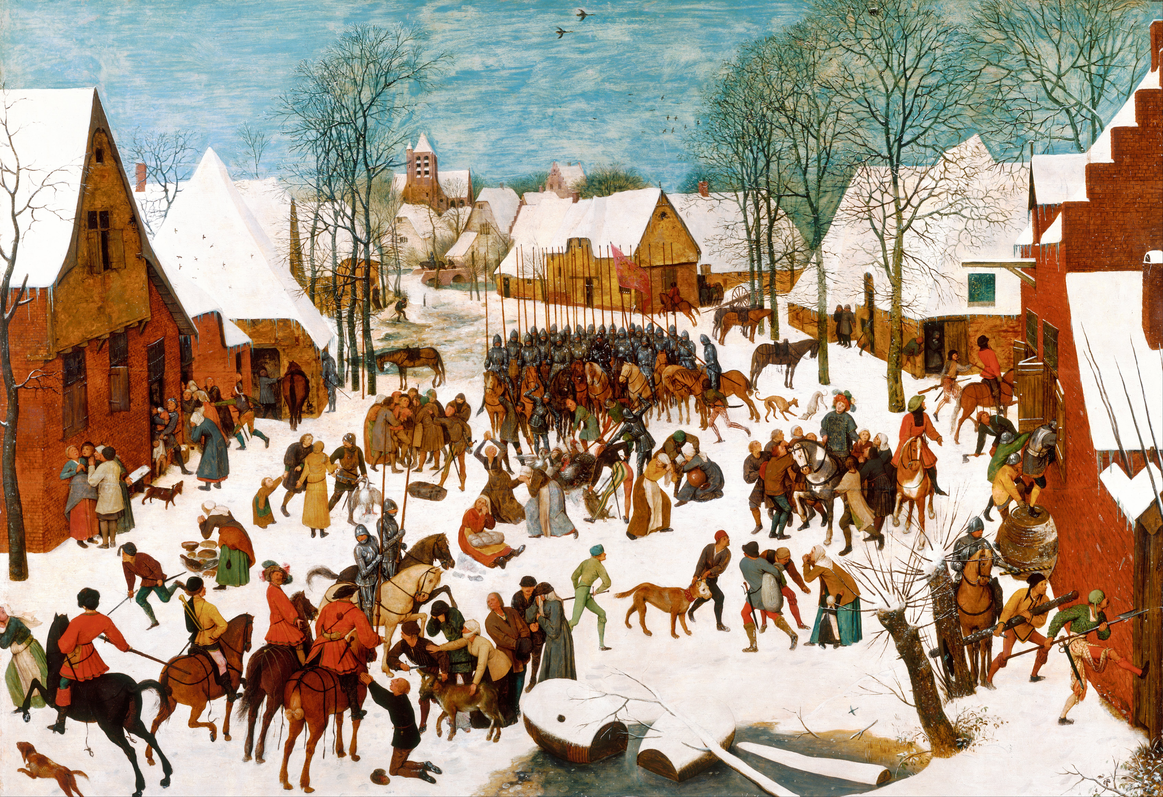
The Baseline: Past Climate and Global Change
Arrhenius,
Molena
https://www.theguardian.com/world/2020/jan/08/viking-runestone-may-allude-to-extreme-winter-study-says

Slide 13
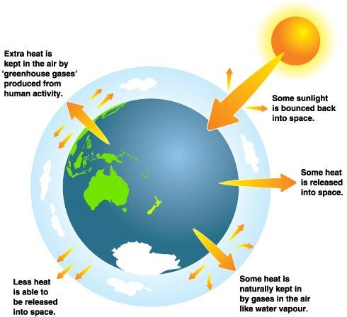
The Baseline: Past Climate and Global Change
Earth's Energy Imbalance (EEI) is the difference between the amount of solar energy absorbed by Earth and the amount of energy the planet radiates to space as heat.
EEI = Solar irradiance - Released Energy
With increasing Greenhouse gases, more heat is stored in atmosphere
EEI > 0: Global Warming
EEI < 0: Global Cooling
Some sunlight is bounced back into space
What can change?
Solar irradiance can change
Currently: 1366±1 W/m² (~240 W/m²)
Reflected radiation can change (albedo)
Absorbed energy can change
Some solar energy is used by plants and stored in fossils fuels
Some heat is released into space
Longterm EEI: 0.0000001-0.0000003 W/m²
10,000 years EEI: ±0.01 W/m²
Current EEI: ~0.6 W/m²
Some heat is absorbed by Greenhouse gases (CO2, CH4, H2O, ...)
Less heat is released to space and stored in ocean and hydrosphere

Slide 14
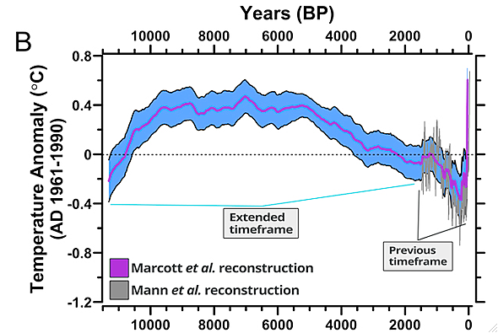
The Baseline: Past Climate and Global Change
Baseline and Range of Changes
}
6ºC
{
5ºC
{
1ºC
Rockstrom and Klum, 2015
Marcott et al., 2013

Slide 15
The Baseline: Past Climate and Global Change
Baseline and Range of Changes
130 m
{
}
130 ppm
{
5ºC

Slide 16
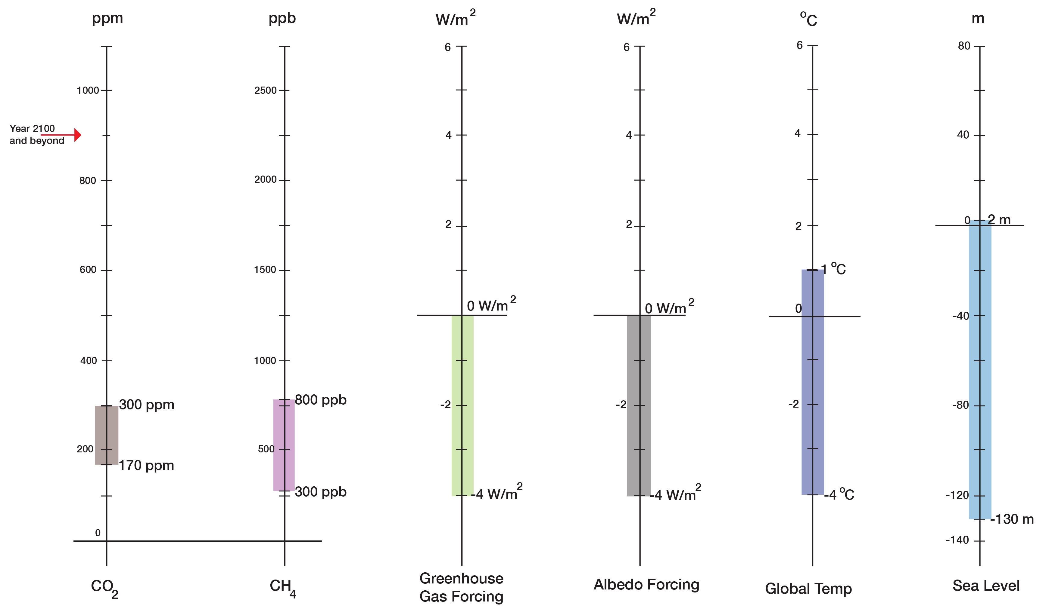
The Baseline: Past Climate and Global Change
Baseline and Range of Changes
Long-term (centuries to millennia) correlations:
130 ppm CO2 <=> 5ºC
130 ppm CO2 <=> 130 m in sea level
Normal Range up to 1900
Holocene

Slide 17
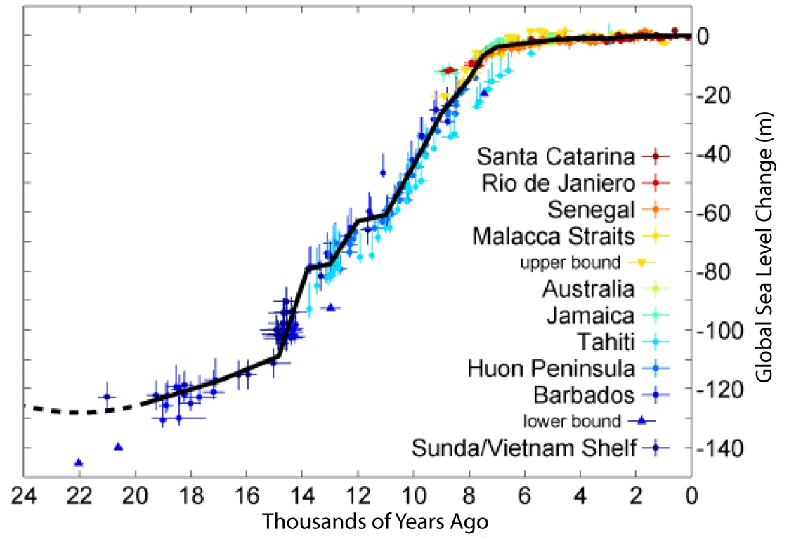
The Baseline: Past Climate and Global Change
Normalcy Bias: Climate variations are small and sea level is stable — a result of the Holocene
Global Temperature Changes
Global Sea Level Changes
Settlements in river deltas
<--Holocene-->
<------------Holocene------------>
Marcott et al., 2013
With stable climate and sea level, the Holocene was a safe operating space for humanity.

Slide 18
Key Points
Baseline
During the Holocene, climate and sea level were exceptionally stable.
The Holocene was a “safe operating space for humanity” allowing the emergence of a dominant species

Slide 19
Modern Climate Change: A Symptom of a
Single-Species High-Energy Pulse
Contents
The Baseline: Past Climate Changes
The Syndrome: Modern Climate and Global Change
The Diagnosis: A new Economy and Global Order
The Prognosis: Leaving the “Safe Operating Space” and into the Unknown
The Therapy: A new Ethics, Economy, and Global Governance
Hans-Peter Plag
February 9, 2016

Slide 20
The Syndrome: Modern Climate and Global Change
Temperature 2008-2012 compared to 1900

Slide 21
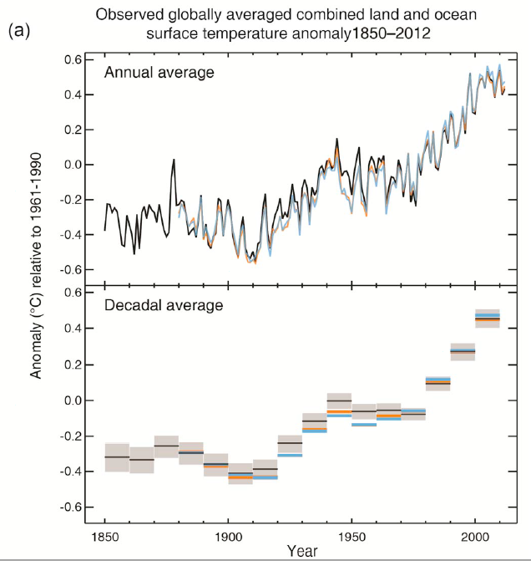
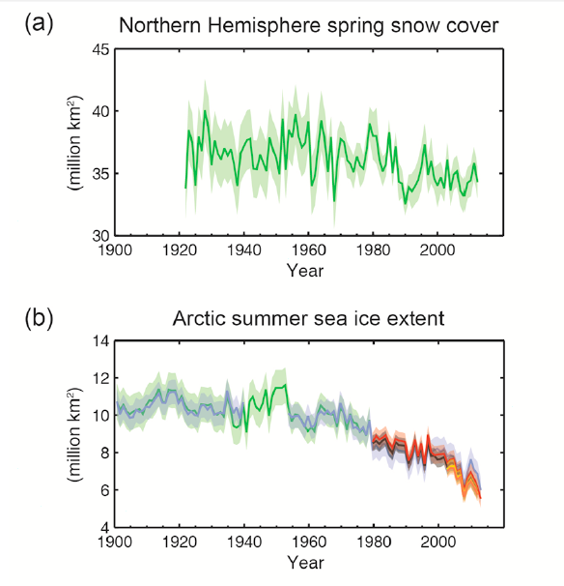
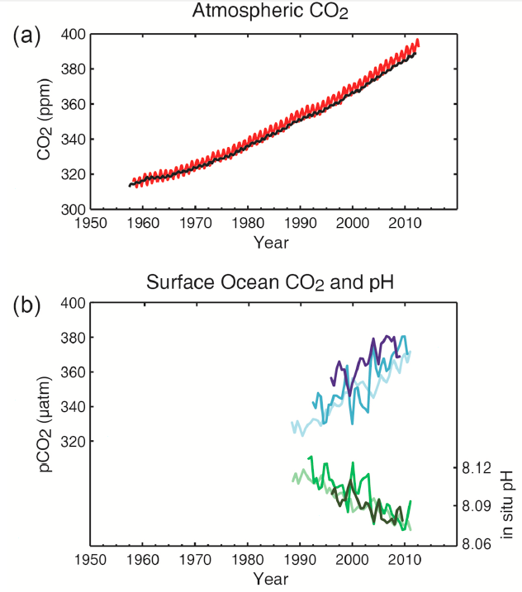
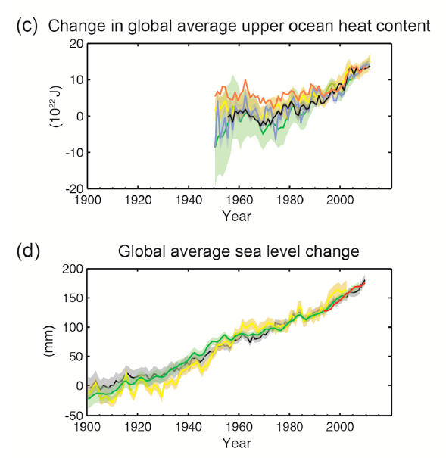
The Syndrome: Modern Climate and Global Change
Snow Cover
Temperature
Sea Ice
Upper Ocean Heat
Sea Level
IPCC, 2013

Slide 22
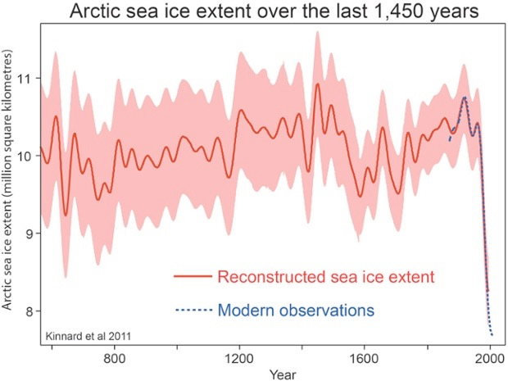
The Syndrome: Modern Climate and Global Change
Marcott et al., 2013
Kinnart et al., 2011

Slide 23
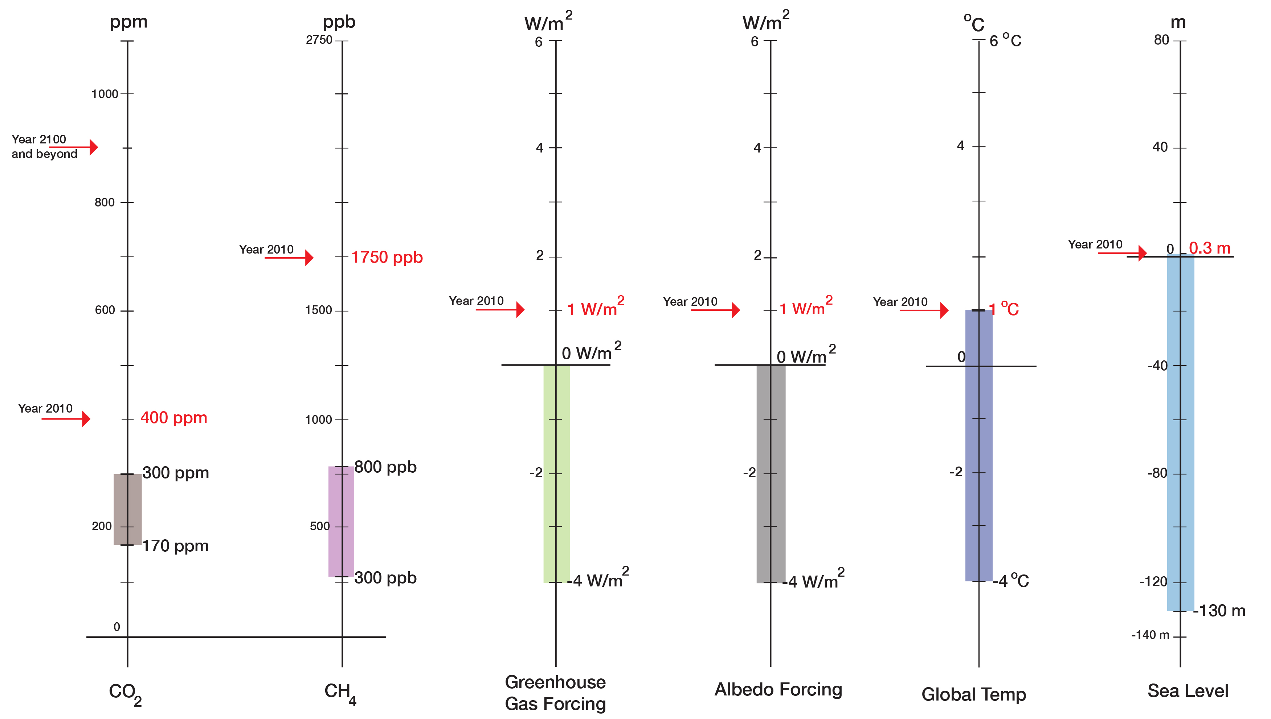
The Syndrome: Modern Climate and Global Change
The Lab Results for “Patient Earth”
“Current State”
“Normal Range”
(800,000 years)

Slide 24
Based on Feedback: The Earth’s Life-Support System and sustainability
Earth’s Energy Imbalance
International System of Units:
Energy: Joules
Power: Energy/time: Joules/s = Watt
1 Watt * 1 s = 1 Joules
Giga: 10⁹ Exa: 10¹⁸
Tera: 10¹² Zeta: 10²¹
Peta: 10¹⁵
Total energy storage in 200 Myrs:
Order 100-1000 ZetaJoules
EEI = 10⁻¹⁰ - 10⁻⁹
I ~ 10⁵ TeraWatt ~ 10¹⁷ Watt (solar irradiation)
P = EEI * I ~ 10⁷ - 10⁸ Watt
(P: power of energy storage on the planet)
200 Myrs = 200,000,000 * 31,557,600 s
200 Myrs * P = 6,311,520,000,000,000 * 10,000,000 Joules
= 63,115,200,000,000,000,000,000
~ 63 ZetaJules ~ 100 ZetaJules
Humanity: 20 TeraWatt,
Energy in 100 yrs:
E = 100 * 31,557,600 s * 20,000,000,000,000 Watt
= 63,115,200,000,000,000,000,000 ~ 100 ZetaJules

Slide 25
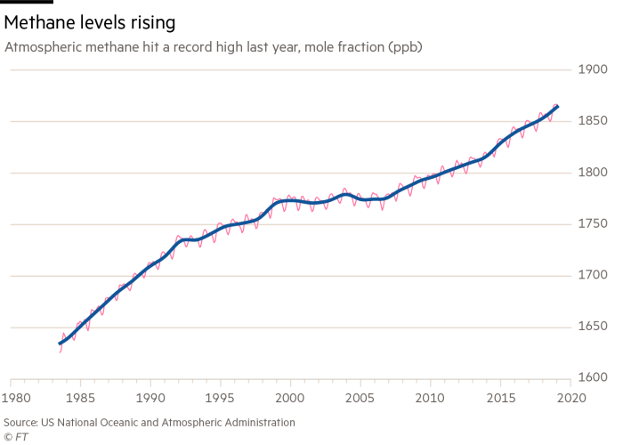
The Syndrome: Modern Climate and Global Change
Greenhouse Gases

Slide 26
The Syndrome: Modern Climate and Global Change
Greenhouse Gases: Example CO2
}
180 ppm: 20,000 years ago (glacial maximum)
270 ppm: 10,000 years ago (transition to agriculture)
280 ppm: At the start of industrialization in the 17th Century
Time since the last glacial maximum
}
312 ppm: My Birth
320 ppm: Started as carpenter
331 ppm: Started at university
350 ppm: PhD
373 ppm: Married
412 ppm: Today (July 2019)
Time of my life
My “age” in CO2 increase: 100 ppm (1.5 ppm/year)
Increase over the last 20,000 before industrialization: 120 ppm (0.006 ppm/year)
The increase in my life-time was 250 times faster than on average during the pre-industrial 20,000 years.

Slide 27
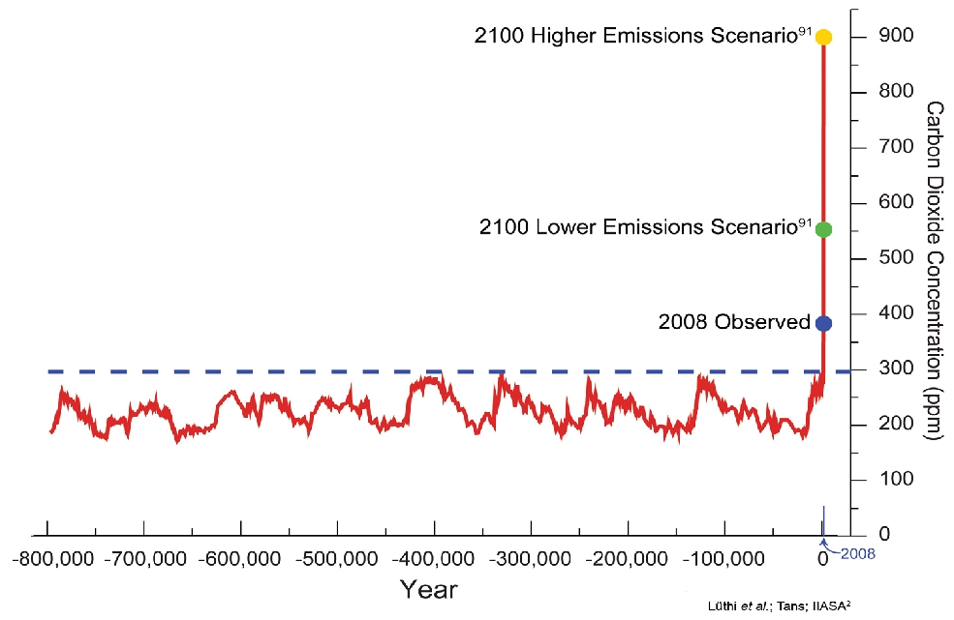
The Syndrome: Modern Climate and Global Change
Two Questions:
What did this increase of CO2 do the Earth’s Energy Imbalance?
Why are we not experiencing the full impact of the dramatic increase?
{
2019
110 ppm
{
130 ppm
Notes:
I can fix this, I also want to add methane (I have it)

Slide 28
The Syndrome: Modern Climate and Global Change
Earth's Energy Imbalance (EEI) is the difference between the amount of solar energy absorbed by Earth and the amount of energy the planet radiates to space as heat.
EEI = Solar irradiance - Released Energy
With increasing Greenhouse gases, more heat is stored in atmosphere
EEI > 0: Global Warming
EEI < 0: Global Cooling
Some sunlight is bounced back into space
What can change?
Solar irradiance can change
Reflected radiation can change (albedo)
Absorbed energy can change (Greenhouse Gases)
Some solar energy is used by plants and stored in fossils fuels
Some heat is released into space
Some heat is absorbed by Greenhouse gases (CO2, CH4, H2O, ...)
Less heat is released to space and stored in ocean and hydrosphere

Slide 29
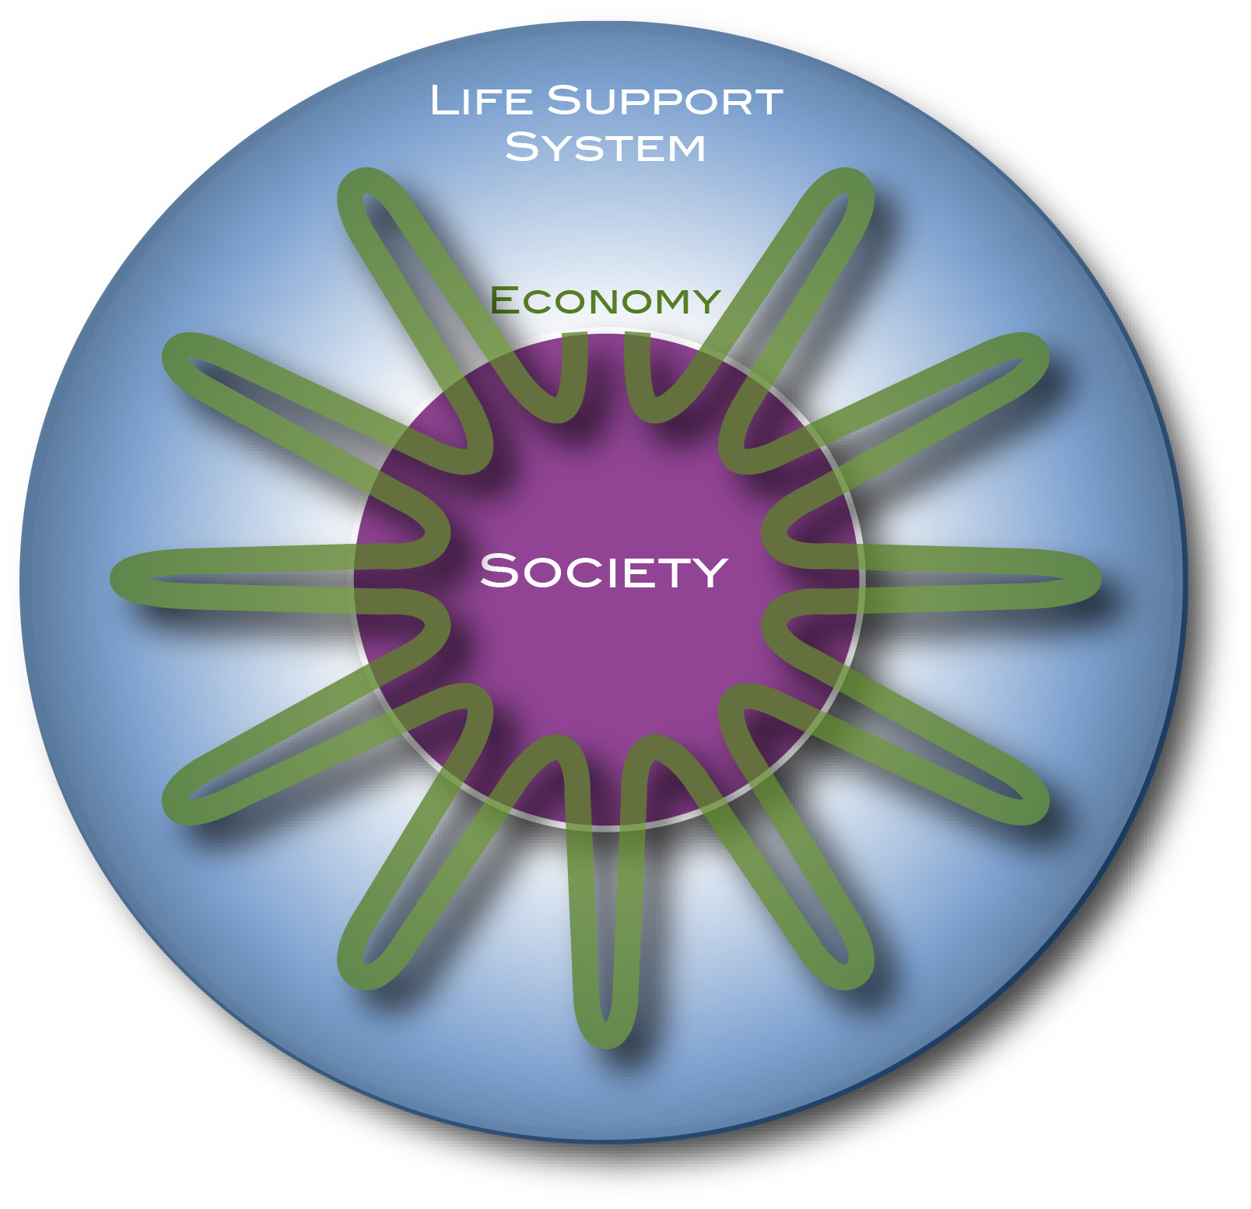
The Syndrome: Modern Climate and Global Change
Earth’s Energy Imbalance
The Earth’s Energy Imbalance increased by a factor of 10⁶ to 10⁷!
10⁻¹⁰-10⁻⁹
Incoming
Solar
3x10⁻³
Incoming
Solar
Outgoing Radiation
Outgoing Radiation
Storage in fossil fuels
Storage in heat
Imbalance on the order of 10⁻¹⁰-10⁻⁹
Imbalance on the order of 3x10⁻³
Last 70 years
Last 200 Million years
Total energy storage in 200 Myrs:
Order 100-1000 ZetaJoules
Total energy storage per century:
Order 1000 ZetaJoules

Slide 30
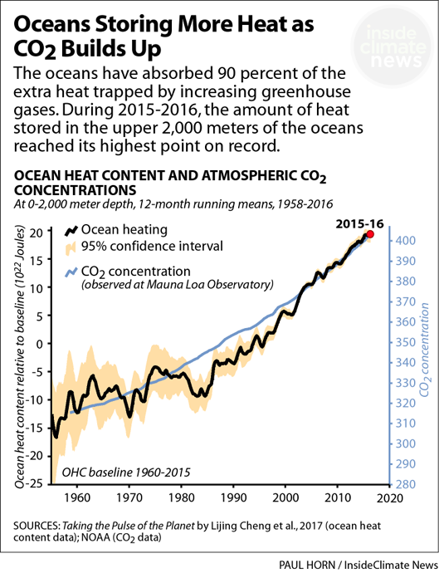
The Syndrome: Modern Climate and Global Change
Earth’s Energy Imbalance
10⁻¹⁰ to 10⁻⁹
Long-term due to photosynthesis: 10-100 MegaWatt
Today: 300-320 TeraWatt
The Earth system is storing far more heat (energy) than what the rising air temperature indicates.
10⁻³
Ocean stores more than 90% of EEI
The Pool-House Effect

Slide 31
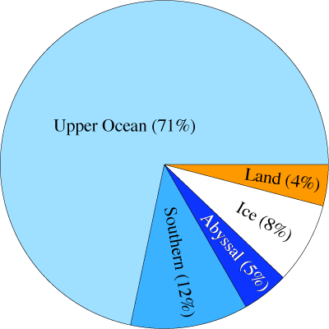
The Syndrome: Recent Climate and Global Change
Earth’s Energy Imbalance
10⁻¹⁰ to 10⁻⁹
Long-term due to photosynthesis: 10-100 MegaWatt
Today: 300-320 TeraWatt
10⁻³
The Earth system is storing far more heat (energy) than what the rising air temperature indicates
Ocean: >90%
The Pool-House Effect

Slide 32
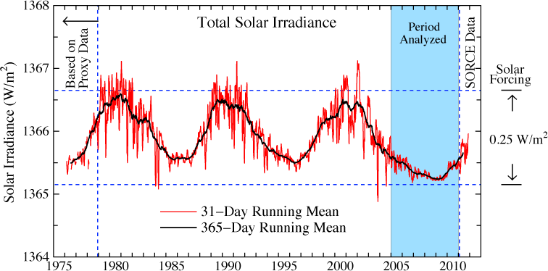
The Baseline: Past Climate and Global Change
Solar irradiance in the era of accurate satellite data. Left scale is the energy passing through an area perpendicular to Sun-Earth line. Averaged over Earth's surface the absorbed solar energy is ~240 W/m², so the amplitude of solar variability is a forcing of ~0.25 W/m². (Credit: NASA/GISS)

Slide 33
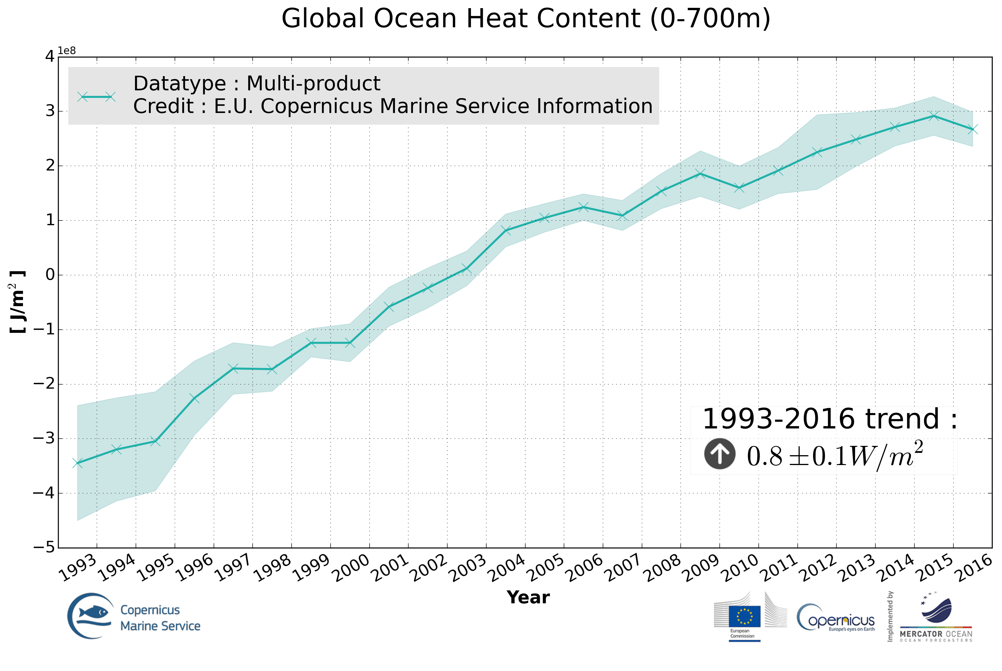
Energy Balance

Slide 34
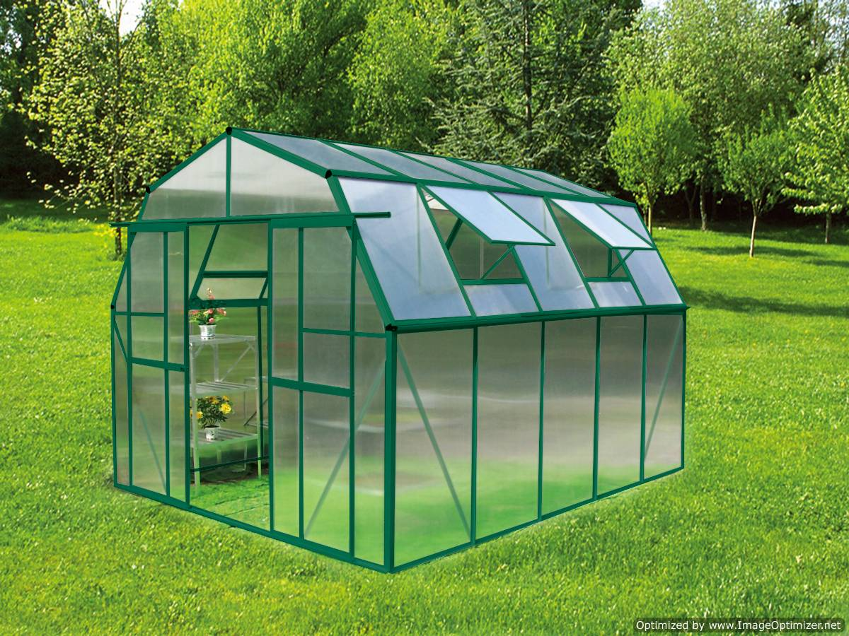
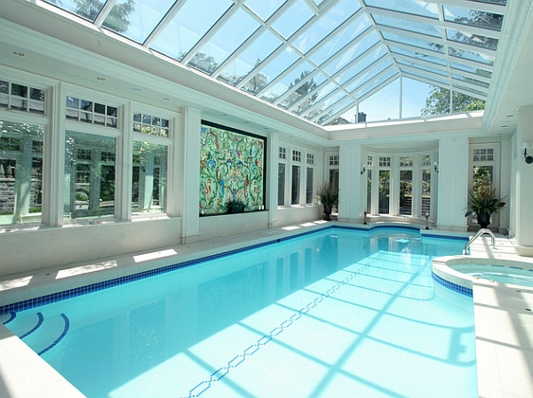
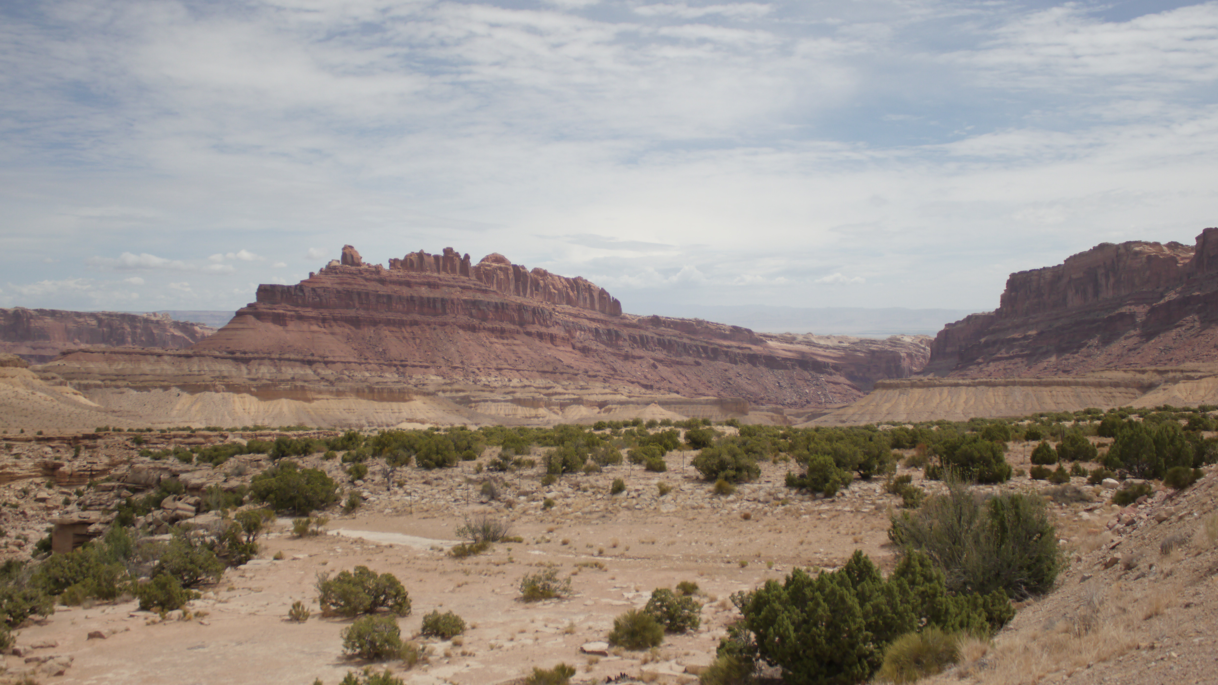
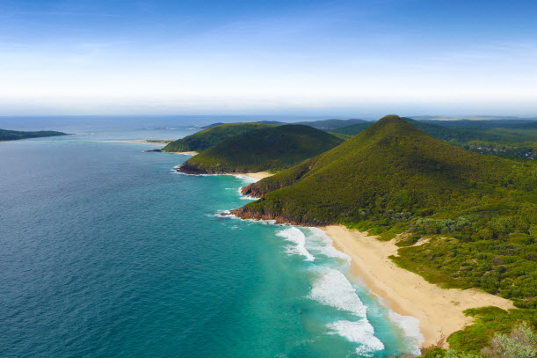
The Syndrome: Recent Climate and Global Change
Greenhouse
Poolhouse
Volumetric heat capacity of water compared to air: About 3300 time higher

Slide 35
The Syndrome: Modern Climate and Global Change
Greenhouse
Poolhouse
Even if carbon emissions are reduced, the ocean is still set for centuries or more of warming, acidification, deoxygenation, and sea level rise.
Volumetric heat capacity of water compared to air: About 3300 time higher

Slide 36
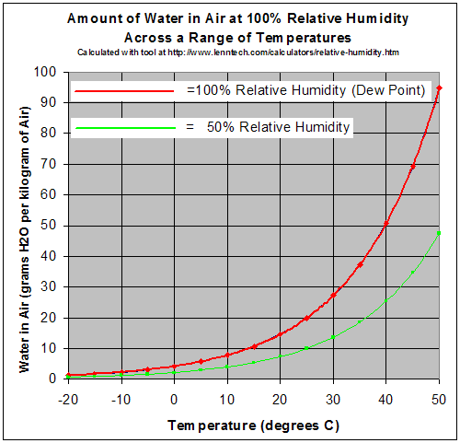
The Baseline: Past Climate and Global Change
Specific heat capacity:
Water: 4200 Jkg⁻¹K⁻¹
Air: 993 Jkg⁻¹K⁻¹
Water has 4.23 times higher specific heat capacity.
Density:
Water: 1000 kg/m³
Air: 1.275 kg/m³
Water is about 785 times denser than air.
Volumetric heat capacity:
Water compared to air:
About 3300 time higher volumetric heat capacity

Slide 37
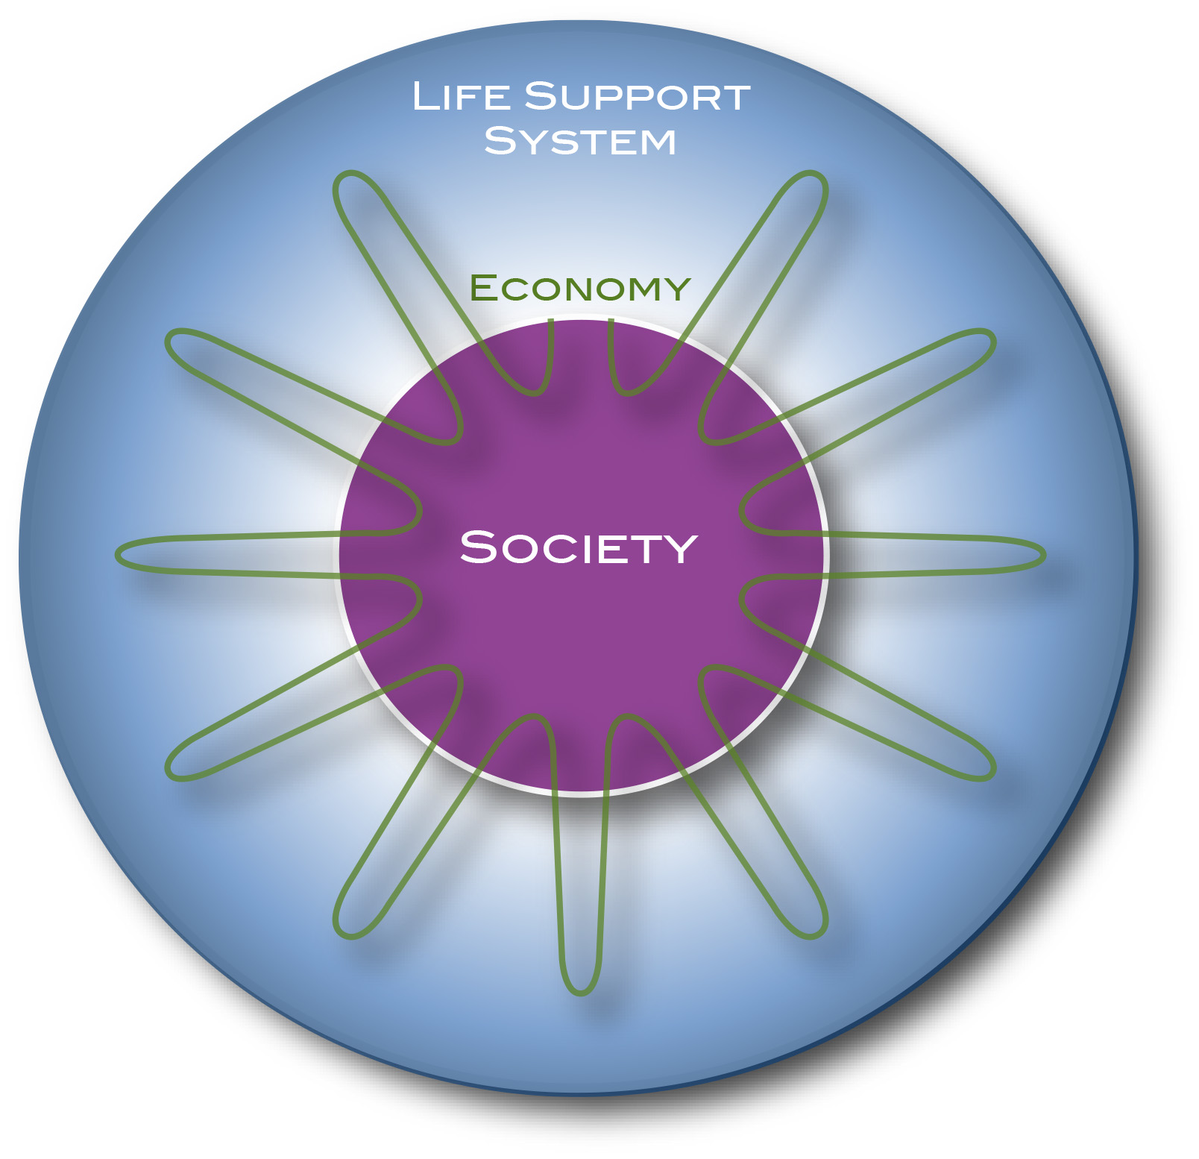
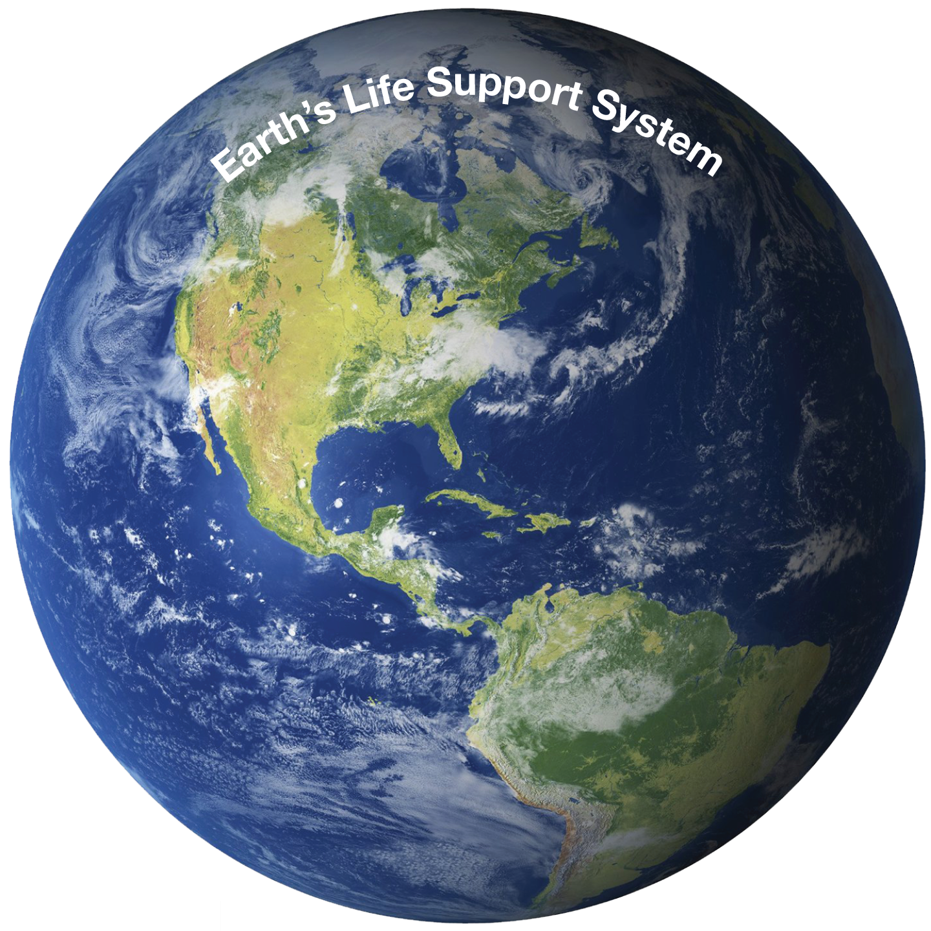
The Syndrome: Modern Climate and Global Change
Planetary Physiology
Earth: Life-Support System for many species
Flows in the Earth System allow assessing the “Health of the Planet”
FLOWS
Everything is about Flows
What about Modern Global Change?
Limitations in the flows between a community and its life-support system limit the growth of the community
For Home sapiens, the flows are regulated by ethical, social, and - recently - economic rules
Global Order:
Colonialization
Consumarism
Globalization

Slide 38
The Syndrome: Modern Climate and Global Change
Planetary Physiology
Earth: Life-Support System for many species
Everything is about Flows
FLOWS
What about Modern Global Change?
Limitations in the flows between a community and its life-support system limit the growth of the community
For Home sapiens, the flows are regulated by ethical, social, and - recently - economic rules
Global Order:
Colonialization
Consumarism
Globalization

Slide 39
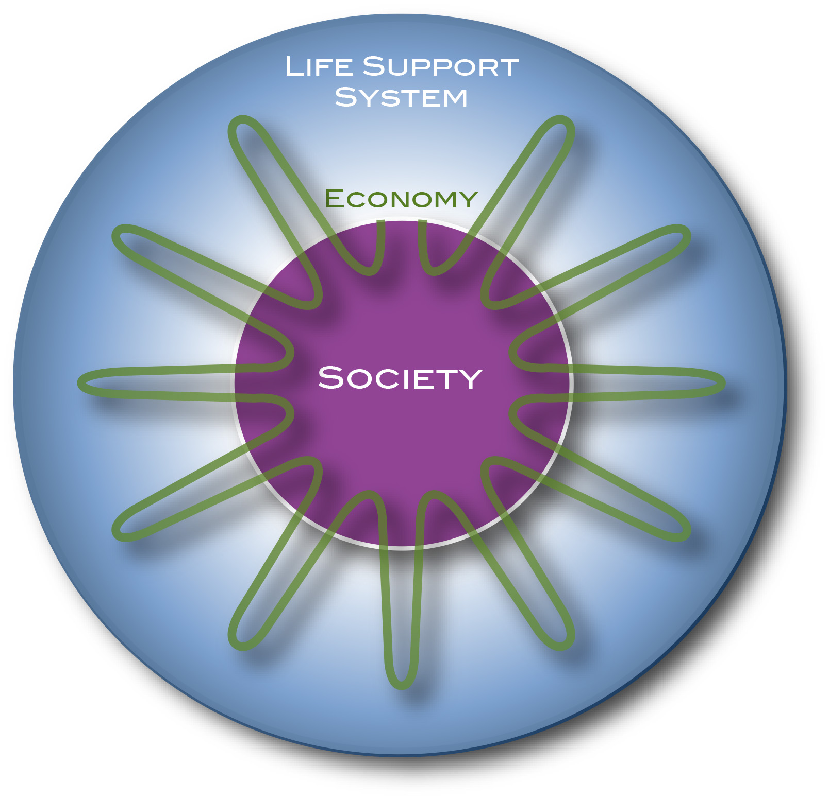
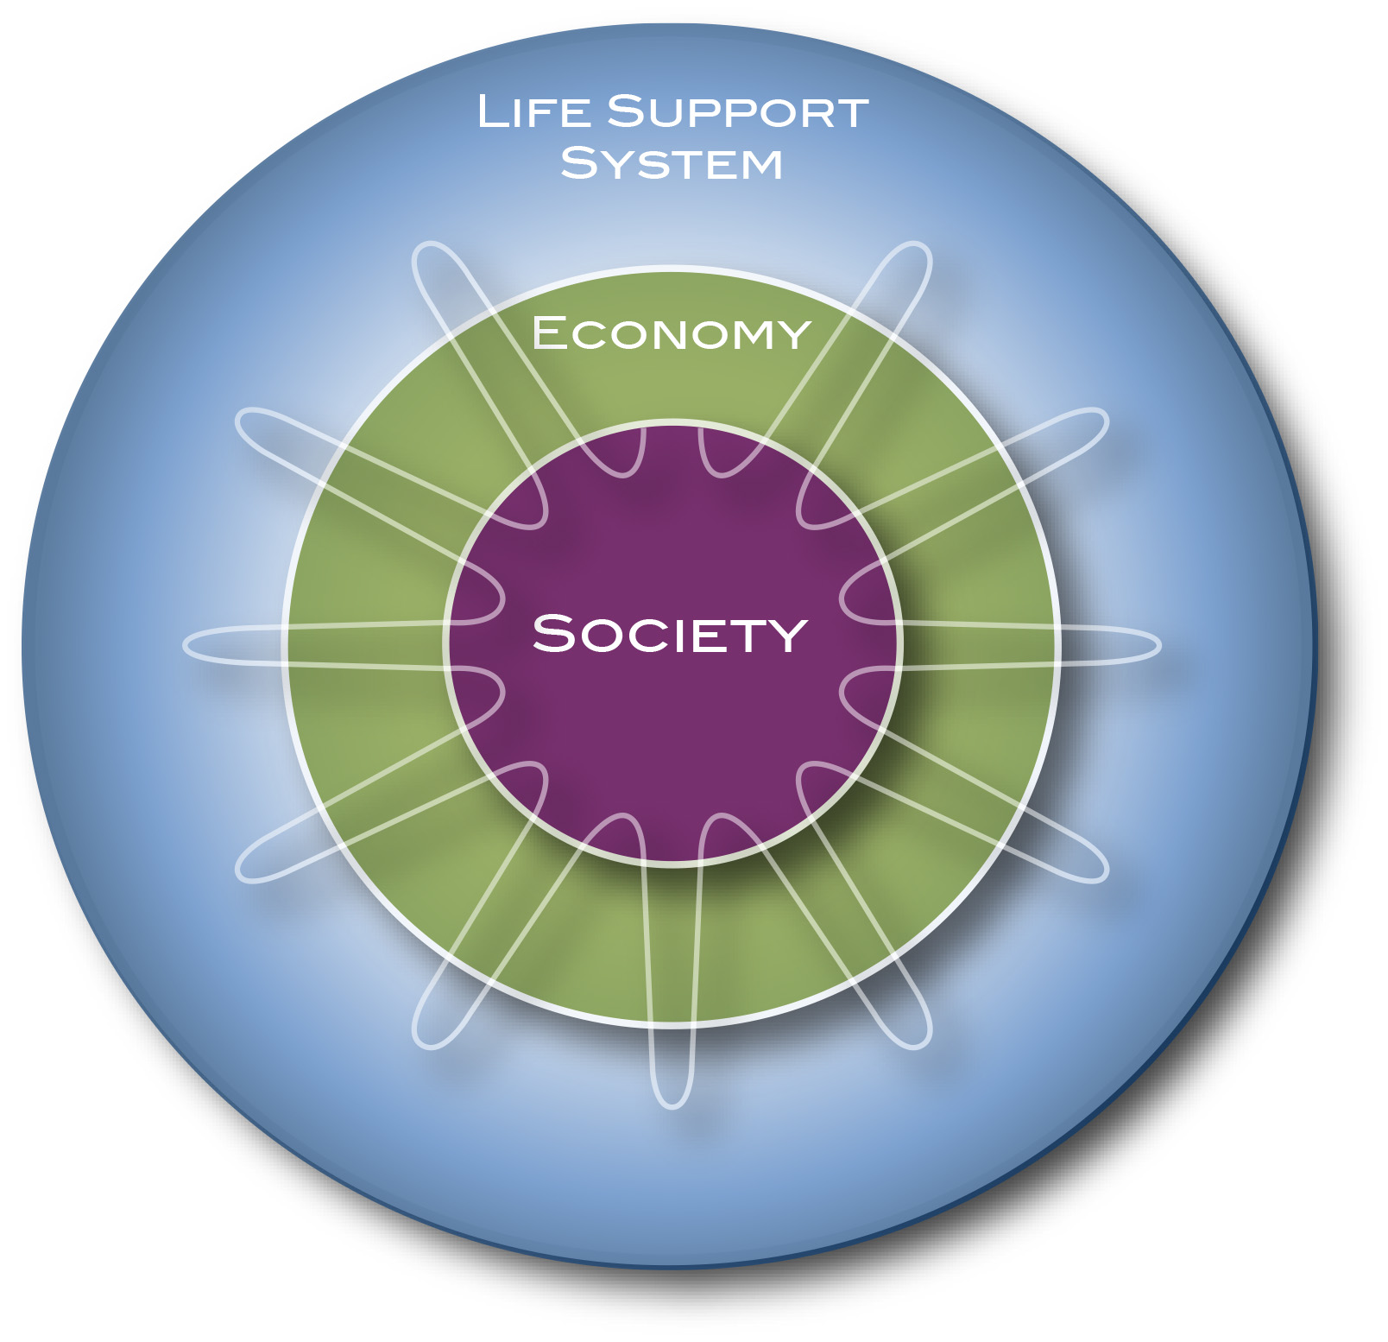
The Syndrome: Modern Climate and Global Change
Planetary Physiology
Earth: Life-Support System for many species
Everything is about Flows
FLOWS
Flows have accelerated in the last 200 years

Slide 40
Holocene:
Stability
20th and 21st Century:
Change, imbalance
Future:
Uncertainty
10.000 BC
1,900 AD
2,000 AD
Plag, 2016
Text

Slide 41
Holocene:
Stability
20th and 21st Century:
Change, imbalance, disequilibrium
Future:
Uncertainty
10.000 BC
1,900 AD
2,000 AD
Plag, 2016
Text

Slide 42
The Syndrome: Modern Climate and Global Change
https://www.theguardian.com/environment/2017/feb/12/humans-causing-climate-to-change-170-times-faster-than-natural-forces?CMP=share_btn_tw

Slide 43
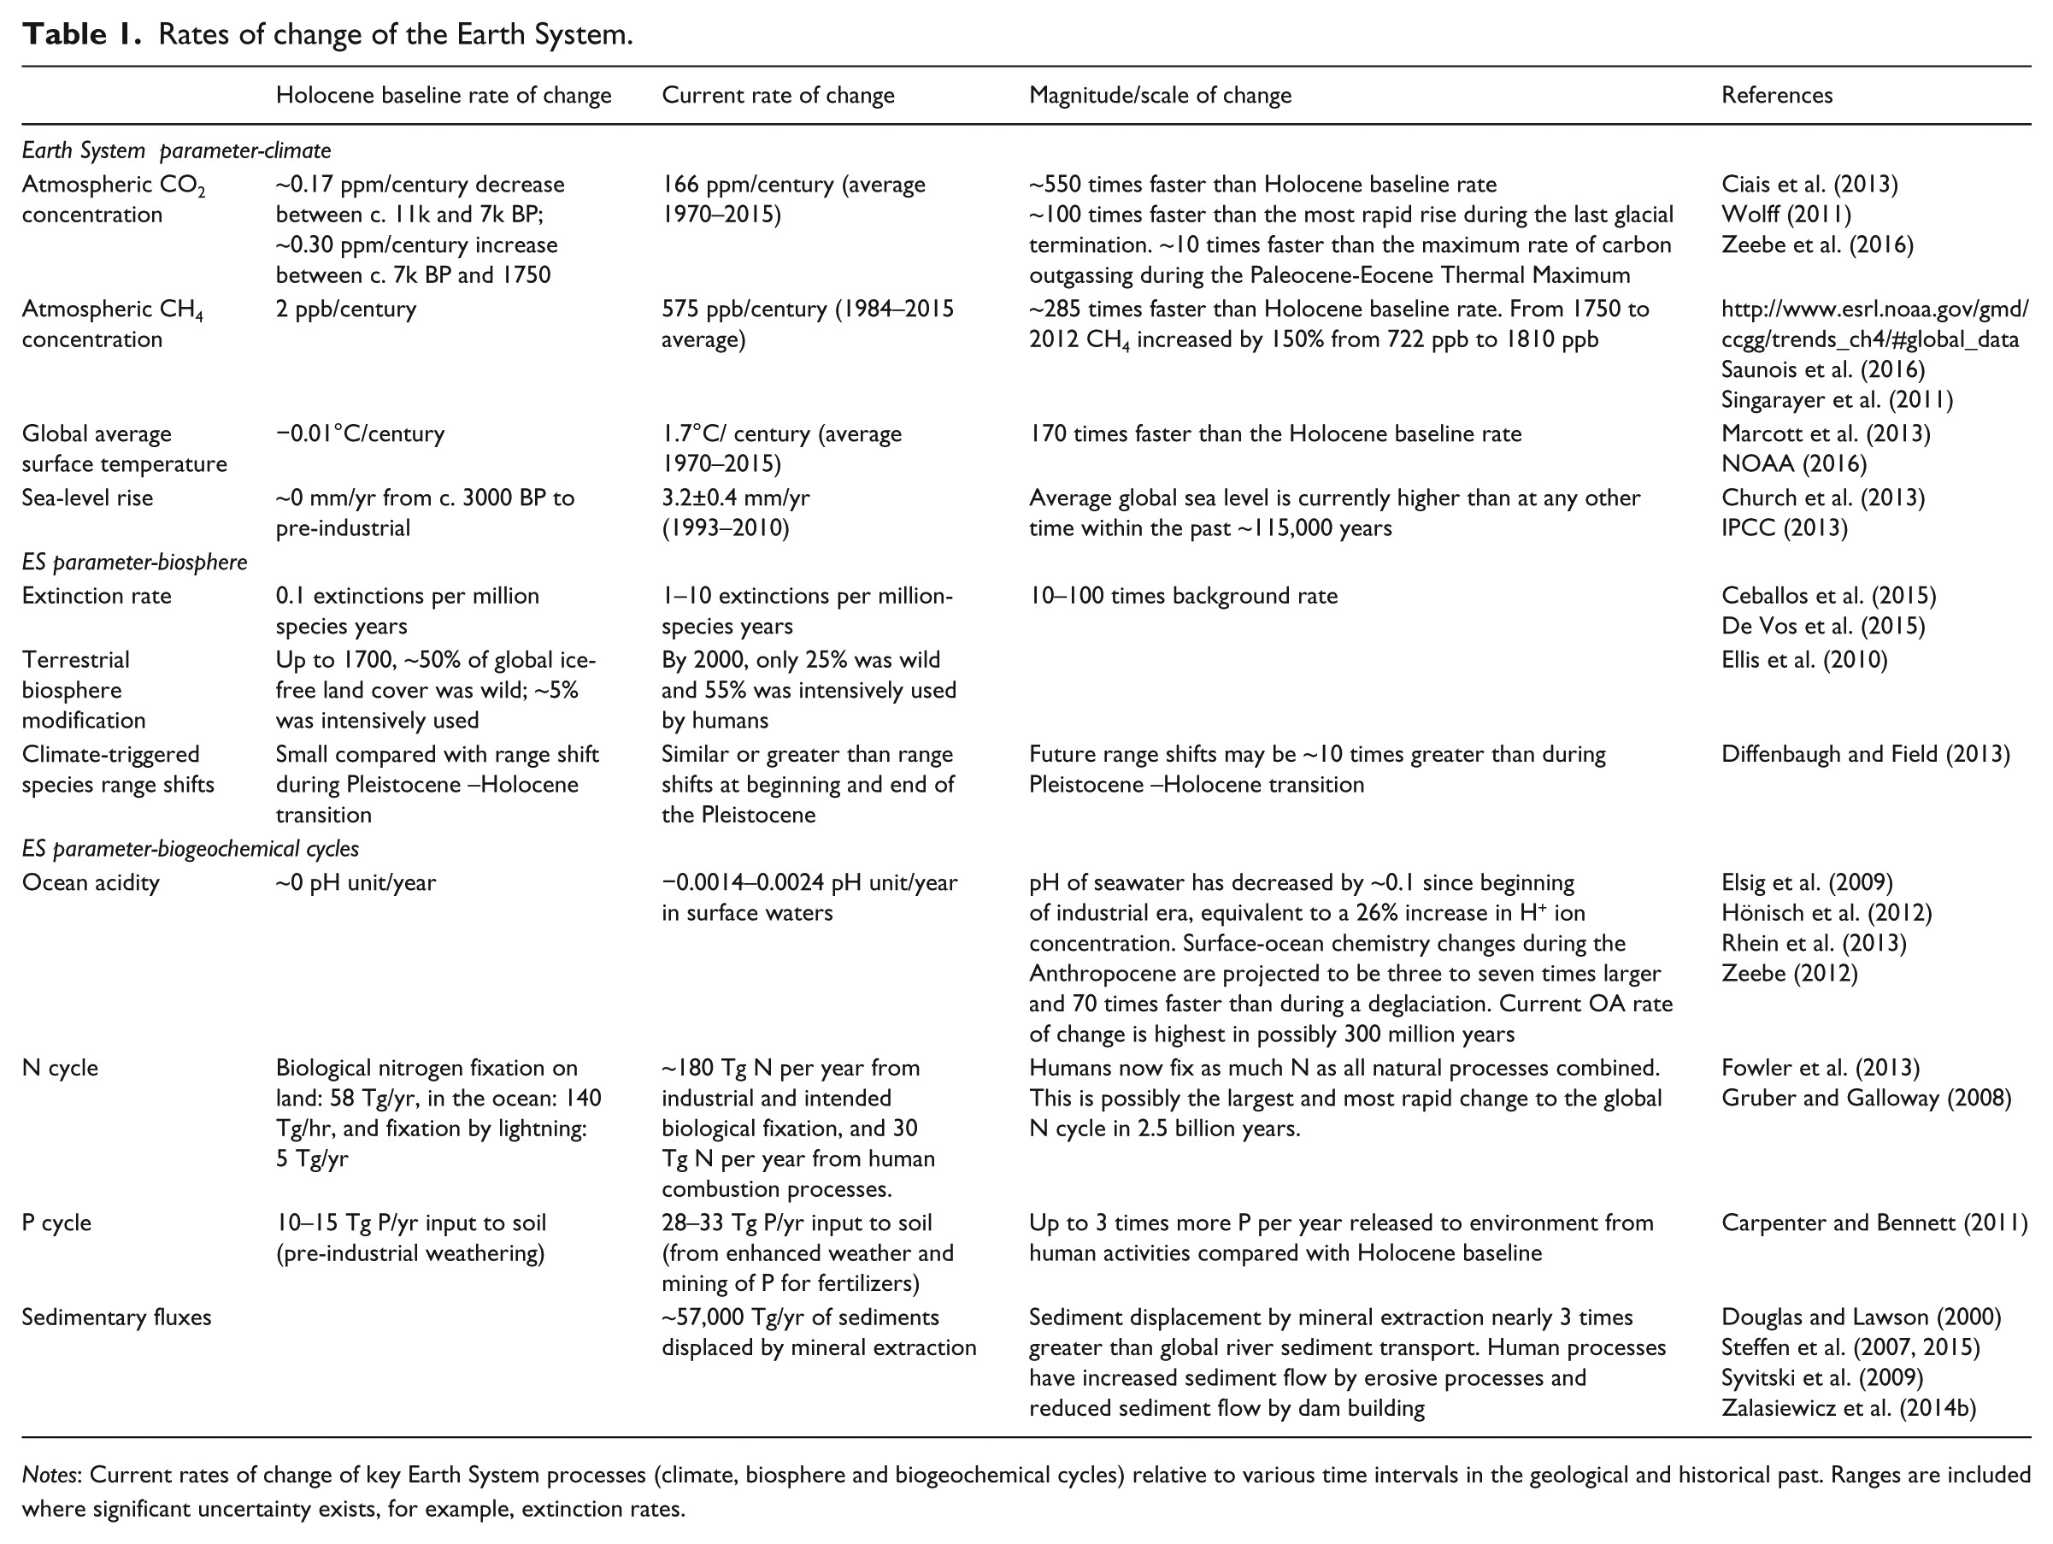
The Syndrome: Recent Climate and Global Change
Current rate of change
Holocene baseline rate of change
Gaffney and Steffen, 2017

Slide 44
The Syndrome: Modern Climate and Global Change
Current rate of change
Global average surface temperature:
~1.7ºC/century
Holocene baseline rate of change
Global average surface temperature:
~0.01ºC/century
Gaffney and Steffen, 2017

Slide 45
The Syndrome: Modern Climate and Global Change
Homo sapiens and Earth
Human environment
300 million tons of humans and
700 million tons of domesticated animals
400 million domesticated dogs
600 million domesticated cats
1.5 billion cows
20 billion chicken
81% of Earth’s surface changed significantly by humans
Earth’s Energy Imbalance increased by roughly 10,000,000 times above pre-human values
Non-Human environment
100 million tons of wild animals (more than 2 kg)
200,000 wolfs
40,000 lions
900,000 African buffalo
50 million penguins
5% of Earth surface still untouched

Slide 46
The Syndrome: Modern Climate and Global Change
Modern climate change is a symptom in the syndrome of Modern Global Change, not the cause.
However, modern climate change is increasingly causing cascading changes, thus extending the syndrome of modern global change

Slide 47
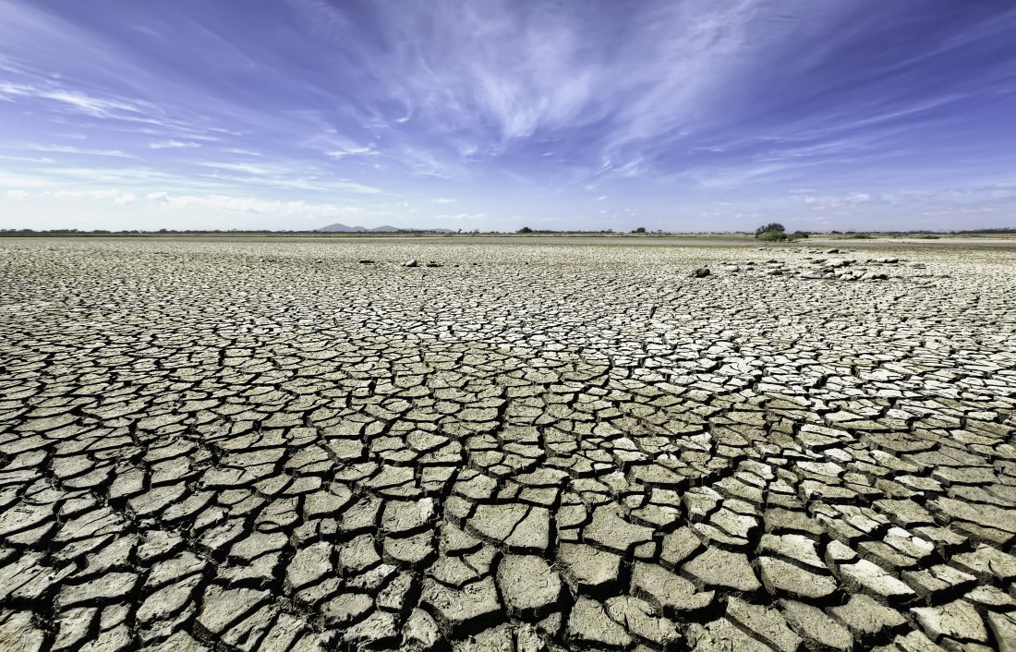
The Syndrome: Modern Climate and Global Change
Hurricane Dorian
September 1, 2019
Extreme weather-related disasters
Cyclone Idai,
March 15, 2019
Cyclone Kenneth,
April 22, 2019

Slide 48
The Syndrome: Modern Climate and Global Change
Increase in Wildfires
Anthropocene or Pyrocene?

Slide 49
The Syndrome: Modern Climate and Global Change
Migration Causing Massive Harm

Slide 50
Key Points
Baseline
During the Holocene, climate and sea level were exceptionally stable.
The Holocene was a “safe operating space for humanity” allowing the emergence of a dominant species
Syndrome
During the last few hundred years, humanity has made large and rapid planetary changes, accelerated existing and introduced new flows in the planetary physiology.
The system is outside the “normal range” and in the dynamic transition into the Post-Holocene.

Slide 51
Modern Climate Change: A Symptom of a
Single-Species High-Energy Pulse
Contents
The Baseline: Past Climate Changes
The Syndrome: Modern Climate and Global Change
The Diagnosis: A new Economy and Global Order
The Prognosis: Leaving the “Safe Operating Space” and into the Unknown
The Therapy: A new Ethics, Economy, and Global Governance
Hans-Peter Plag
February 9, 2016

Slide 52
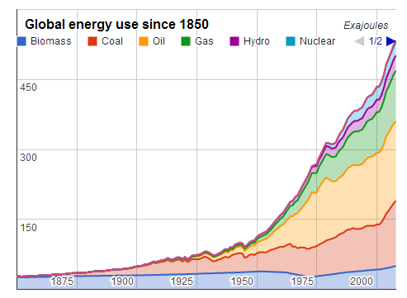
The Diagnosis: A New Economy and Global Order
Easy access to seemingly infinite energy combined with technology
Increasing access to material resources
Increasing food efficiency and reducing time needed to process food
Homo sapiens
Colonizers
Mainly a (light-skinned) subspecies from Europe
Holocene
Single-Species Dominance
Post-Holocene
Overcoming extreme poverty:
Goal of economy is to create “human wealth”
Adam
Smith
Technology and access to fossil fuels facilitate economic growth
10⁶
10⁵
10⁴
10³
10²
10¹
10⁰
10¹
10²
10³
Reducing time needed to obtain food
Years BP
2000
Years
Accumulate, accumulate, …
Population
Consume, consume, …
4 M
50 M
1.6 B
5.3 B
6.0 B
6.9 B
12 B?
?
Total energy use
<10⁻⁶ TW
<10⁻³ TW
0.5 TW
10.0 TW
12.8 TW
16.5 TW
>100.0 TW?

Slide 53
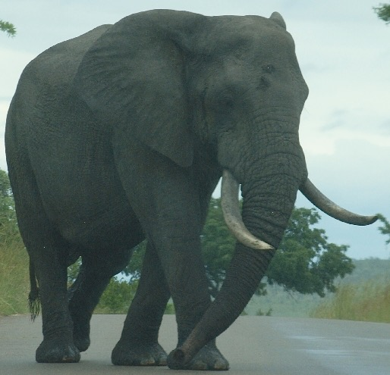
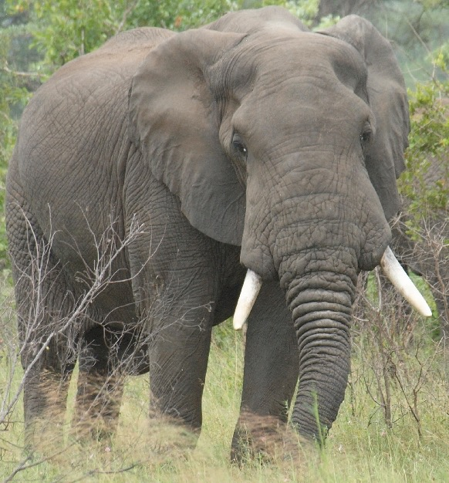
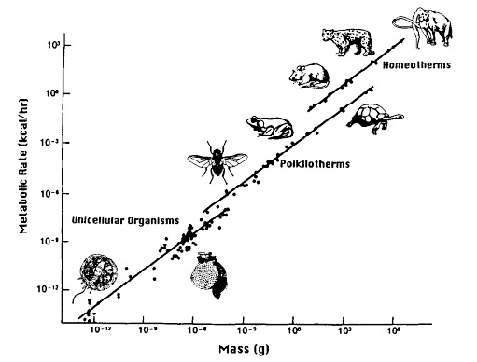
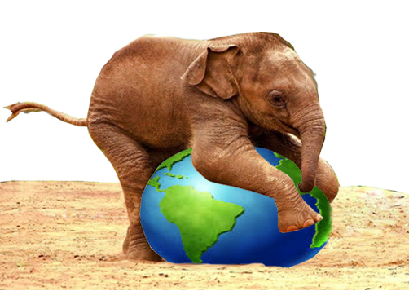
The Diagnosis: A New Economy and Global Order
Out of Scale
Scaling law for metabolic rate:
Y = Y0 * M^{(3/4)}
human: Y = 50 -100 Watt
Metabolic Rate
Extended metabolic rate:
YE = Y + CE
(CE: total energy consumption)
Energy consumption per capita:
Global Average: YE = 2,835 Watt
M = 10 metric tons
Humanity has an extended metabolic rate equivalent to 14 Billion elephants
(2.7 Billion for the U.S. alone)
Mass
14 Billion elephants: a heavy “load’ for Earth

Slide 54
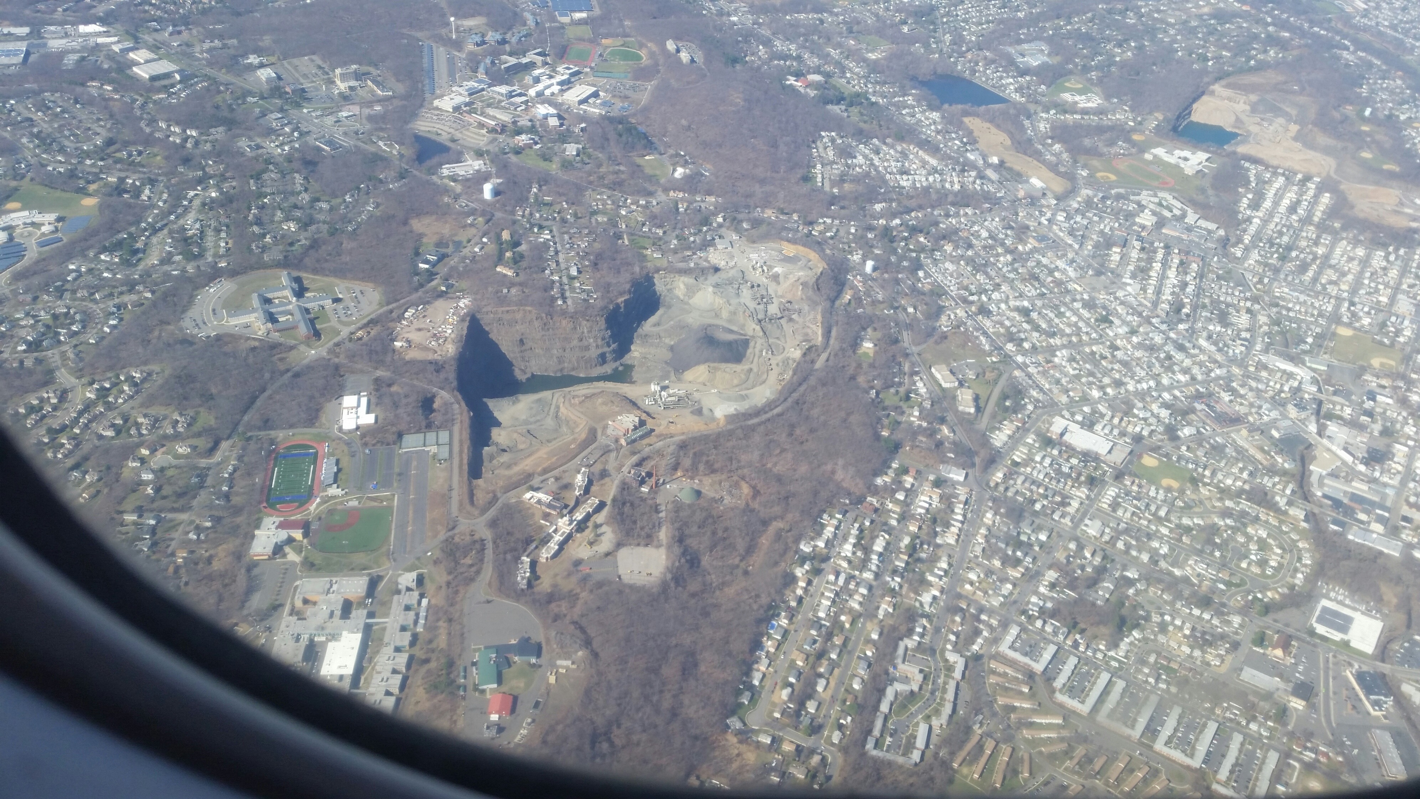
The Diagnosis: A New Economy and Global Order
22
2 km
impactor
“Single-Species
Cataclysm”
21
Homo sapiens
2.10¹³ W
VEI 8
Toba-Type
Eruption
10¹⁶ W lasting 10⁵ s
20
19
Energy Log (Joules)
VEI 7
Tambora-Type
Eruption
18
M = 9.5
Earthquake
10¹⁷ W lasting
100 s
17
16
The Homo sapiens: Cataclysmic Virus (HCV) in the Earth’s Life-Support System
Can the “virus” transform itself into the “healer”?
15
0
1
2
3
4
5
6
7
Recurrence Log (Years)

Slide 55
Malignant skin cancer of the planet Plag, 2010
Anthropogenic Cataclysmic Virus (ACV) Plag, 2015
Can the “virus” transform itself into the “healer”?

Slide 56
The Diagnosis: Leaving the “Safe Operating Space”
Breaking Scaling Laws
Brain is the most energy-demanding part in an organism.
Brain to body ratio is limited by energy available to the organism to sustain the metabolic rate.
Great apes such as gorillas and orangutans need to spend hours foraging to have enough energy to sustain the large body frames.
They cannot afford larger brains.
How could Homo sapiens “break” the scaling law?
The human brain represents 2% of body mass, but it uses about 25% of the metabolic rate.
Supporting a large, more efficient brain requires high-energy, easy to process food:
Homo sapiens achieved this by using fire to process food (particularly meat)

Slide 57
Breaking Scaling Laws
Easy access to seemingly infinite energy combined with technology
Increasing food efficiency and reducing time needed to process food
Increasing access to material resources
Mainly a light-skinned (almost white) subspecies from Europe
Homo sapiens
Colonizers
Holocene
Single-Species Dominance
Post-Holocene
Technology
Fire
Agriculture
Oil
Goal of economy is to create “human wealth”
Adam Smith
10⁶
10⁵
10⁴
10³
10²
10¹
10⁰
10¹
10²
10³
Years BP
2000
Technology and access to fossil fuels facilitate economic growth
Reducing time needed to obtain food
Years
Accumulate, accumulate, …
4 M
50 M
1.6 B
5.3 B
6.0 B
6.9 B
<10⁻⁶ TW
<10⁻³ TW
0.5 TW
10.0 TW
12.8 TW
16.5 TW
>100.0 TW?

Slide 58
The Diagnosis: A New Economy and Global Order
Role of Mainstream Economic Model
Economy: the “invisible hand”
Assumption:
Agents independently seeking their own gain will produce the overall best result for society
The current mainstream model of the global economy is based on a number of assumptions about the way the world works, what the economy is, and what the economy is for. These assumptions arose in an earlier period, when the world was relatively empty of humans and their artifacts. Built capital was the limiting factor, while natural capital was abundant. It made sense not to worry too much about environmental “externalities,” since they could be assumed to be relatively small and ultimately solvable. It also made sense to focus on the growth of the market economy, as measured by gross domestic product (GDP), as a primary means to improve human welfare. And it made sense to think of the economy as only marketed goods and services and to think of the goal as increasing the amount of these that were produced and consumed.
The Worldwatch Institute. State of the World 2013: Is Sustainability Still Possible? (Kindle Locations 2921-2927). Island Press. Kindle Edition.
Increasing the flows became the sole means of economy to create “built” (human wealth
Published in 1776

Slide 59
The Diagnosis: A New Economy and Global Order
Role of Mainstream Economic Model
For almost a century, the consumption of products has been the dominant paradigm and mindset.
John Maynard Keynes (“The General Theory of Employment, Interest and Money”, 1936):“I should support at the same time all sorts of policies for increasing the propensity to consume. For it is unlikely that full employment can be maintained, whatever we may do about investment, with the existing propensity to consume.”
Victor Lebow (1955): “Our enormously productive economy … demands that we make consumption our way of life, that we convert the buying and use of goods into rituals, that we seek our spiritual satisfaction, our ego satisfaction, in consumption … we need things consumed, burned up, replaced and discarded at an ever-accelerating rate.”
In 1970, Milton Friedman argued that businesses’ sole purpose is to generate profit for shareholders.
This led to globalization …

Slide 60
The Diagnosis: Leaving the “Safe Operating Space”
Role of Mainstream Economic Model
In 1970, Milton Friedman argued that businesses’ sole purpose is to generate profit for shareholders.
This led to globalization …

Slide 61
400 million tons (Mt)
The Diagnosis: Leaving the “Safe Operating Space”
448 Mt in 2015
}
A LIFETIME OF PLASTIC
The first plastics made from fossil fuels are just over a century old.They came into widespread use after World War II and are found today in everything from cars to medical devices to food packaging. Their useful lifetime varies. Once disposed of, they break down into smaller fragments that linger for centuries.
Average usetime: 5 years
Production contributes as much CO2 emission as 40 million cars
Build.+Const.: 72 Mt, 35 yrs
Industrial mach.: 3 Mt, 20 yrs
Transportation: 30 Mt, 13 yrs
Electrical: 19 Mt, 8 yrs
Textiles: 65 Mt, 5 yrs
Consum. prod.: 46 Mt, 3 yrs
Packaging: 161 Mt, <0.5 yrs
LIFETIMES:
100 to 5000 years
161Mt < 6 months
JASON TREAT AND RYAN WILLIAMS, NGM STAFF
SOURCE: ROLAND GEYER, UNIVERSITY OF CALIFORNIA, SANTA BARBARA
https://www.nationalgeographic.com/magazine/2018/06/plastic-planet-waste-pollution-trash-crisis/

Slide 62
The Diagnosis: A New Economy and Global Order
Inequality of Emissions

Slide 63
The Diagnosis: A New Economy and Global Order
Inequality of Emissions

Slide 64
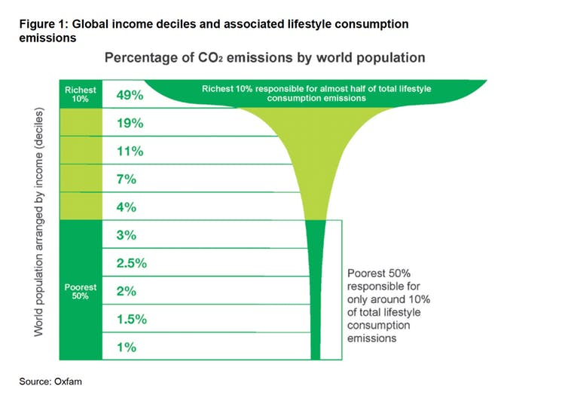
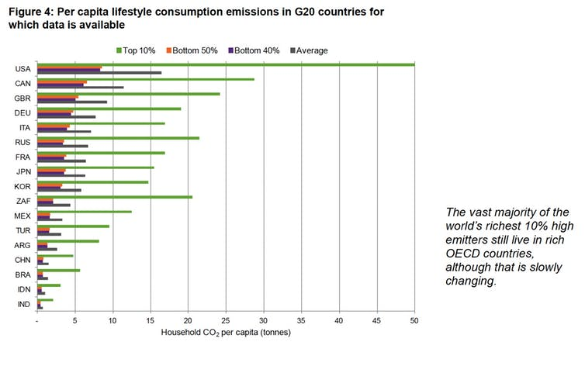
The Diagnosis: A New Economy and Global Order
Inequality of Emissions

Slide 65
Key Points
Baseline
During the Holocene, climate and sea level were exceptionally stable.
The Holocene was a “safe operating space for humanity” allowing the emergence of a dominant species
Syndrome
During the last few hundred years, humanity has made large and rapid planetary changes, accelerated existing and introduced new flows in the planetary physiology.
The system is outside the “normal range” and in the dynamic transition into the Post-Holocene.
Diagnosis
Easy access to seemingly unlimited energy allowed humans to accelerate flows in the Earth’s life-support system and sustain rapid population growth and increasing demands.
The new mainstream economic model and a changed global order has turned humans into the “Anthropogenic Cataclysmic Virus” (ACV) in the Earth’s life-support system.

Slide 66
Modern Climate Change: A Symptom of a
Single-Species High-Energy Pulse
Contents
The Baseline: Past Climate Changes
The Syndrome: Modern Climate and Global Change
The Diagnosis: A new Economy and Global Order
The Prognosis: Leaving the “Safe Operating Space” and into the Unknown
The Therapy: A new Ethics, Economy, and Global Governance
Hans-Peter Plag
February 9, 2016

Slide 67
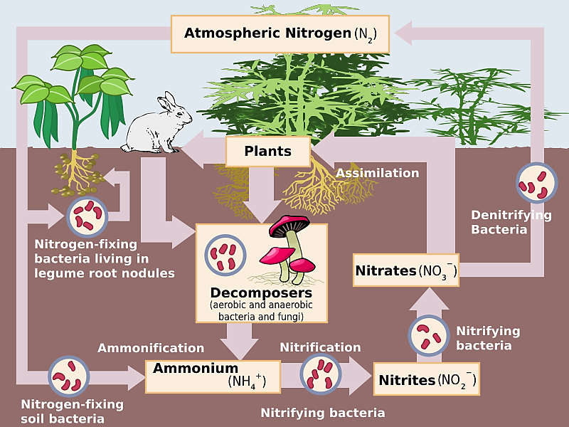
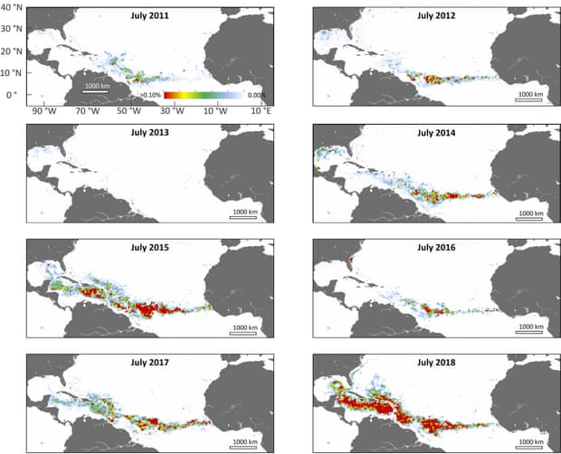
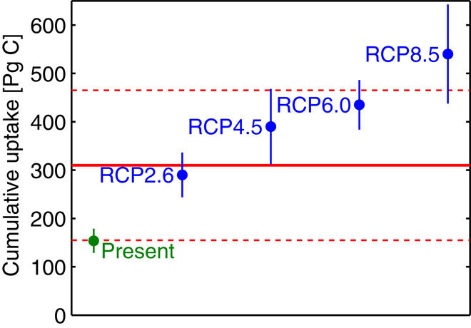
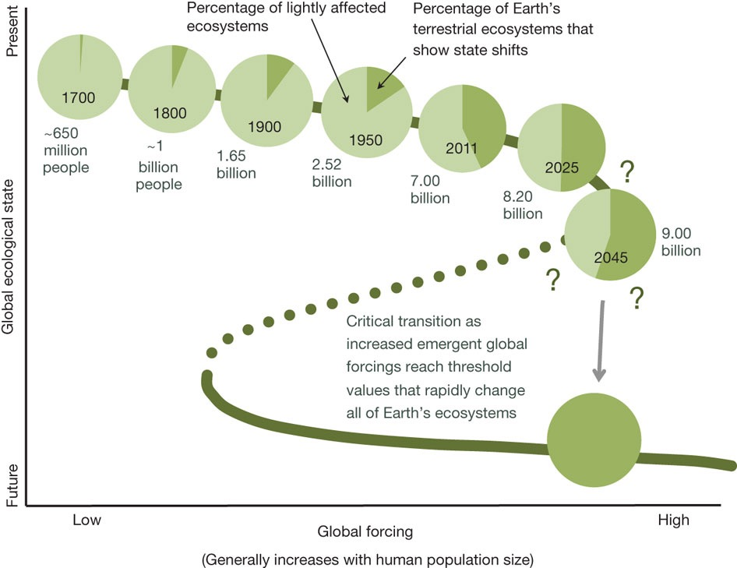
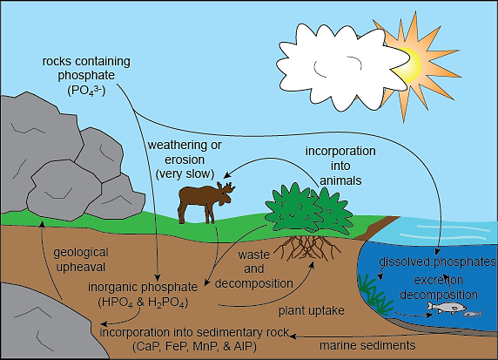
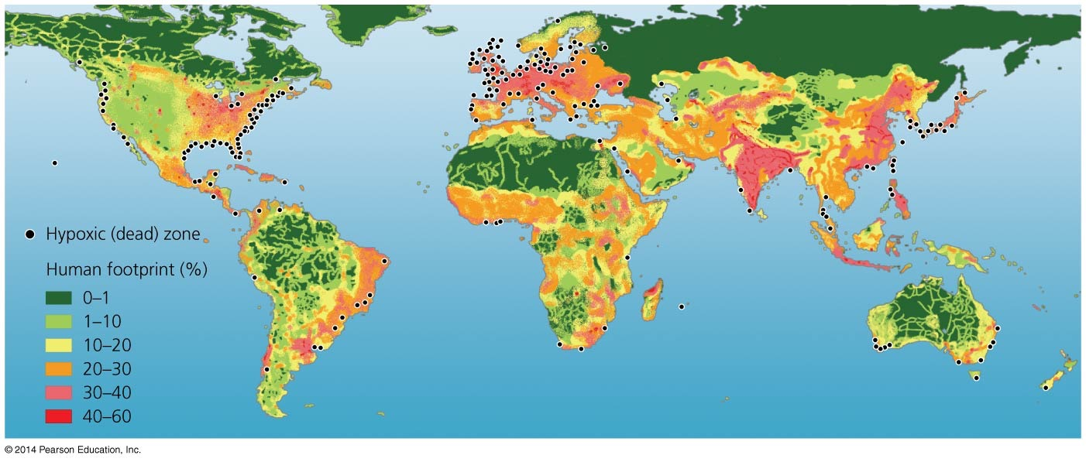
“We are the asteroid …”
Prognosis: Leaving the “Safe Operating Space” and into the Unknown
The Holocene was a “safe operating space for humanity”
Sargassum
“We are the asteroid …”
https://www.youtube.com/watch?v=gPq9YAg9mfc&feature=youtu.be
Current extinction rates:
300 times background rate for birds
80,000 times background rate for mammals
The urgent challenge of plastics
448 Million tons in 2015
Average use time: 5 years
Average lifetime: 1000-5000 years
Rothman, 2017
Rockstrom and Klum, 2015

Slide 68
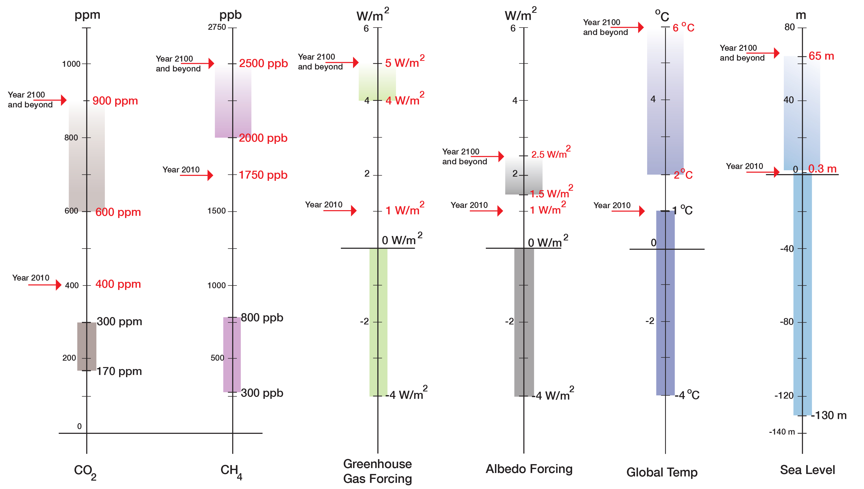
Prognosis: Leaving the “Safe Operating Space” and into the Unknown
“Prognosis”
“Current State”
“Normal Range”
(800,000 years)

Slide 69
Prognosis: Leaving the “Safe Operating Space” and into the Unknown
Air Temperature in ºC
}
Known to humanity

Slide 70
The Prognosis: Journey Into the Unknown
Build mobile infrastructure and buildings
Slowly divest in exposed coastal areas
Eventually, protections will fail
Longer-term:
1ºC corresponds to about 25 m in sea level
Expect large sea level rise over several centuries (several meters to >20 m)
Horizontal migration of coasts
Pollution of inundated coastal areas and waters
Prepare for loss of coastal cities
We have committed to an ice-free planet: eventually 65 m (195 ft) of sea level rise
(1000 - 5000 years)
Costs might be very high
Zillow study:
1.8 m by 2100
36 U.S. Coastal Cities lost;
more than 50 cities lose at least 50% of residential real estate
$1 Trillion in loss (2% of residential real estate value)
Clean up the coastal zone
Sea level rise
this century
0 1 2 3 4 m

Slide 71
Prognosis: Leaving the “Safe Operating Space” and into the Unknown
Build mobile infrastructure and buildings
Slowly divest in exposed coastal areas
Eventually, protections will fail
Longer-term:
1ºC corresponds to about 25 m in sea level
Expect large sea level rise over several centuries (several meters to >20 m)
Horizontal migration of coasts
Pollution of inundated coastal areas and waters
Prepare for loss of coastal cities
We have committed to an ice-free planet: eventually 65 m (195 ft) of sea level rise
(1000 - 5000 years)
Costs might be very high
Zillow study:
1.8 m by 2100
36 U.S. Coastal Cities lost;
more than 50 cities lose at least 50% of residential real estate
$1 Trillion in loss (2% of residential real estate value)
Clean up the coastal zone
Sea level rise
this century
0 1 2 3 4 m

Slide 72
Prognosis: Leaving the “Safe Operating Space” and into the Unknown
Assessing the risk …
Homo sapiens have a huge amount of data and knowledge

Slide 73
Prognosis: Leaving the “Safe Operating Space” and into the Unknown
Assessing the risk …

Slide 74
Prognosis: Leaving the “Safe Operating Space” and into the Unknown

Slide 75
Prognosis: Leaving the “Safe Operating Space” and into the Unknown
Anthropocene or
Post-Holocene?

Slide 76
Prognosis: Leaving the “Safe Operating Space” and into the Unknown
Extinction of mammals and birds
Extinction of insects
Is the Success Story of Homo sapiens going to continue?
Loss of soil

Slide 77
Prognosis: Leaving the “Safe Operating Space” and into the Unknown
Tipping Point: Population growth and carrying capacity
Plag, 2019

Slide 78
Prognosis: Leaving the “Safe Operating Space” and into the Unknown
Spectrum of Possible Futures
Archetypal futures
Collapse
Continue
Past
Discipline
Transformation
Jem Bendell’s “Deep Adaptation”: Who do we want to be after the unavoidable social collapse?
Dator, 2009;
Bengtson, 2018
Voros, 2003, 2012

Slide 79
Key Points
Baseline
During the Holocene, climate and sea level were exceptionally stable.
The Holocene was a “safe operating space for humanity” allowing the emergence of a dominant species
Syndrome
During the last few hundred years, humanity has made large and rapid planetary changes, accelerated existing and introduced new flows in the planetary physiology.
The system is outside the “normal range” and in the dynamic transition into the Post-Holocene.
Diagnosis
Easy access to seemingly unlimited energy allowed humans to accelerate flows in the Earth’s life-support system and sustain rapid population growth and increasing demands.
The new mainstream economic model and a changed global order has turned humans into the “Anthropogenic Cataclysmic Virus” (ACV) in the Earth’s life-support system.
Prognosis
The planet is heading rapidly towards tipping points and a very different system state (Post-Holocene, Anthropocene, Pyrocene, …).
Our knowledge is changing rapidly; the risk is very high; foresight is needed.

Slide 80
The planetary life-support system is rapidly degrading and overheating; ; They are heading for a mono-species system
A few humans keep accumulating “wealth” while destroying the life-support system of all
Humans’ system knowledge increases, and for the first time, they can see the control levers, knobs and switches that drive the Earth system
But they don’t have the control panel, the cockpit to control and operate the system
Before we leave, a recommendation for humanity …
Plag, 2000
Importantly,
they discount the future;
they don’t have a design plan;
there is no planetary governance to take the system to a future desirable for Homo sapiens

Slide 81
Modern Climate Change: A Symptom of a
Single-Species High-Energy Pulse
Contents
The Baseline: Past Climate Changes
The Syndrome: Modern Climate and Global Change
The Diagnosis: A new Economy and Global Order
The Prognosis: Leaving the “Safe Operating Space” and into the Unknown
The Therapy: A new Ethics, Economy, and Global Governance
Hans-Peter Plag
February 9, 2016

Slide 82
The Therapy: A new Ethics, Economy, and Global Governance

Slide 83
The Therapy: A new Ethics, Economy, and Global Governance

Slide 84
The Therapy: A new Ethics, Economy, and Global Governance
Plag and Jules-Plag, 2019

Slide 85
The Therapy: A new Ethics, Economy, and Global Governance
Homo sapiens: An Exceptional Success Story
Spectrum of Possible Futures
Is the Success Story of Homo sapiens going to continue?
Science-based warnings to humanity
Deep Adaptation: Preparing for the time after the total social collapse - Who do we want to be then?

Slide 86
The Therapy: A new Ethics, Economy, and Global Governance
Importance of flows
Strategies for Sustainability:
To consume nature’s flows while conserving the stocks (that is, live off the ‘interest’ while conserving natural capital).
To increase society’s stocks (human resources, civil institutions) and limit the flow of materials and energy.
Brown et al. (2004)
A Species that has unparalleled power to grow and change the planetary physiology must exercise self limitation:
a small family ethics and responsible procreation;
limitation of wealth creation and accumulation
Importance of Mainstream Economic Model

Slide 87
The Therapy: A new Ethics, Economy, and Global Governance
Purpose of economy is to increase human wealth;
Earth and its natural wealth is basically infinite.
Smith (1776)
Published in 1776

Slide 88
The Therapy: A new Ethics, Economy, and Global Governance
Purpose of economy is to increase human wealth;
Earth and its natural wealth is basically infinite.
Smith (1776)
"Sustainable development is development that meets the needs of the present without compromising the ability of future generations to meet their own needs”.
WCED (1987)
Published in 1987

Slide 89
The Therapy: A new Ethics, Economy, and Global Governance
Purpose of economy is to increase human wealth;
Earth and its natural wealth is basically infinite.
Smith (1776)
"Sustainable development is development that meets the needs of the present without compromising the ability of future generations to meet their own needs”.
WCED (1987)
What Global Order is needed to transform the purpose of Economy?
“Sustainable Development is a development that meets the needs of the present while safeguarding Earth’s life support systems, on which the welfare of current and future generations depends.”
Griggs et al. (2013)
Our Message to Humanity: You need an economy that meets the needs of the present while safeguarding Earth’s life support systems, on which the welfare of current and future generations of all human and non-human animals depends.

Slide 90
The Therapy: A new Ethics, Economy, and Global Governance
Global Order: The “Global Ruling Class”
This paper starts with summarizing the major theoretical elements in the definition of a global ruling class. It then examines how neoconservatives in the US took power and used regime change to create chaos in other regions. A strategy of tension is used to press the population into conformity. But the real revolution is to what extent factual politics escape any attempt to democratic control. Three case studies show how far the Deep State already goes. Democracy is on the brink of survival.
Global Ruling Class of approximately 350 billionaires

Slide 91
The Therapy: A new Ethics, Economy, and Global Governance
Global Order: The “Global Ruling Class”
US Goal: Capitalizing on fossil fuels as fast as possible

Slide 92
The Therapy: A new Ethics, Economy, and Global Governance
Mitigation:
reducing GHG emissions
reducing flows in the Earth’s life support system
reducing population growth
Adaptation:
Preparing for an yet unknown planet: heat waves, cold spells, storms, droughts, extreme rain events, new pandemics, …
Being ready to move to “life-boats”: higher above sea level and to moderate climates
Preparing for large-scale migration, social unrest, …
Aiming for a sustainable future:
Changing the purpose of economy
Limiting consumption to the planetary “interests”

Slide 94
Key Points
Baseline
During the Holocene, climate and sea level were exceptionally stable.
The Holocene was a “safe operating space for humanity” allowing the emergence of a dominant species
Syndrome
During the last few hundred years, humanity has made large and rapid planetary changes, accelerated existing and introduced new flows in the planetary physiology.
The system is outside the “normal range” and in the dynamic transition into the Post-Holocene.
Diagnosis
Easy access to seemingly unlimited energy allowed humans to accelerate flows in the Earth’s life-support system and sustain rapid population growth and increasing demands.
The new mainstream economic model and a changed global order has turned humans into the “Anthropogenic Cataclysmic Virus” (ACV) in the Earth’s life-support system.
Prognosis
The planet is heading rapidly towards tipping points and a very different system state (Post-Holocene, Anthropocene, Pyrocene, …).
Our knowledge is changing rapidly; the risk is very high; foresight is needed.
Therapy
Change in the purpose of economy from growing human wealth (growth addiction) to meeting our needs while safe-guarding the life-support system
A new global order and governance that can handle the coming social, economic, and environmental challenges (climate change, weather extremes, migration, social and economic collapse, wars, …)

Slide 95
They have all the Knowledge …

Slide 96
They have all the Knowledge …

Slide 97
Breaking Scaling Laws
Role of Economy
In 2008, people around the world used 68 billion tons of materials, including metals and minerals, fossil fuels, and biomass. That is an average of 10 tons per person— or 27 kilograms each and every day. That same year, humanity used the biocapacity of 1.5 planets, consuming far beyond what the Earth can sustainably provide.
Assadourian, 2013
World Extraction of Non-Renewable Materials
The urban population in the developing world will double by 2030. The implications are staggering. One is that we have 20 years to build as much urban housing as was built in the past 6,000. Reinhard Goethert, School of Architecture and Planning, MIT, 2010.

Slide 98
Breaking Scaling Laws
Role of Economy
The Jevons Paradox is the product of a capitalist economic system that is unable to conserve on a macro scale, geared, as it is, to maximizing the throughput of energy and materials from resource tap to final waste sink. Energy savings in such a system tend to be used as a means for further development of the economic order, generating what Alfred Lotka called the “maximum energy flux,” rather than minimum energy production.
An economic system devoted to profits, accumulation, and economic expansion without end will tend to use any efficiency gains or cost reductions to expand the overall scale of production. Technological innovation will therefore be heavily geared to these same expansive ends. It is no mere coincidence that each of the epoch-making innovations (namely, the steam engine, the railroad, and the automobile) that dominated the eighteenth, nineteenth, and twentieth centuries were characterized by their importance in driving capital accumulation and the positive feedback they generated with respect to economic growth as a whole—so that the scale effects on the economy arising from their development necessarily overshot improvements in technological efficiency.

Slide 99
They have all the Knowledge …
Homo sapiens have a huge amount of data and knowledge
Homo sapiens have (controversial) ideas about how to fix the problems
But they use reason more to find fault in others’ thoughts than to agree on a common future
Published in 1987
Published in 2009
Published in 2016
Published in 2018

