Slide 1
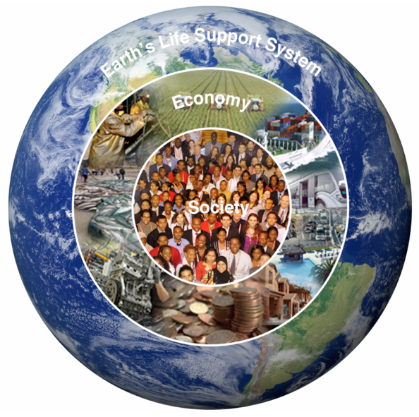
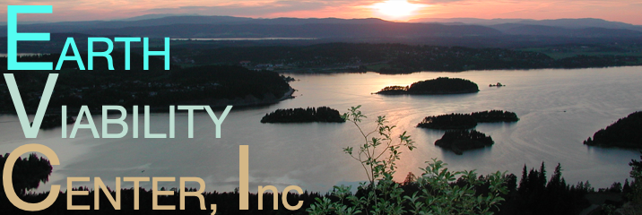
Tackling the Planetary Emergency:
A new Purpose of Economy
Hans-Peter Plag

Slide 2
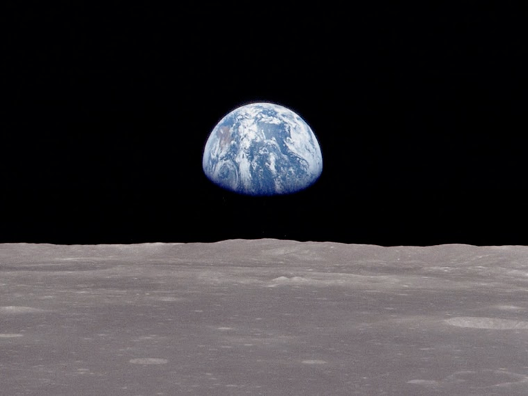
Our perception depends on the distance we have …

Slide 3
Outline of my Reasoning
The Syndrome of Modern Global Change has evolved into a Planetary Emergency
Homo sapiens has evolved into the most invasive species within the
Earth’s life-support system,
comparable in growth and impact to a virus in a living organism
Being in control of the planet, a therapy requires that
the “virus” transforms itself into the healer
The Root Cause for the Syndrome of Modern Global Change is
an official purpose of economy that is in conflict with the de facto purpose.
Therapy requires an official purpose of economy aligned to the de facto purpose
An economy that meets the needs of the present while
safeguarding the Earth’s life-support system
on which the welfare of current and future generations of al life depends
At the End: Comments on how to safeguard the Earth’s life-support system

Slide 4
The Syndrome of Modern Global Change Has Evolved Into A Planetary Emergency
The Syndrome of Modern Global Change has evolved into a Planetary Emergency

Slide 5
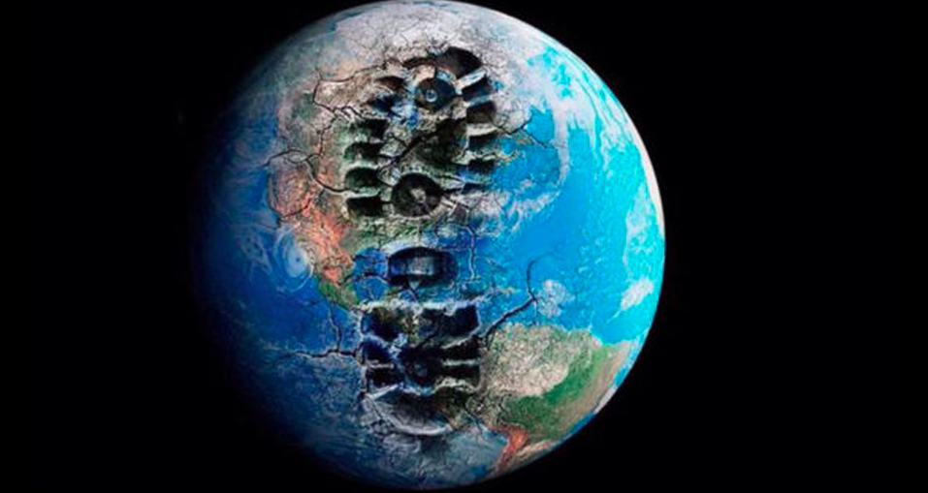
The Syndrome of Modern Global Change Has Evolved Into A Planetary Emergency
We are in a new epoch of a reengineered planetary system, and we are in a massive and extremely dangerous state of overshoot.
But the most crucial characteristics makes it the “Age of Extinction:”
Some of us call it the Pyrocene: An epoch dominated by wildfires and heat waves
Some of us call it the Anthropocene: The epoch of our making

Slide 6
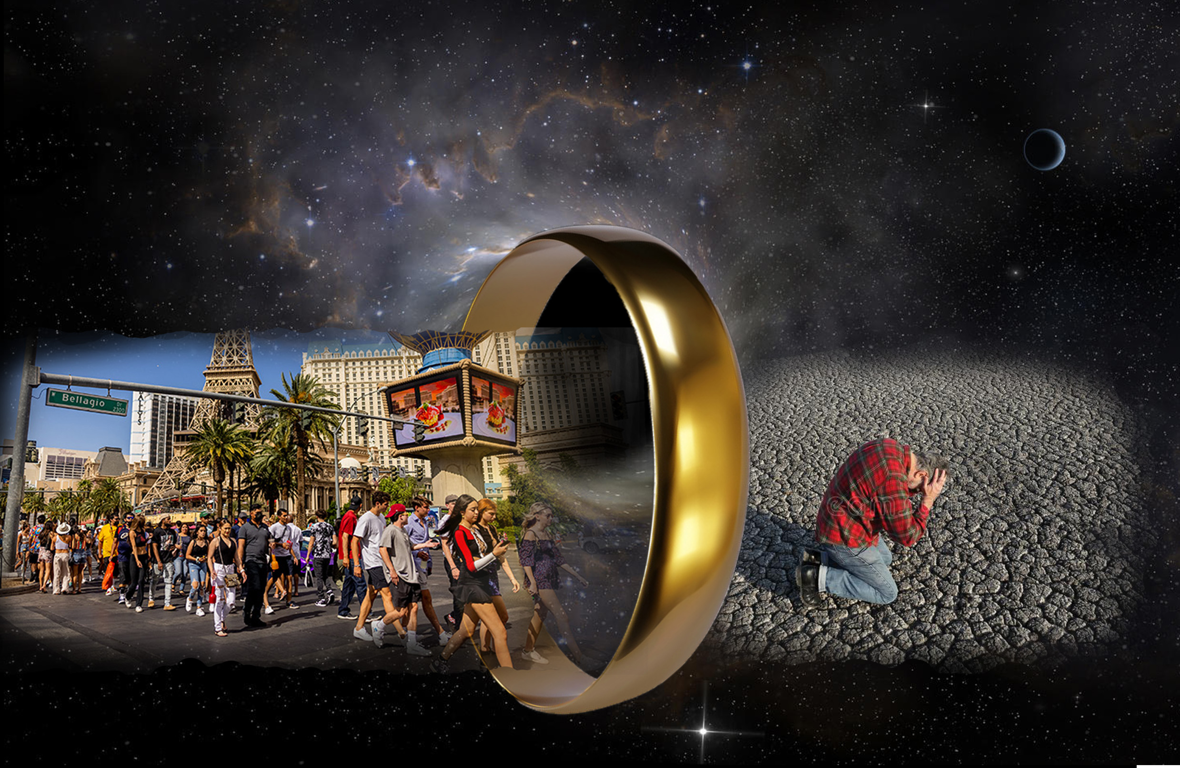
The Result of this EOM: The Age of Extinction
We are in a new epoch of a reengineered planetary system, and we are in a massive and extremely dangerous state of overshoot.
But the most crucial characteristics makes it the “Age of Extinction:”
Do we want this future?

Slide 7
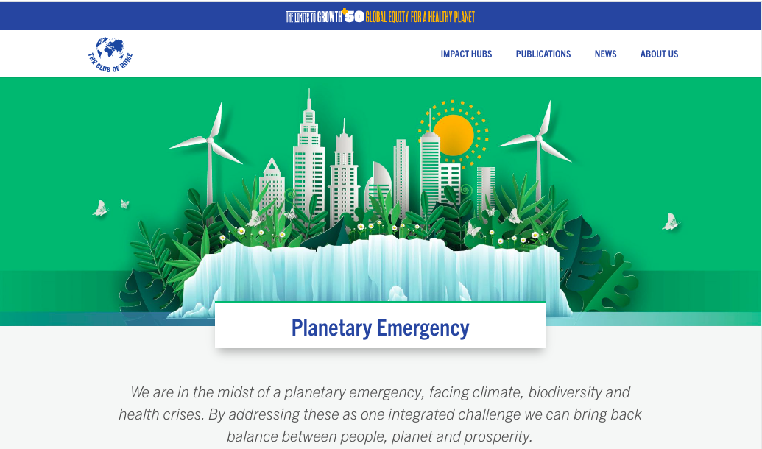
The Syndrome of Modern Global Change Has Evolved Into A Planetary Emergency
https://www.clubofrome.org/impact-hubs/climate-emergency/
The Club of Rome and other declared the planetary emergency on September 22, 2022

Slide 8
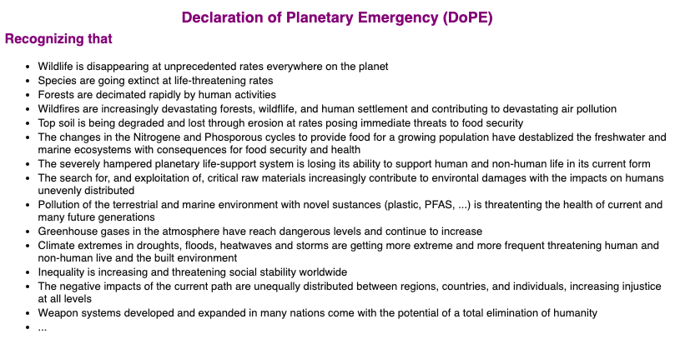
The Syndrome of Modern Global Change Has Evolved Into A Planetary Emergency
We are drafting a Declaration of Planetary Emergency Declarations of the
Concerned Citizen of Planet Earth
https://www.place4us.net

Slide 9
Global Dominance of an Invasive Species
The Syndrome of Modern Global Change has evolved into a Planetary Emergency
Homo sapiens has evolved into the most invasive species within the
Earth’s life-support system,
comparable in growth and impact to a virus in a living organism

Slide 10
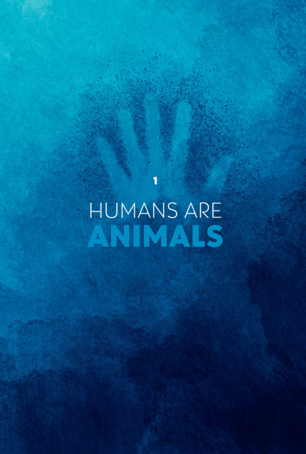
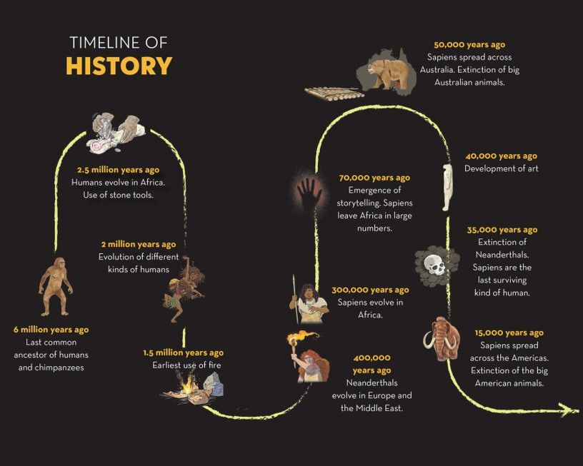
Global Dominance of an Invasive Species
The Syndrome of Modern Global Change has evolved into a Planetary Emergency
Homo sapiens has evolved into the most invasive species within the
Earth’s life-support system,
comparable in growth and impact to a virus in a living organism

Slide 11
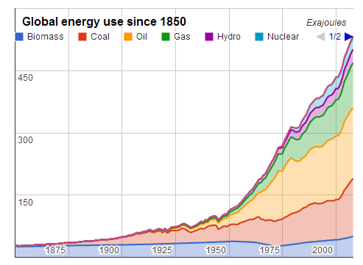
Global Dominance of an Invasive Species
Easy access to seemingly infinite energy combined with technology
Mainly a (light-skinned) subspecies from Europe: Increasing access to material resources
Increasing food efficiency and reducing time needed to process food
Homo sapiens
Colonizers
Holocene
Single-Species Dominance
Post-Holocene
Overcoming extreme poverty:
Goal of economy is to create “human wealth”
Adam
Smith
Technology and access to fossil fuels facilitate economic growth
10⁶
10⁵
10⁴
10³
10²
10¹
10⁰
10¹
10²
10³
Reducing time needed to obtain food
Years BP
2000
Years
Accumulate, accumulate, …
Population
Consume, consume, …
4 M
50 M
1.6 B
5.3 B
6.0 B
6.9 B
12 B?
?
Total energy use
<10⁻⁶ TW
<10⁻³ TW
0.5 TW
10.0 TW
12.8 TW
16.5 TW
>100.0 TW?

Slide 12
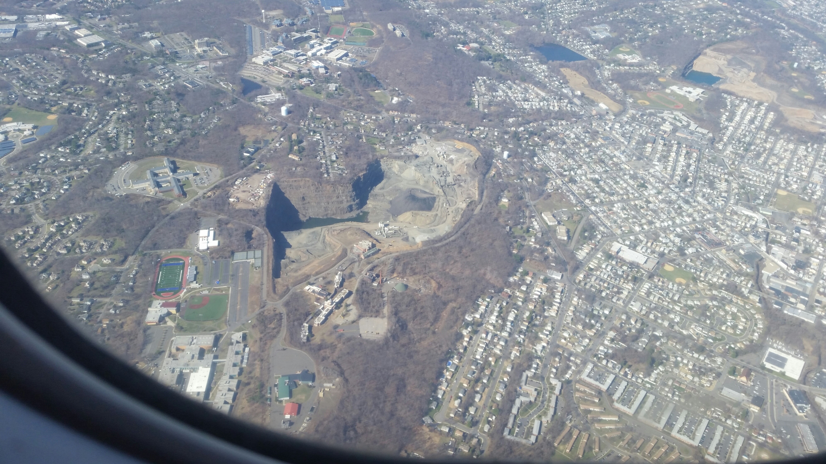
Global Dominance of an Invasive Species
22
2 km
impactor
“Single-Species
Cataclysm”
21
Homo sapiens
2.10¹³ W
VEI 8
Toba-Type
Eruption
10¹⁶ W lasting 10⁵ s
20
19
Energy Log (Joules)
18
VEI 7
Tambora-Type
Eruption
17
M = 9.5
Earthquake
10¹⁷ W lasting
100 s
16
The Homo sapiens: Cataclysmic “Virus” (HCV) in the Earth’s Life-Support System
15
0
1
2
3
4
5
6
7
Recurrence Log (Years)

Slide 13
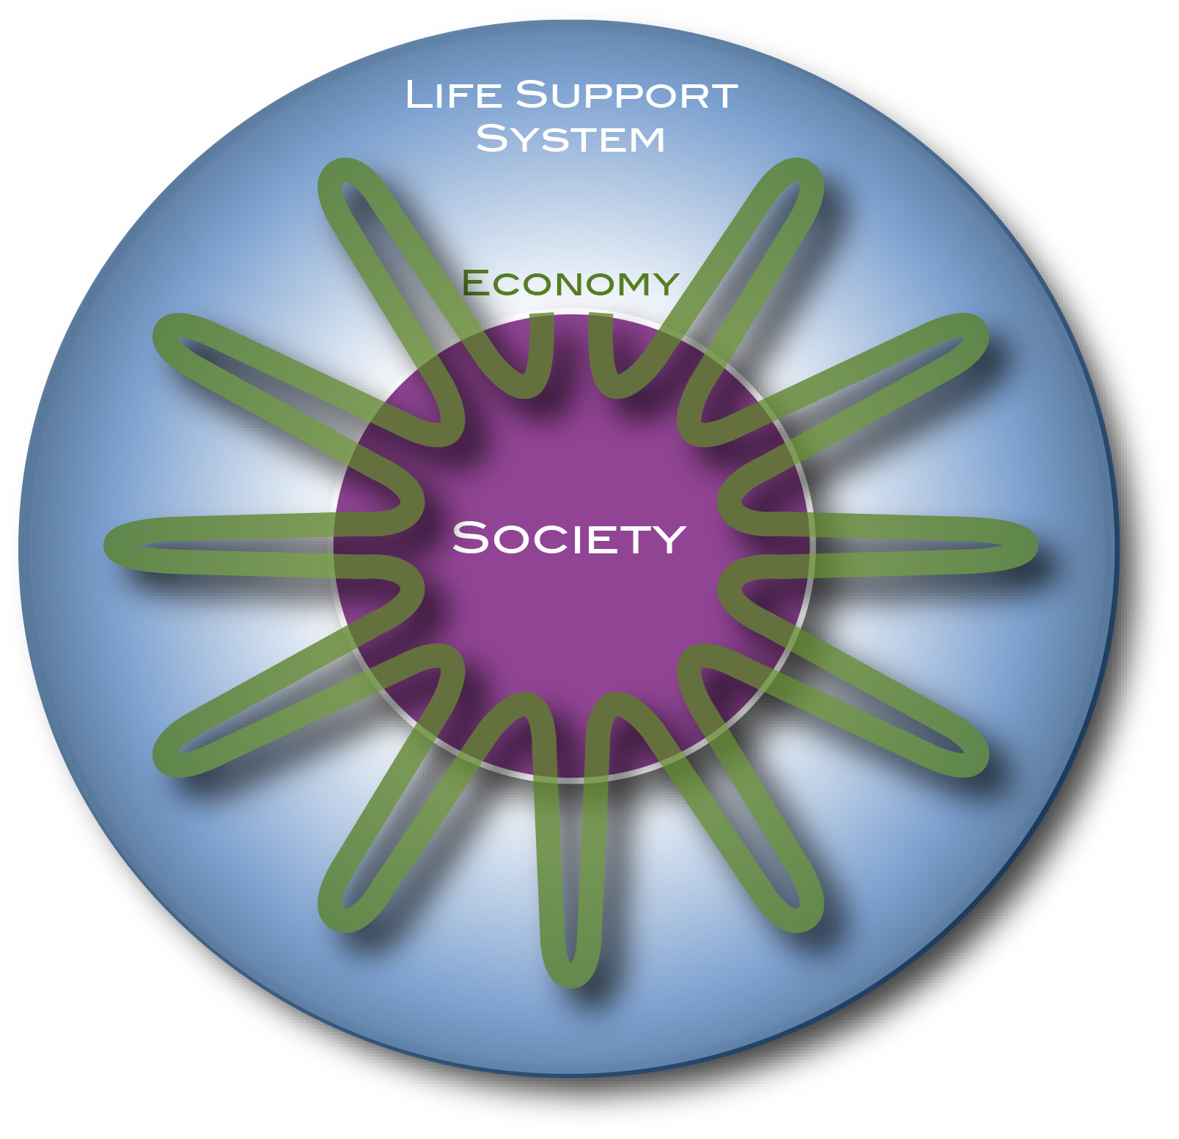
Global Dominance of an Invasive Species
Earth’s Energy Imbalance
The Earth’s Energy Imbalance increased by a factor of 10⁶ to 10⁷!
10⁻¹⁰-10⁻⁹
Incoming
Solar
3x10⁻³
Incoming
Solar
Outgoing Radiation
Outgoing Radiation
Storage in fossil fuels
Storage in heat
Imbalance on the order of 10⁻¹⁰-10⁻⁹
Imbalance on the order of 3x10⁻³
Last 70 years
Last 200 Million years
Total energy storage in 200 Myrs:
Order 100-1000 ZetaJoules
Total energy storage per century:
Order 1000 ZetaJoules

Slide 14
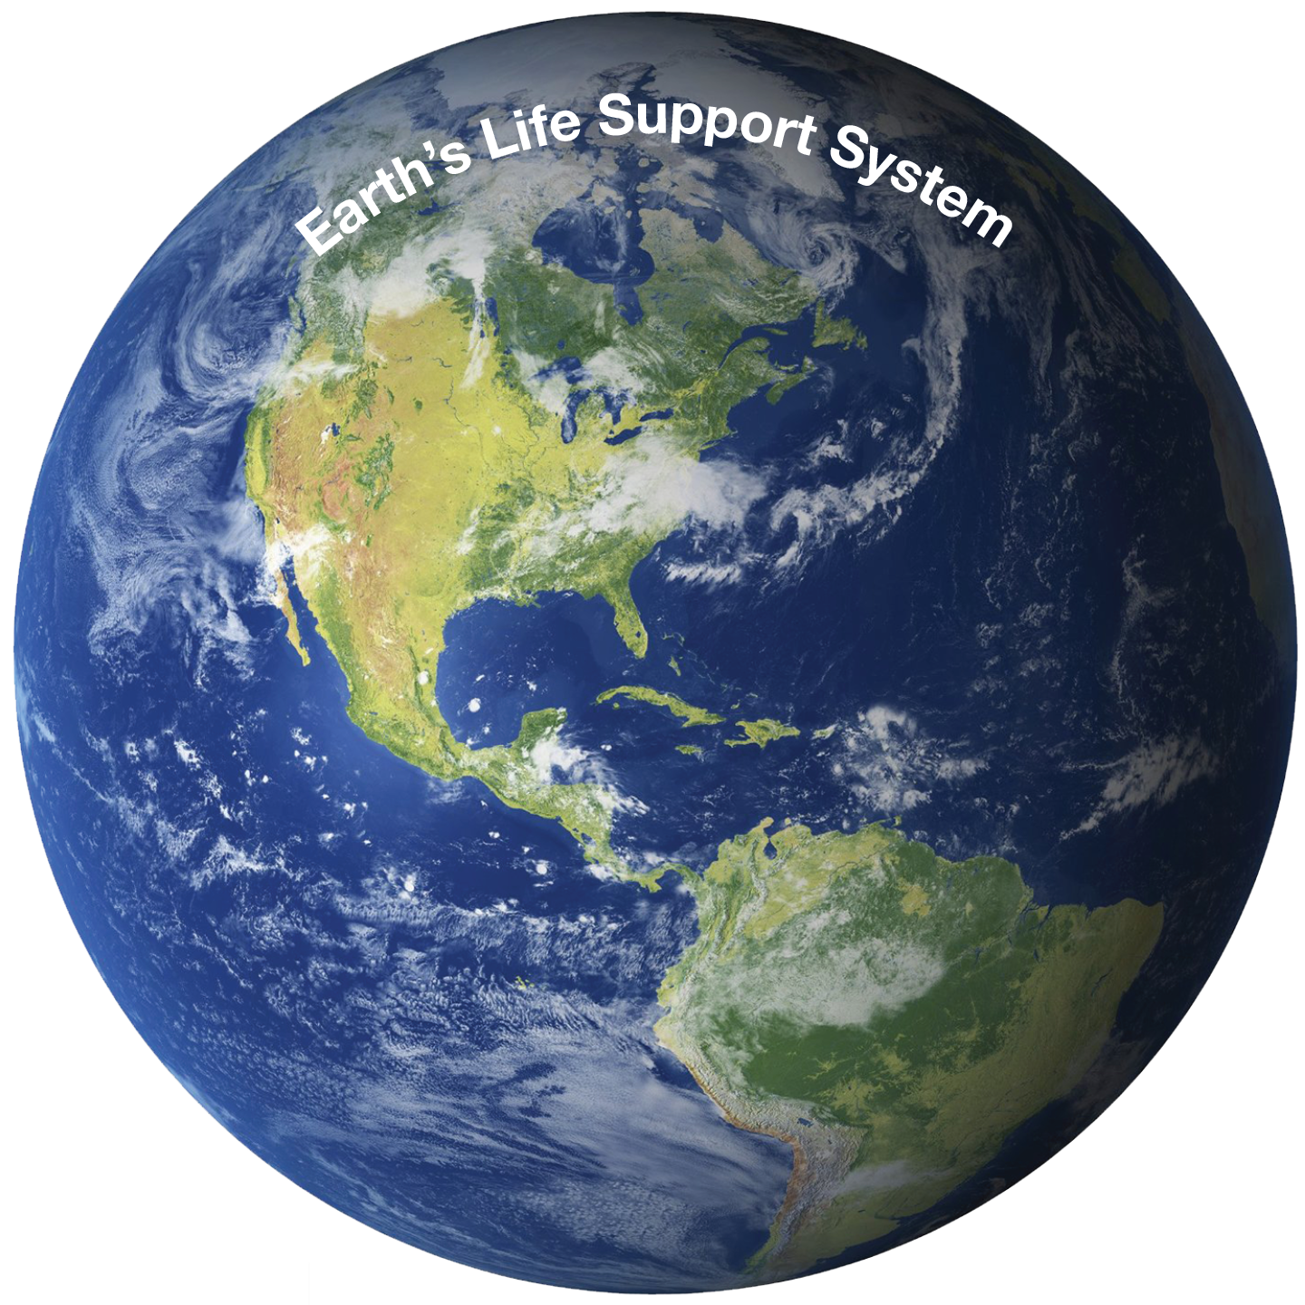
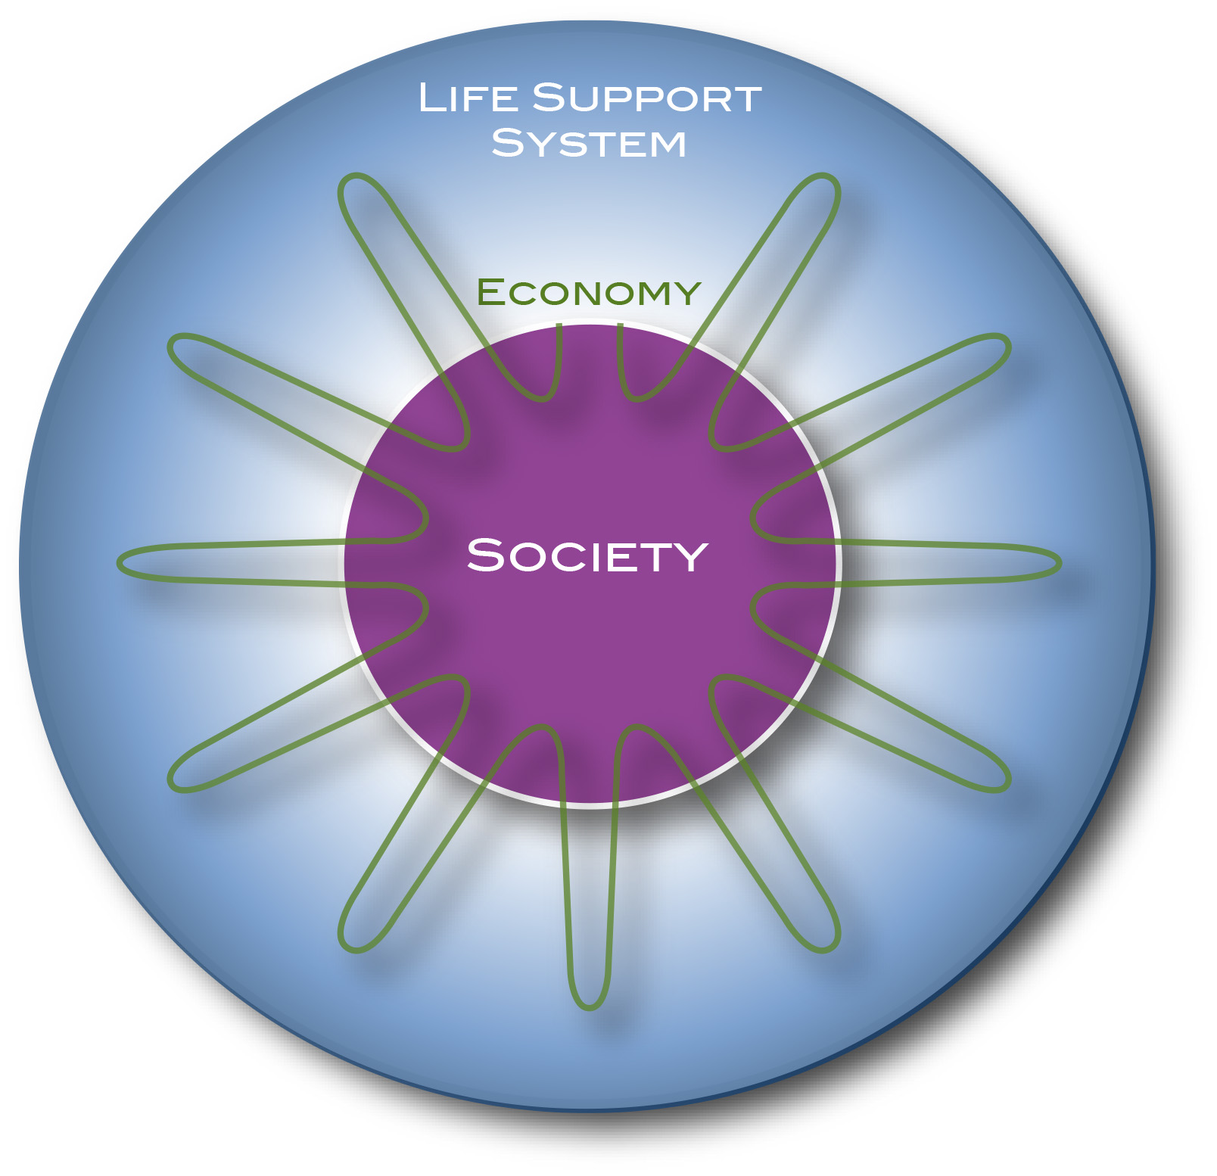
Global Dominance of an Invasive Species
Everything is about flows
Limitations in the flows limit the growth of the community
FLOWS
Flows have accelerated dramatically in the last 200 years
Changing the limits of growth requires a change of the planetary physiology
Life-Support System for many species

Slide 15
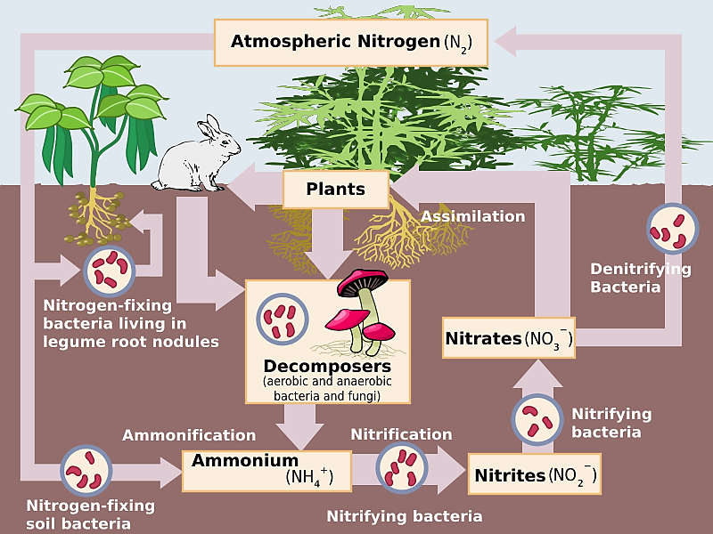
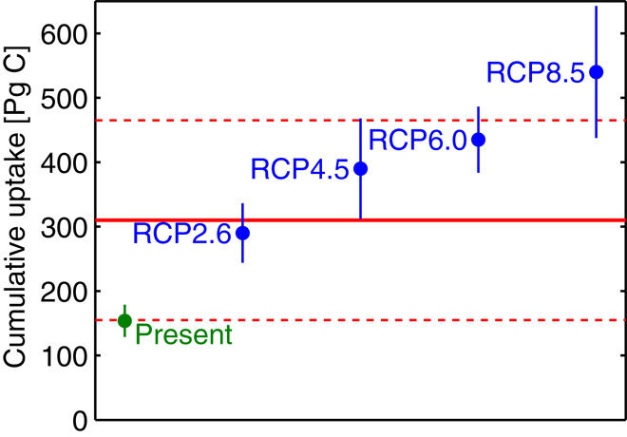
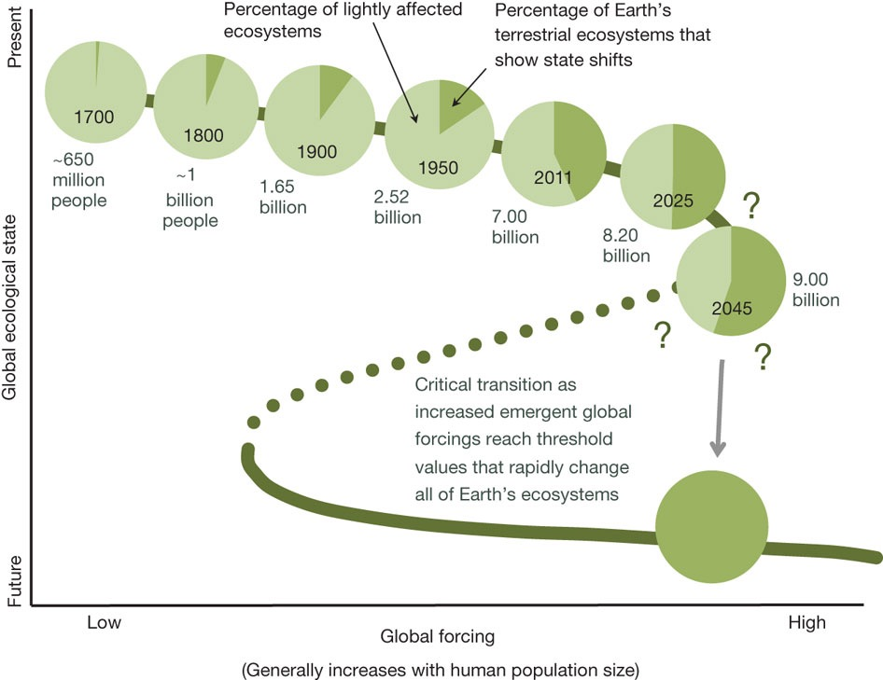
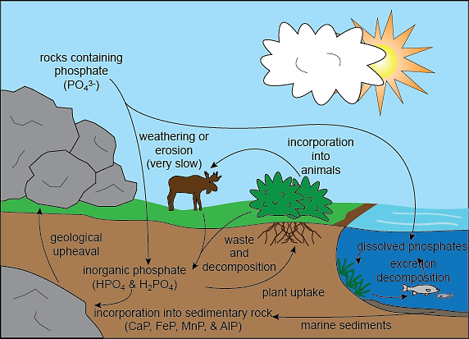
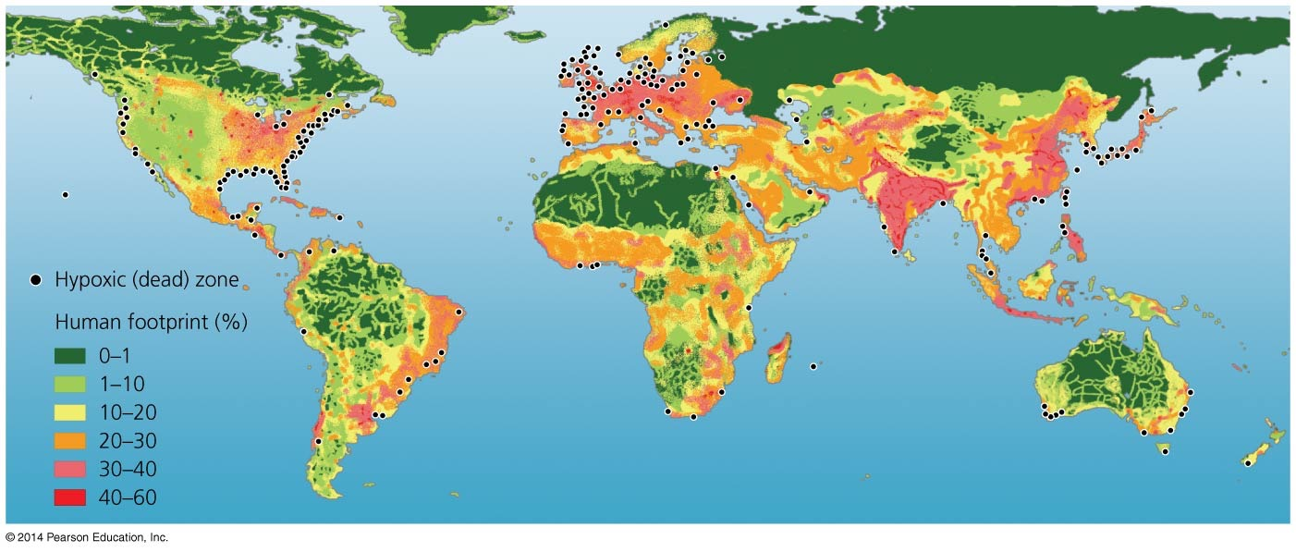
“We are the asteroid …”
Global Dominance of an Invasive Species
Impacts on the Earth’s Life-Support System
Current extinction rates:
300 times background rate for birds
80,000 times background rate for mammals
Rothman, 2017
Modern climate change is a symptom, not the cause, not the “sickness.”
Rockstrom and Klum, 2015

Slide 16
Global Dominance of an Invasive Species
Homo sapiens and other Species on Earth
Human environment
300 million tons of humans and
700 million tons of domesticated animals
400 million domesticated dogs
600 million domesticated cats
1.5 billion cows
20 billion chicken
81% of Earth’s surface changed significantly by humans
Earth’s Energy Imbalance increased by roughly 10,000,000 times above pre-human values
Non-Human environment
100 million tons of wild animals (more than 2 kg)
200,000 wolfs
40,000 lions
900,000 African buffalo
50 million penguins
5% of Earth surface still untouched
>90% of biomass of mammals
<10% of biomass of mammals
70% of wildlife that still existed in 1970 has disappeared/been eliminated in the last 50 years

Slide 17
The Therapy: Transforming the “virus” into the healer
The Syndrome of Modern Global Change has evolved into a Planetary Emergency
Homo sapiens has evolved into the most invasive species within the
Earth’s life-support system,
comparable in growth and impact to a virus in a living organism
Being in control of the planet, a therapy requires that
the “virus” transforms itself into the healer

Slide 18
The Therapy: Transforming the “virus” into the healer
Earth’s life-support system
Human (HCV)
Coronavirus
Goal: increasing biodiversity
Number: 1
Goal: unlimited growth
Number: 8 billion
Goal: unlimited growth
Number: ?(viral load unkown)
12,742,000 m
1.8 m
0.12⋅10⁻⁶ m
Ratio host/virus: 7⋅10⁶
Ratio host/virus: 15⋅10⁶
Can the “virus” transform itself into the “healer”?
Impact: permanent health damage certain
Impact: permanent health damage possible
Number of hosts: 1
Number of hosts: >8 Billion
What is the root cause that turned us in a very invasive planetary virus?
Homo sapiens: A Cataclysmic Virus in the Earth’s Life-Support System
First species to cause a pandemic in the planetary life-support system

Slide 19
Root Cause: The Official Purpose of Economy
The Syndrome of Modern Global Change has evolved into a Planetary Emergency
Homo sapiens has evolved into the most invasive species within the
Earth’s life-support system,
comparable in growth and impact to a virus in a living organism
Being in control of the planet, a therapy requires that
the “virus” transforms itself into the healer
The Root Cause for the Syndrome of Modern Global Change is
an official purpose of economy that is in conflict with the de facto purpose.

Slide 20
Root Cause: The Official Purpose of Economy
Homo sapiens
Colonizers
Holocene
Single-Species Dominance
Post-Holocene
Overcoming extreme poverty:
Goal of economy is to create “human wealth”
Adam
Smith
Consume, consume, …
10³
10⁶
10⁵
10⁴
10³
10²
10¹
10⁰
10¹
10²
Years BP
2000
Years
Population
Accumulate, accumulate, …
4 M
50 M
1.6 B
5.3 B
6.0 B
6.9 B
12 B?
?
Total energy use
<10⁻⁶ TW
<10⁻³ TW
0.5 TW
10.0 TW
12.8 TW
16.5 TW
>100.0 TW?

Slide 21
Root Cause: The Official Purpose of Economy
Role of Mainstream Economic Model
For almost a century, the consumption of products has been the dominant paradigm and mindset.
John Maynard Keynes (“The General Theory of Employment, Interest and Money”, 1936):“I should support at the same time all sorts of policies for increasing the propensity to consume. For it is unlikely that full employment can be maintained, whatever we may do about investment, with the existing propensity to consume.”
Victor Lebow (1955): “Our enormously productive economy … demands that we make consumption our way of life, that we convert the buying and use of goods into rituals, that we seek our spiritual satisfaction, our ego satisfaction, in consumption … we need things consumed, burned up, replaced and discarded at an ever-accelerating rate.”
In 1970, Milton Friedman argued that businesses’ sole purpose is to generate profit for shareholders.
This led to globalization …
Neglecting the reciprocity of humans and the Earth’s life-support system

Slide 22
The Therapy: A New Purpose of Economy
The Syndrome of Modern Global Change has evolved into a Planetary Emergency
Homo sapiens has evolved into the most invasive species within the
Earth’s life-support system,
comparable in growth and impact to a virus in a living organism
Being in control of the planet, a therapy requires that
the “virus” transforms itself into the healer
The Root Cause for the Syndrome of Modern Global Change is
an official purpose of economy that is in conflict with the de facto purpose.
Therapy requires an official purpose of economy aligned to the de facto purpose

Slide 23
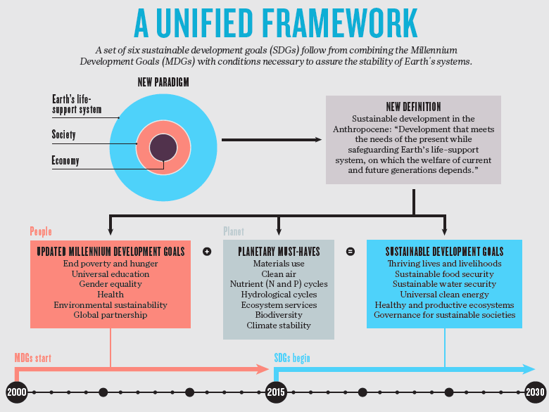
The Therapy: A New Purpose of Economy
New Paradigm
New Definition of
Sustainable Development in the Anthropocene:
“Development that meets the needs of the present while safeguarding Earth’s life-support system, on which the welfare of current and future generations depends”
Griggs et al., 2013

Slide 24
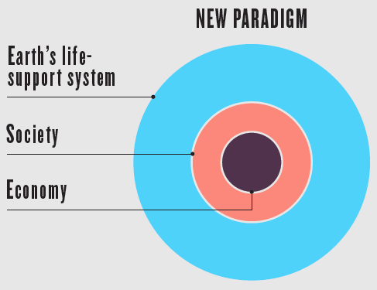
The Therapy: A New Purpose of Economy
New Paradigm:
Still neglecting the reciprocity of humans and the Earth’s life-support system

Slide 25
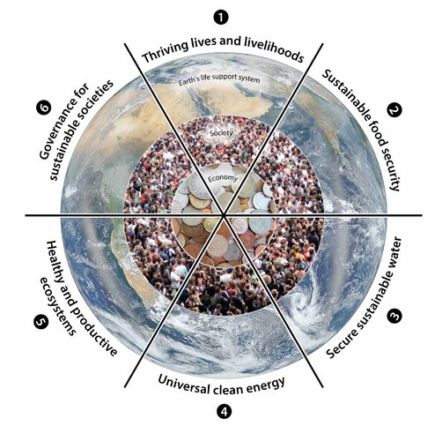
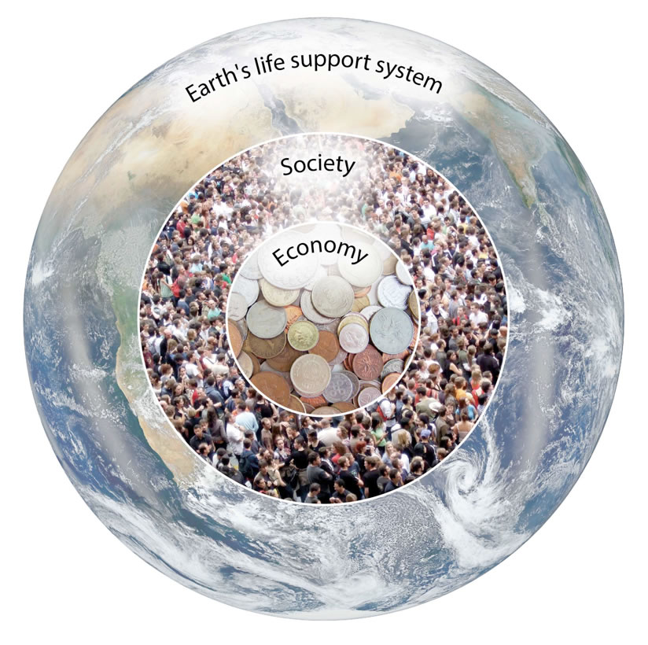
The Therapy: A New Purpose of Economy
Not reflecting the official purpose of economy correctly
phys.com
Plag & Jules-Plag, 2013
nytimes.com

Slide 26
The Therapy: A New Purpose of Economy
Flows
Modern “economy” is a “game” being played on the interconnected Earth’s life-support system, the built environment and the social fabric.
In modern economy, the “winners” can change the rules
What is the de facto purpose of “economy”?

Slide 27
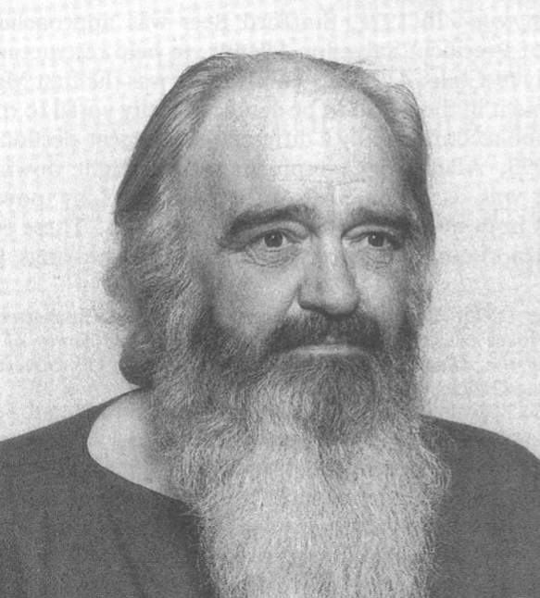
The Therapy: A New Purpose of Economy
Purpose of a System
The Purpose of a System Is What It Does - POSIWID
This is the de facto purpose.
Humans often attribute an “official” purpose to a system that is not aligned to the de facto purpose.
Beer (2001):
“According to the cybernetician the purpose of a system is what it does. This is a basic dictum.
It stands for bald fact, which makes a better starting point in seeking understanding than the familiar attributions of good intention, prejudices about expectations, moral judgment or sheer ignorance of circumstances."
Stafford Beer
1926 - 2002
Purpose of Economy - Questions to ask:
What does economy?
Among others:
President of the World Organization of Systems and Cybernetics
What did economy throughout human history?
What does “economy” for non-human animals?

Slide 28
The Therapy: A New Purpose of Economy
Environment
What is the Purpose of “Economy”?
(Earth’s) Life-Support System
Conditions:
weather, climate
land cover
ecosystems
What does the system we call “economy” do?
Community
“Economy” is a
supply system
Resources
Meeting the needs:
food+water
habitat
safety
health
Returns
De facto Purpose of “supply system” (sometimes called “economy”) is:
To meet the needs of the present while safeguarding the Earth’s life-support system, on which the welfare of current and future generations depends
Hazards

Slide 29
An (Infinite) Economy for Humanity
The Syndrome of Modern Global Change has evolved into a Planetary Emergency
Homo sapiens has evolved into the most invasive species within the
Earth’s life-support system,
comparable in growth and impact to a virus in a living organism
Being in control of the planet, a therapy requires that
the “virus” transforms itself into the healer
The Root Cause for the Syndrome of Modern Global Change is
an official purpose of economy that is in conflict with the de facto purpose.
Therapy requires an official purpose of economy aligned to the de facto purpose
An economy that meets the needs of the present while
safeguarding the Earth’s life-support system
on which the welfare of current and future generations of al life depends

Slide 30
An (Infinite) Economy for Humanity
Purpose of economy is to increase human wealth;
Earth and its natural wealth is basically infinite.
Smith (1776)
Published in 1776

Slide 31
An (Infinite) Economy for Humanity
Purpose of economy is to increase human wealth;
Earth and its natural wealth is basically infinite.
Smith (1776)
"Sustainable development is development that meets the needs of the present without compromising the ability of future generations to meet their own needs”.
WCED (1987)
Published in 1987

Slide 32
An (Infinite) Economy for Humanity
Purpose of economy is to increase human wealth;
Earth and its natural wealth is basically infinite.
Smith (1776)
"Sustainable development is development that meets the needs of the present without compromising the ability of future generations to meet their own needs”.
WCED (1987)
The new Purpose of Economy: To meet the needs of the present while safeguarding Earth’s life support systems, on which the welfare of current and future generations of all life (human and non-human) depends.
An economy that full recognizes the reciprocity of humanity and the Earth’s life-support system
“Sustainable Development is a development that meets the needs of the present while safeguarding Earth’s life support systems, on which the welfare of current and future generations depends.”
Griggs et al. (2013)
Does the current global order allow for a transformation of the purpose of Economy?

Slide 33
An (Infinite) Economy for Humanity
Global Order: The “Global Ruling Class”
This paper starts with summarizing the major theoretical elements in the definition of a global ruling class. It then examines how neoconservatives in the US took power and used regime change to create chaos in other regions. A strategy of tension is used to press the population into conformity. But the real revolution is to what extent factual politics escape any attempt to democratic control. Three case studies show how far the Deep State already goes. Democracy is on the brink of survival.
Global Ruling Class of approximately 350 billionaires

Slide 34
An (Infinite) Economy for Humanity
Celebrities in
All the rest
Science
Art
CEOs
A few very rich families
Media
of big companies
Did we create a global bee hive?
Governments
Based on Hamm (2016)

Slide 35
How to Safeguard the Earth’s Life-Support System
The Syndrome of Modern Global Change has evolved into a Planetary Emergency
Homo sapiens has evolved into the most invasive species within the
Earth’s life-support system,
comparable in growth and impact to a virus in a living organism
Being in control of the planet, a therapy requires that
the “virus” transforms itself into the healer
The Root Cause for the Syndrome of Modern Global Change is
an official purpose of economy that is in conflict with the de facto purpose.
Therapy requires an official purpose of economy aligned to the de facto purpose
An economy that meets the needs of the present while
safeguarding the Earth’s life-support system
on which the welfare of current and future generations of al life depends
At the End: Comments on how to safeguard the Earth’s life-support system

Slide 36
How to Safeguard the Earth’s Life-Support System
Importance of flows
Strategies for Sustainability:
To consume nature’s flows while conserving the stocks (that is, live off the ‘interest’ while conserving natural capital).
To increase society’s stocks (human resources, civil institutions) and limit the flow of materials and energy.
Brown et al. (2004)
A Species that has unparalleled power to grow and change the planetary physiology must exercise self limitation:
a small family ethics and responsible procreation;
limitation of wealth creation and accumulation

Slide 37
How to Safeguard the Earth’s Life-Support System
Environment
(Earth’s) Life-Support System
Accounted for “natural wealth” and minimal use of resources
Conditions:
weather, climate
land cover
ecosystems
Community
Accounting for “pollution” and minimizing returns
“Economy” is a
supply system
Resources
Meeting the needs:
food+water
habitat
safety
health
Returns
De facto Purpose of “supply system” (sometimes called “economy”) is:
To meet the needs of the present while safeguarding the Earth’s life-support system, on which the welfare of current and future generations depends
Meeting needs with minimal effort and consumption: Minimizing flows
Hazards
Is this really enough to safeguard the Earth’s life-support system?
What about protecting the purpose of the Earth’s life-support system?

Slide 38
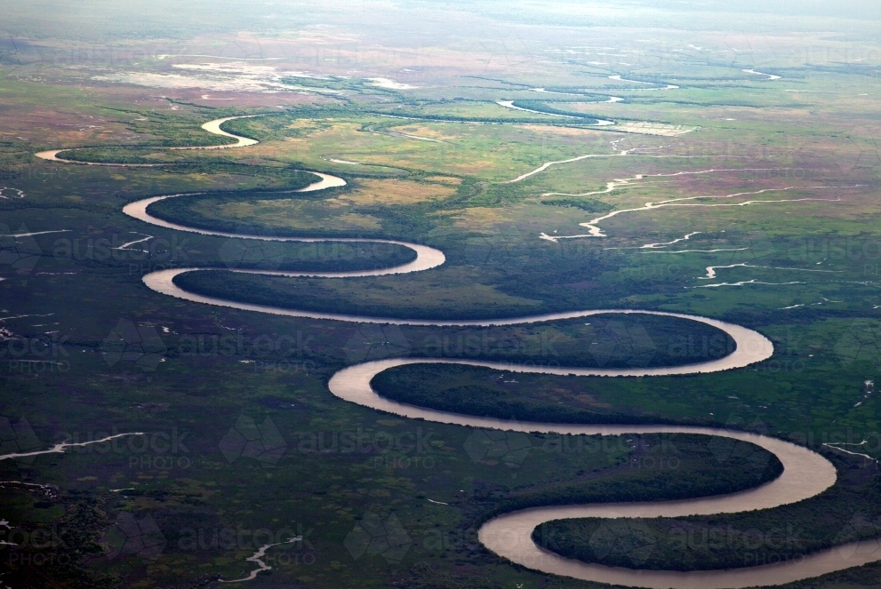
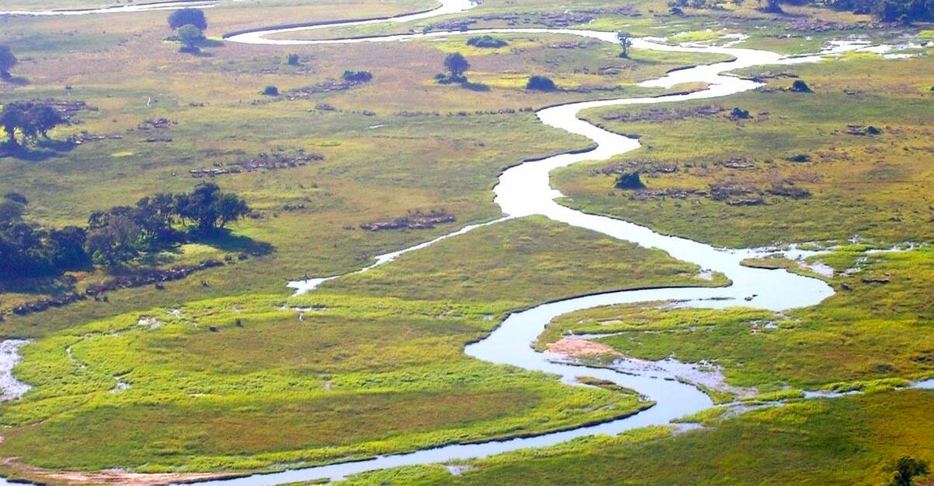
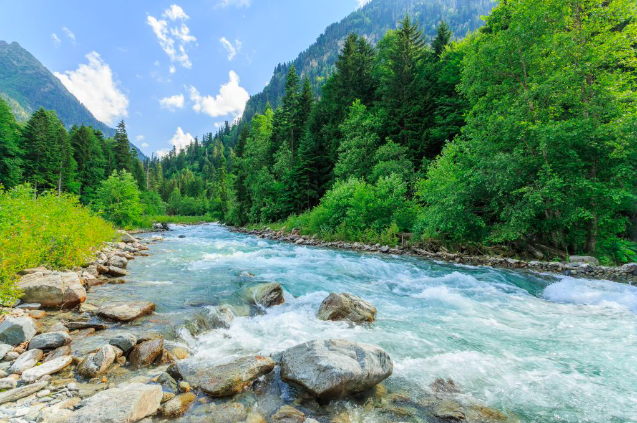
How to Safeguard the Earth’s Life-Support System
The Purpose of a System Is What It Does!
What does a river do? A river:
transports water in the water cycle
replenishes groundwater
transports sediments
creates topography and contributes to several mass cycles
maintains wetlands and wets flood planes
sustains complex freshwater ecosystems
feeds land animals (including humans)
…

Slide 39
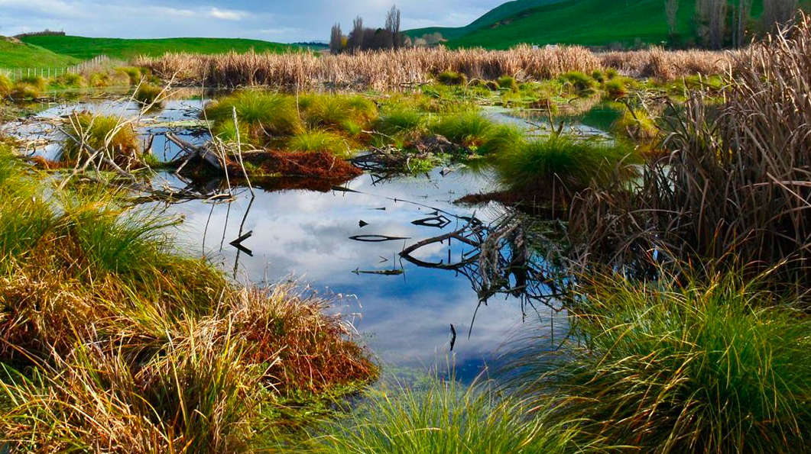
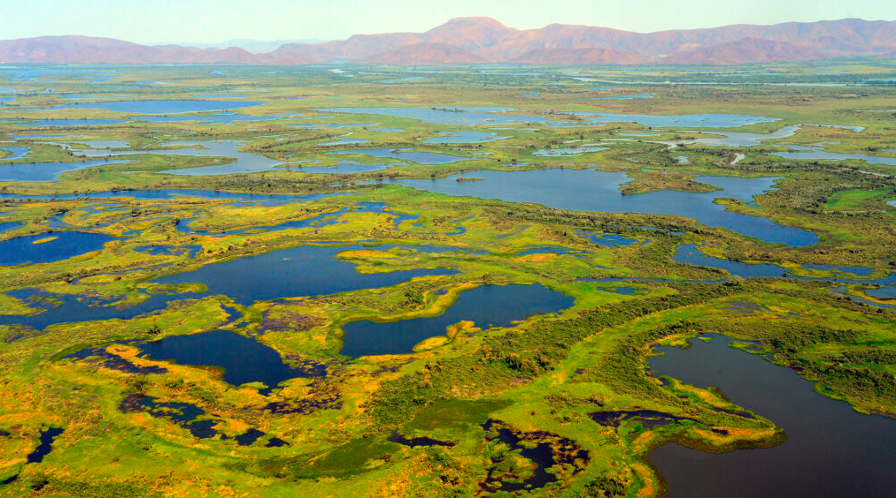
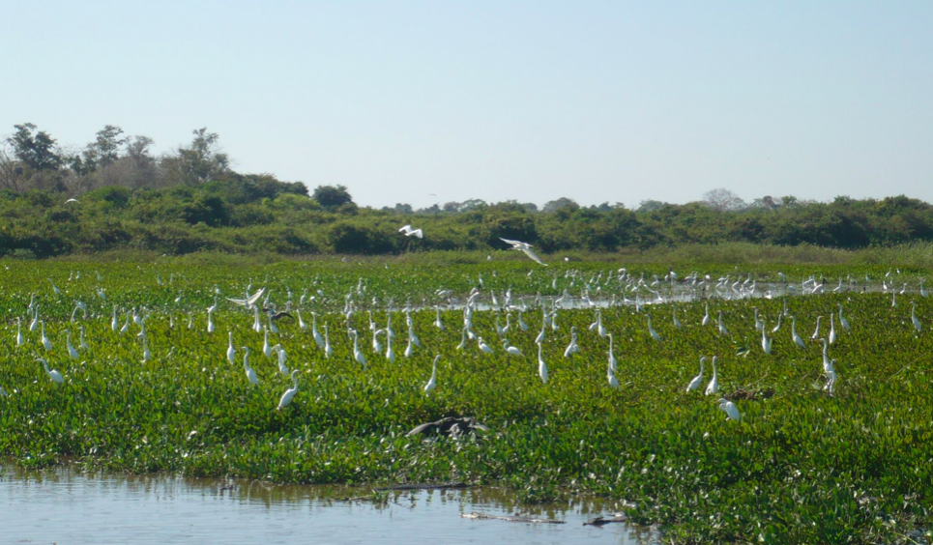
How to Safeguard the Earth’s Life-Support System
The Purpose of a System Is What It Does!
What does a wetland do? A wetland:
provides a transition between water and land
sustains a wide range of ecosystems
is an area of high bio-productivity
provides resources for life in water and on land
…

Slide 40
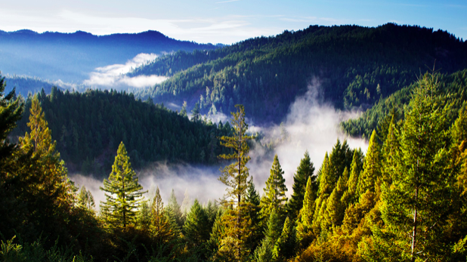
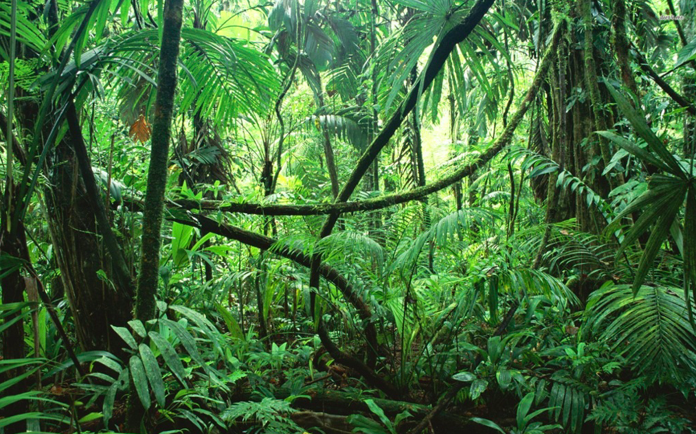
How to Safeguard the Earth’s Life-Support System
The Purpose of a System Is What It Does!
What does a forest do? A forest:
participate in the carbon and other mass cycles
is a main producer of biomass
sustains a complex ecosystem
provides habitat and food to the animals (and humans) ins the forest
regulates water and maintains topsoil
…

Slide 41
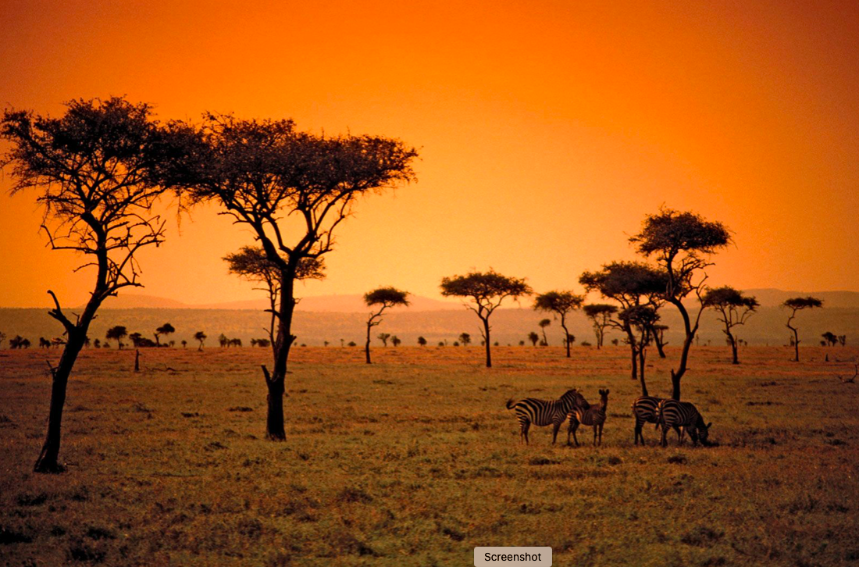
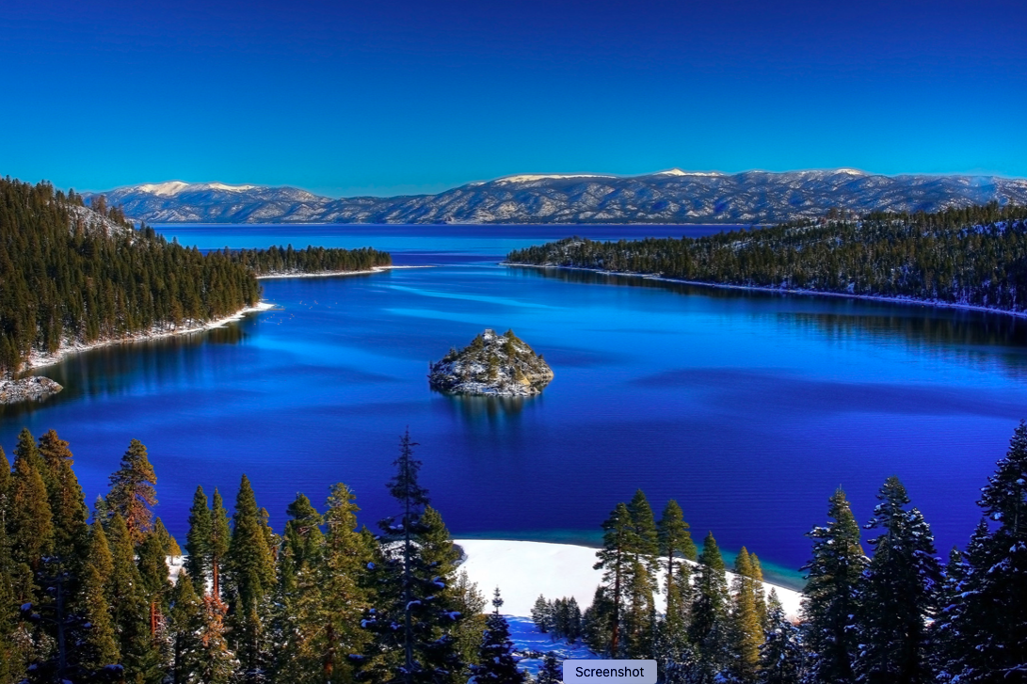
How to Safeguard the Earth’s Life-Support System
The Purpose of a System Is What It Does!
What does the ocean do?
What does the savanna do?
What does a lake do?
What does the ELSS do?
To safeguard the Earth’s life-support system, in what we do, we cannot change what the Earth’s life-support system does!

Slide 42
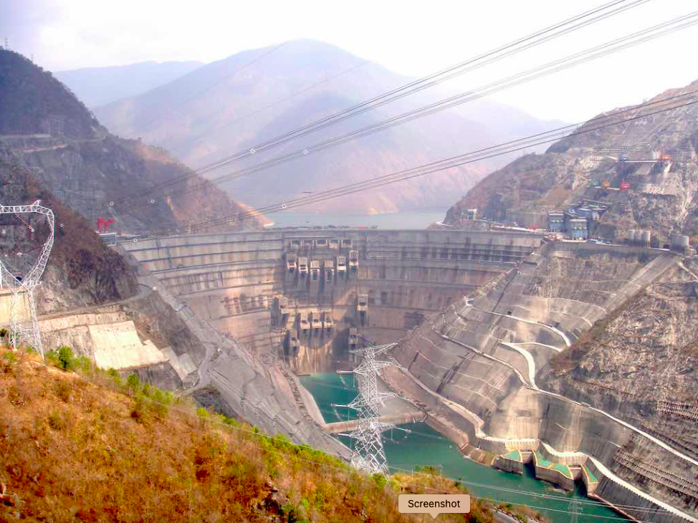
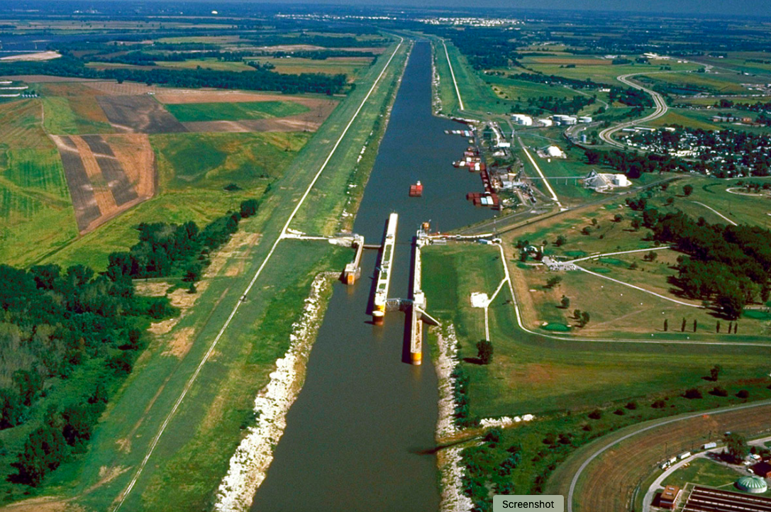
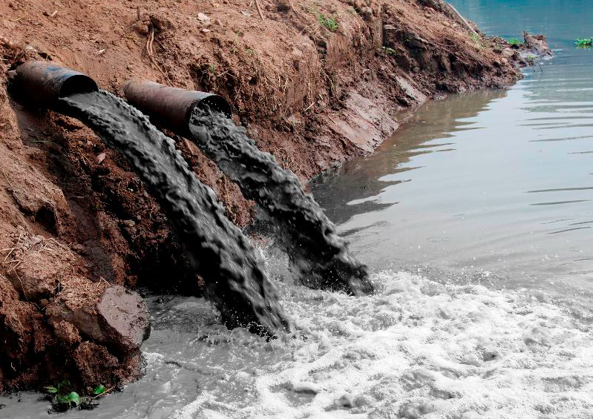
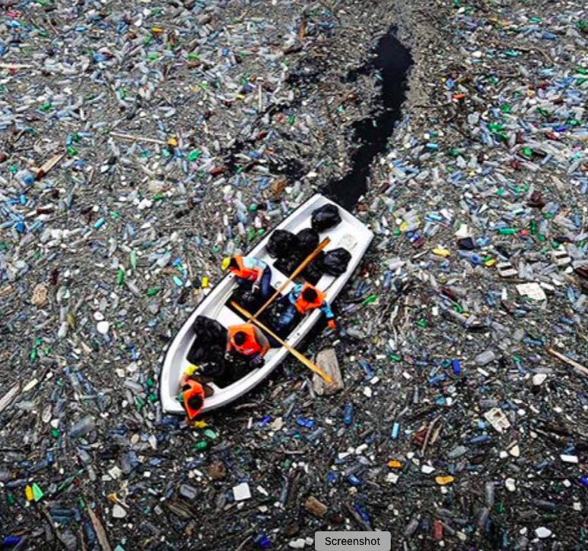
How to Safeguard the Earth’s Life-Support System
The Purpose of a System Is What It Does!
Humans have changed what the systems in the ELSS do:
What does a reengineered river? It
provides hydro-energy
removes water quickly
absorbs pollution
transports waste and pollutes the ocean
…

Slide 43
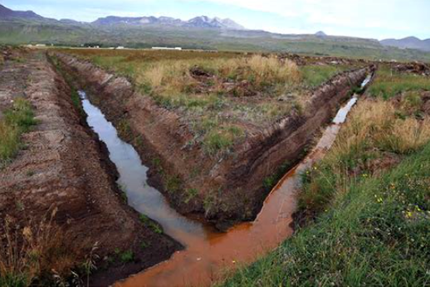
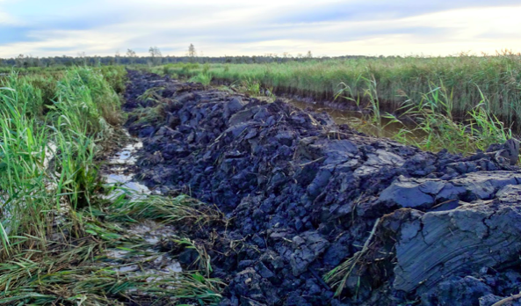
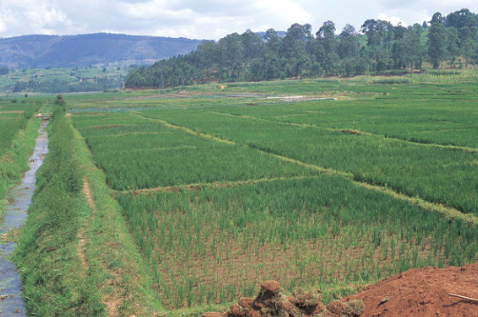
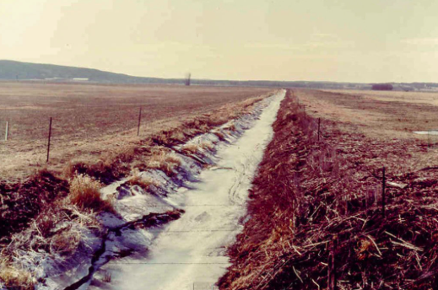
How to Safeguard the Earth’s Life-Support System
The Purpose of a System Is What It Does!
Humans have changed what the systems in the ELSS do:
What does a drained wetland do? It
provides land for human use (agriculture, built environment)
provides access to peat for humans
sustains very limited ecosystems

Slide 44
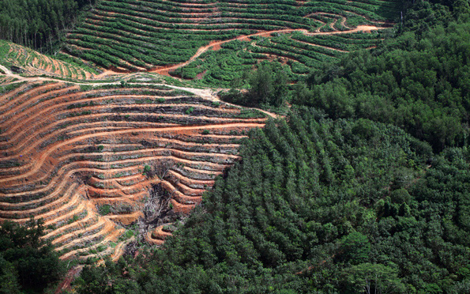
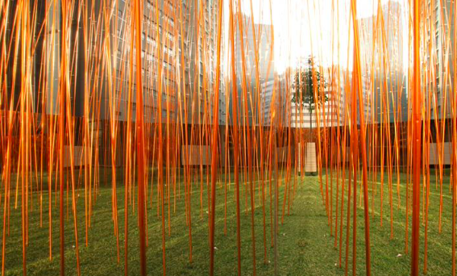
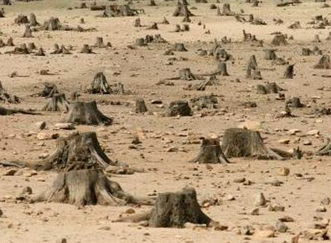
How to Safeguard the Earth’s Life-Support System
The Purpose of a System Is What It Does!
Humans have changed what the systems in the ELSS do:
What does an industrial forest do? It
provides wood for production of consumer goods
sustains very limited and unstable ecosystems

Slide 45
How to Safeguard the Earth’s Life-Support System
The Purpose of a System Is What It Does!
Humans HAVE CHANGED the purpose of the ELSS do!
Safeguarding the Earth’s life-support system requires safeguarding the purpose of the systems that constitute the Earth’s life-support system:
We need to protect the Purpose of the Earth’s life-support system and all its systems
We need a Convention on the Right of all systems in the ELSS to maintain their purpose

Slide 46
My Reasoning
The Syndrome of Modern Global Change has evolved into a Planetary Emergency
Homo sapiens has evolved into the most invasive species within the
Earth’s life-support system,
comparable in growth and impact to a virus in a living organism
Being in control of the planet, a therapy requires that
the “virus” transforms itself into the healer
Thank You!
Questions?
The Root Cause for the Syndrome of Modern Global Change is
an official purpose of economy that is in conflict with the de facto purpose.
Therapy requires an official purpose of economy aligned to the de facto purpose
An economy that meets the needs of the present while
safeguarding the Earth’s life-support system
on which the welfare of current and future generations of al life depends
At the End: Comments on how to safeguard the Earth’s life-support system

