Slide 1
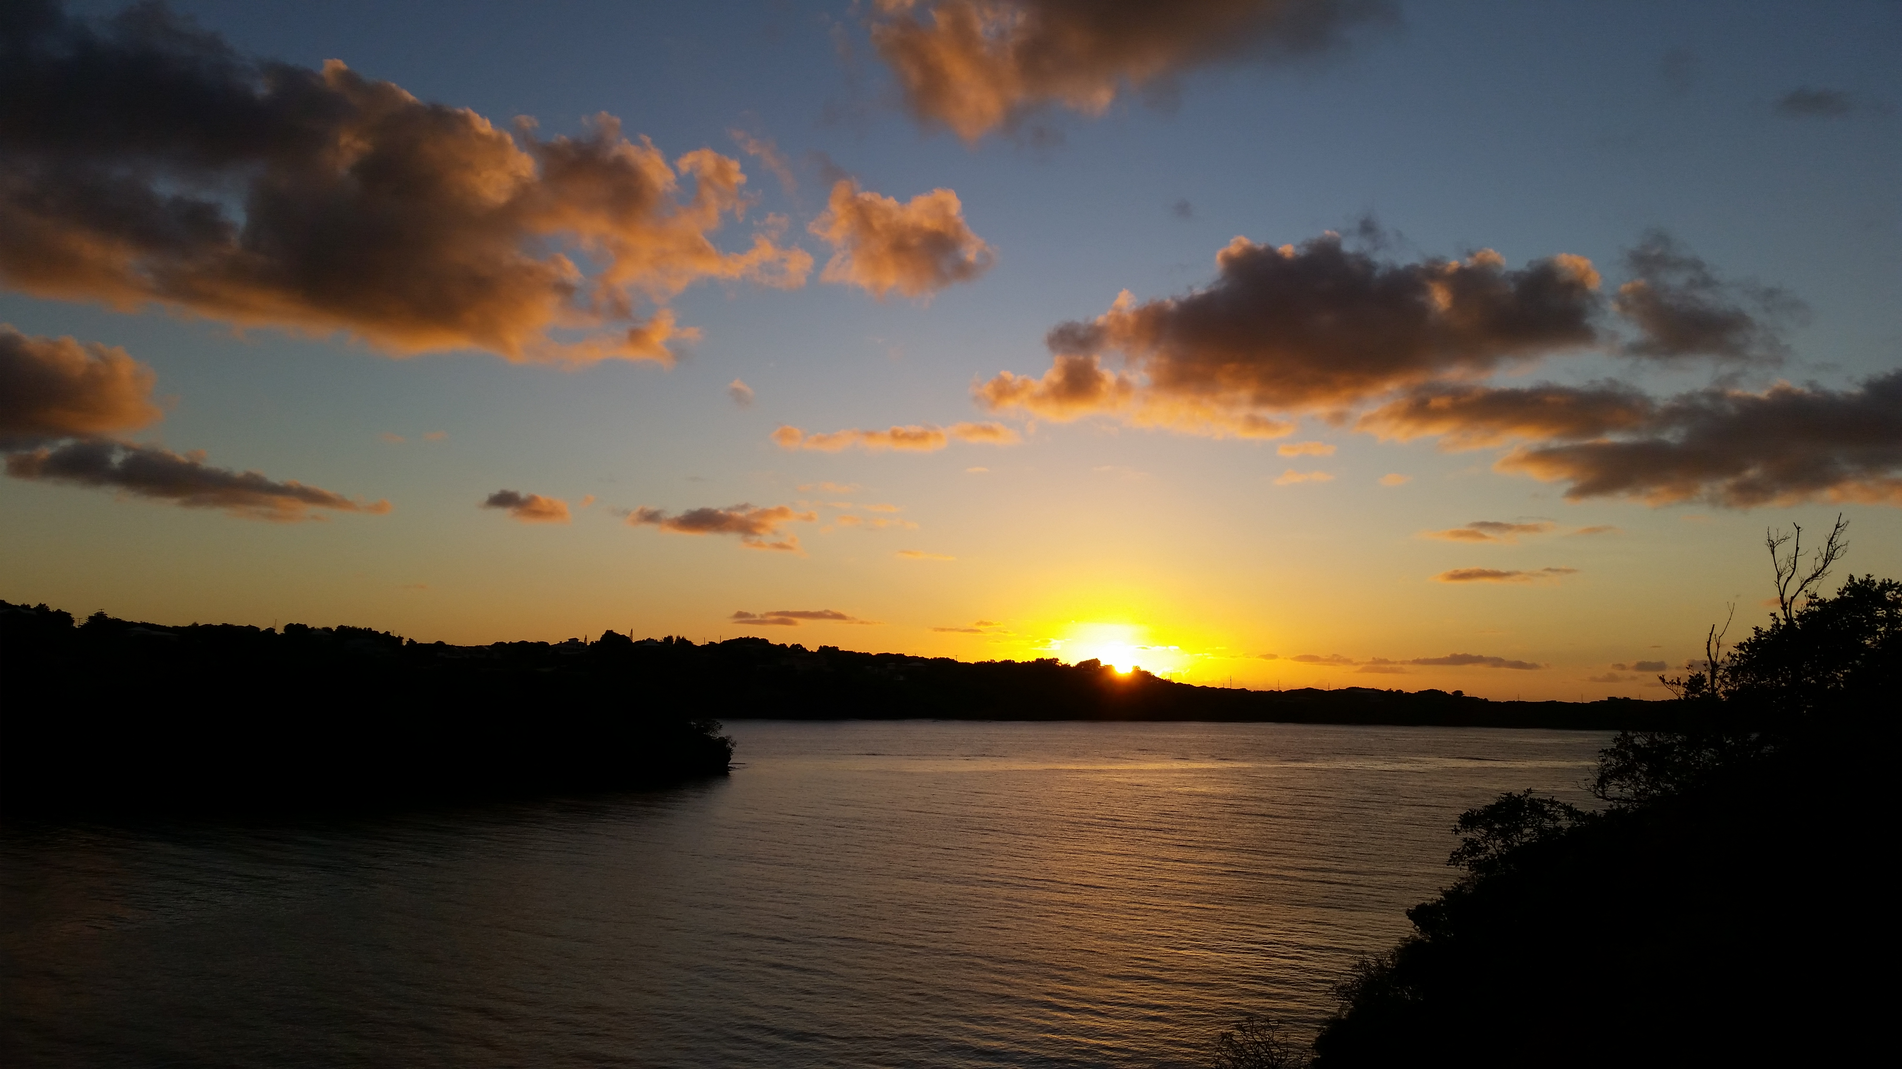
Preparing for a Broad Range of Futures in Grenada
Hans-Peter Plag
Old Dominion University
Norfolk, VA, USA

Slide 2
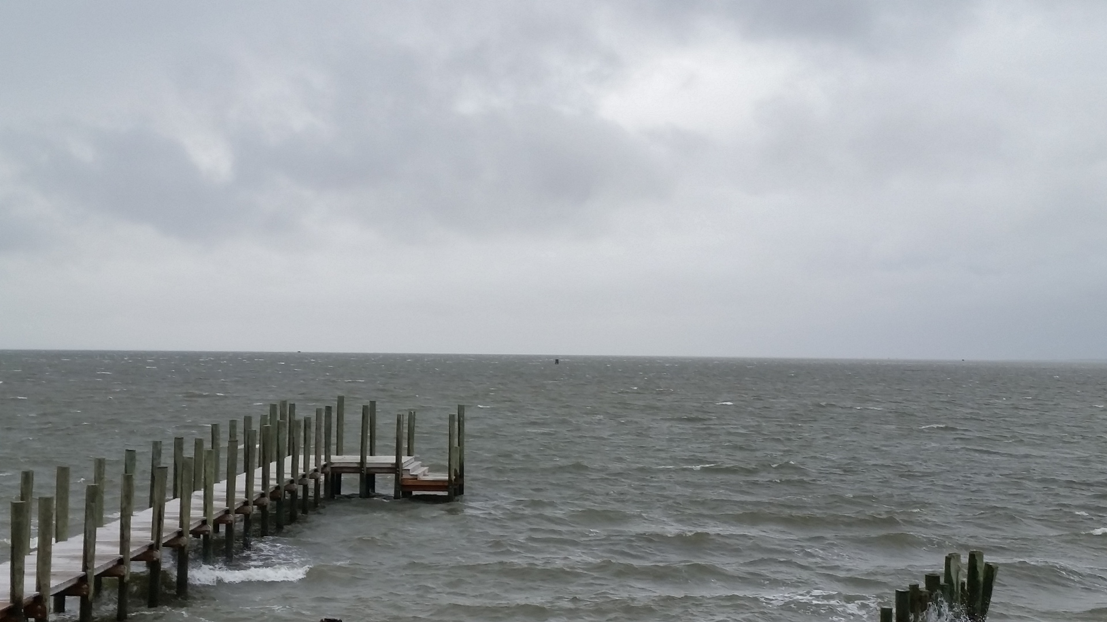
The Syndrome of Modern Global Change:
A Cataclysmic Single-Species Energy Pulse
Contents
The Baseline: Past Climate Changes
The Syndrome: Modern Climate and Global Change
The Diagnosis: Wealth Creation Through Increased Consumption
The Prognosis: Leaving the “Safe Operating Space” and into the Unknown
The Therapy: A new Ethos, Economy, and Global Governance
Hans-Peter Plag
February 9, 2016

Slide 3
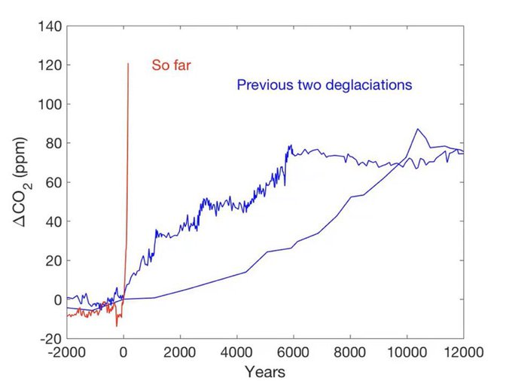
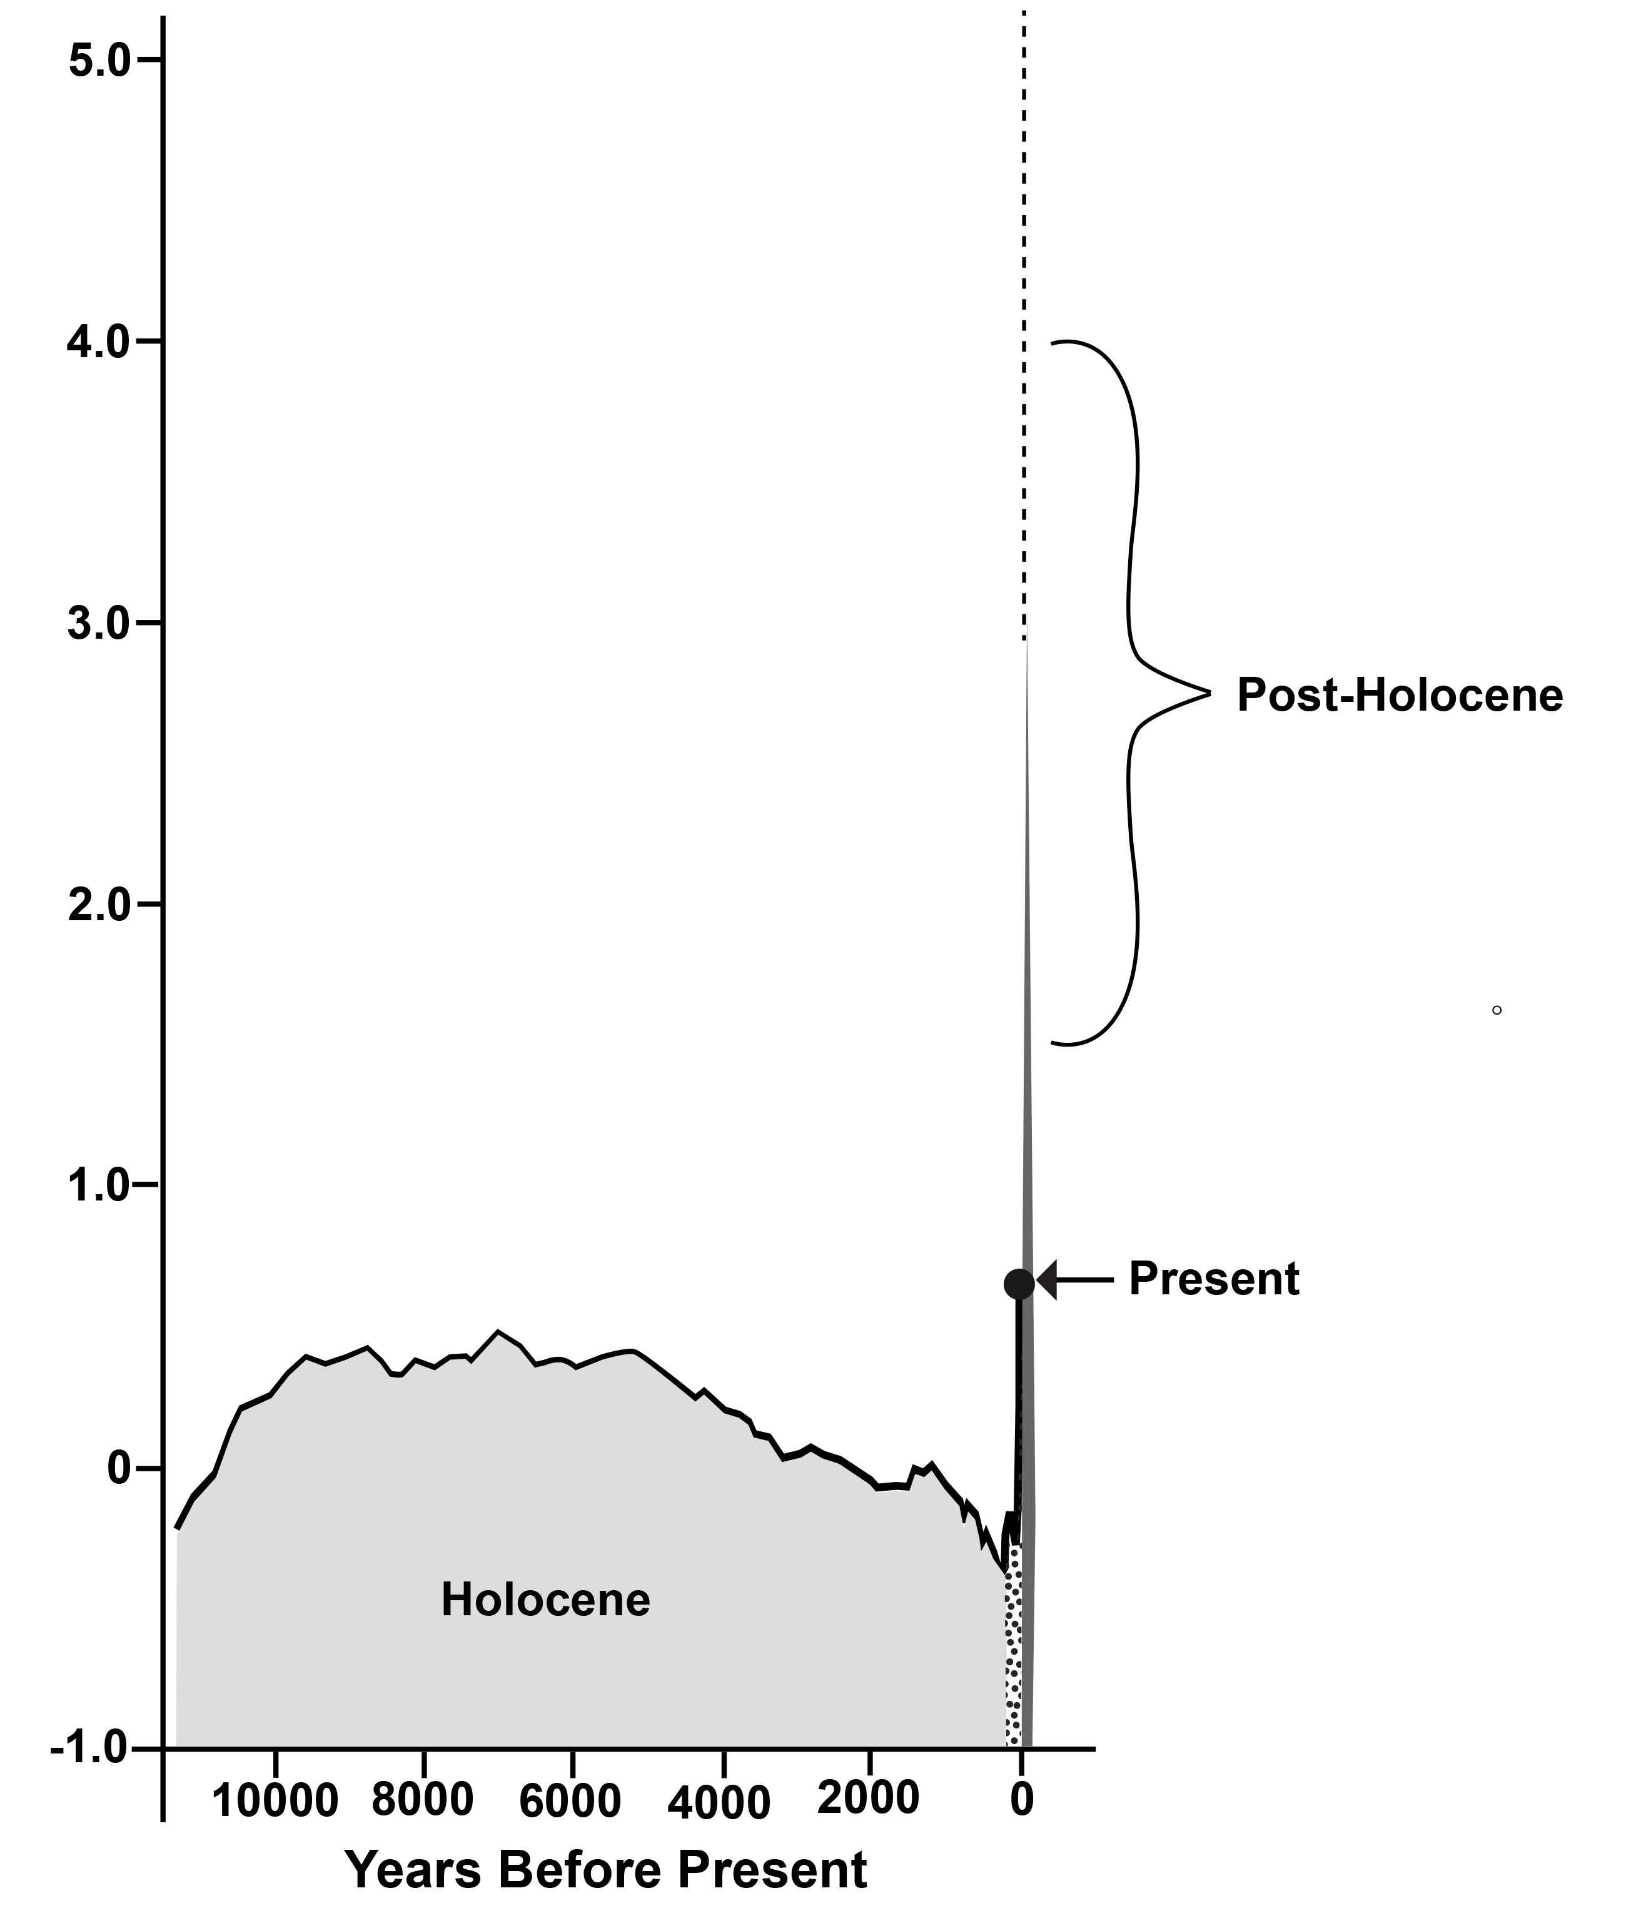
Modern Global Change: A Mega Event
~ 420 ppm
}
~ 300 ppm
Global Mean Air Temperature
~5ºC
~ 300 ppm
If ~100 ppm increase in CO2 corresponds to ~4ºC increase, why are we not experiencing the full impact of the dramatic increase of 120 ppm in Greenhouse Gasses?
~ 200 ppm
1900
Plag, 2020

Slide 4
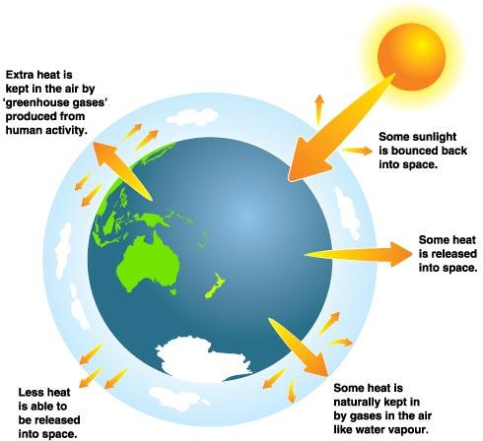
A Planet far away from its Equilibrium Temperature
Climate changes if:
Solar irradiance changes
Reflected radiation(albedo) changes
Absorbed energy changes
Earth's energy imbalance is the difference between the amount of solar energy absorbed by Earth and the amount of energy the planet radiates to space as heat.
With increasing Greenhouse gases, more heat is stored in atmosphere
Some sunlight is bounced back into space
Earth’s Energy Imbalance:
EEI = Solar irradiance - Released Energy
Some solar energy is used by plants and stored in fossils fuels
Some heat is released into space
EEI > 0: Global Warming
EEI < 0: Global Cooling
Longterm EEI: 0.0000001-0.0000003 W/m²
10,000 years EEI: ±0.001 W/m²
Current EEI: ~0.6 W/m² = ~320 TeraWatt
Some heat is absorbed by Greenhouse gases (CO2, CH4, H2O, ...)
Less heat is released to space and stored in ocean and hydrosphere

Slide 5
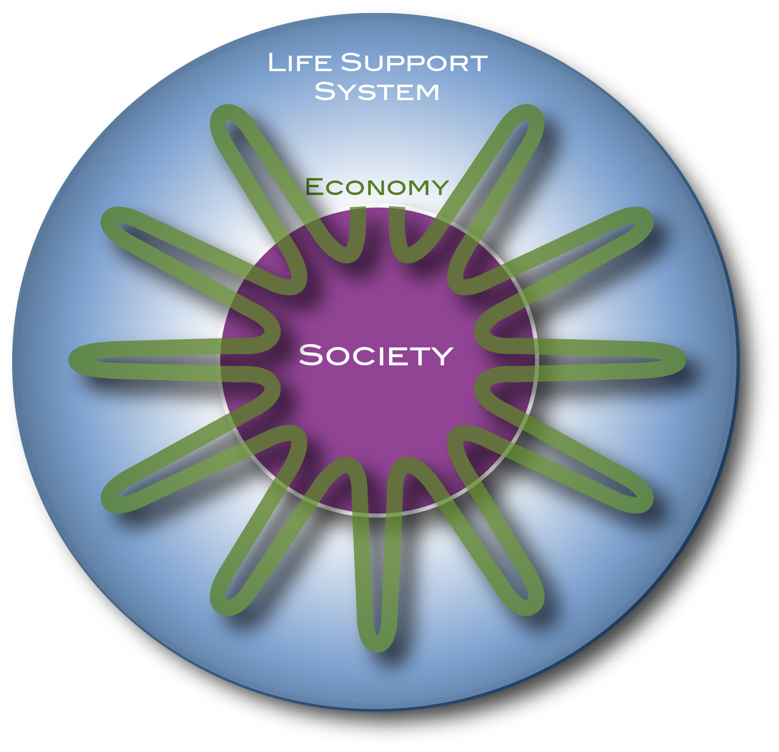
Earth Energy Imbalance off Scale
Earth’s Energy Imbalance
The Earth’s Energy Imbalance increased by a factor of 10⁶ to 10⁷!
10⁻¹⁰-10⁻⁹
Incoming
Solar
3x10⁻³
Incoming
Solar
Outgoing Radiation
Outgoing Radiation
Storage in fossil fuels
Storage in heat
Imbalance on the order of 10⁻¹⁰-10⁻⁹
Imbalance on the order of 3x10⁻³
Last 70 years
Last 200 Million years
Total energy storage in 200 Myrs:
Order 100-1000 ZetaJoules
Total energy storage per century:
Order 1000 ZetaJoules

Slide 6
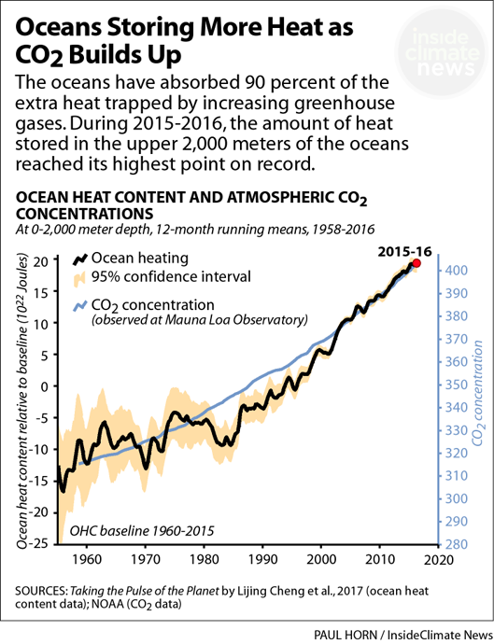
Earth is a Pool House, not a Greenhouse
Earth’s Energy Imbalance
10⁻¹⁰ to 10⁻⁹
Long-term due to photosynthesis: 10-100 MegaWatt
Today: 300-320 TeraWatt
10⁻³
The Earth system is storing far more heat (energy) than what the rising air temperature indicates.
Ocean stores more than 90% of EEI
The Pool-House Effect

Slide 7
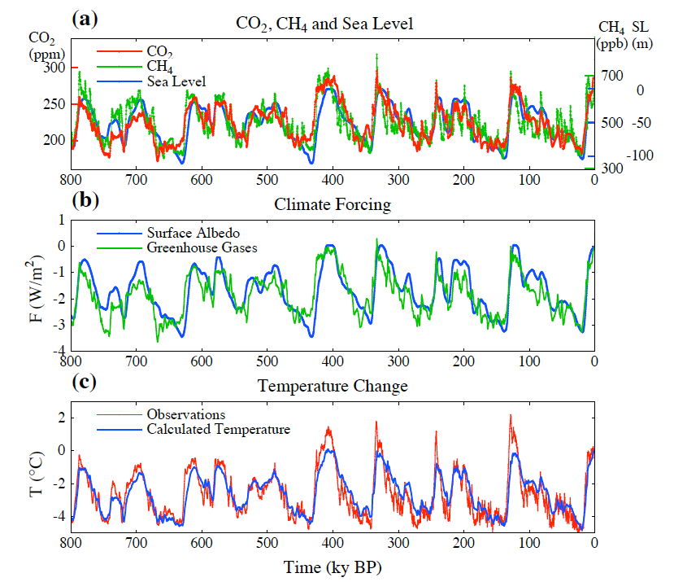
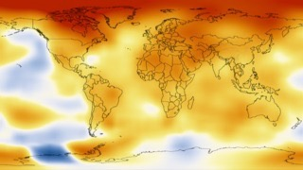
The Baseline: Past Climate and Global Change
Climate Change is a long-term shift in the statistics of weather:
averages
frequency and magnitude of extremes.
Climate is determined by:
incoming radiation (sun, distribution)
reflected radiation (albedo)
retained heat (Greenhouse gases)
Warm period
“Inter-glacial”
Correlation between CO2 and T
Cold period
Ice age
“glacial”
Climate can change from local to global scales.
Temperature anomaly 2008-2012 compared to 1900
Climate can change a lot over time.
Temperature difference:
4ºC - 5ºC

Slide 8
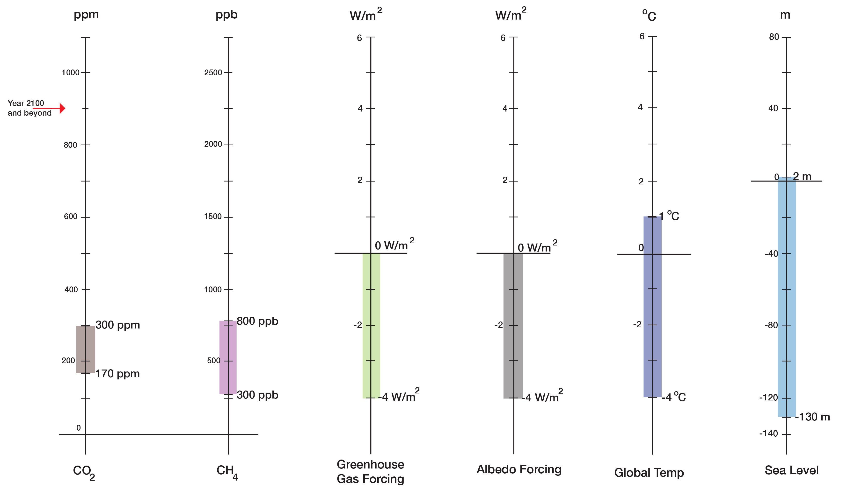
The Baseline: Past Climate and Global Change
Baseline and Range of Changes
Long-term (centuries to millennia) correlations:
130 ppm CO2 <=> 5ºC
130 ppm CO2 <=> 130 m in sea level
Normal Range up to 1900
Holocene

Slide 9
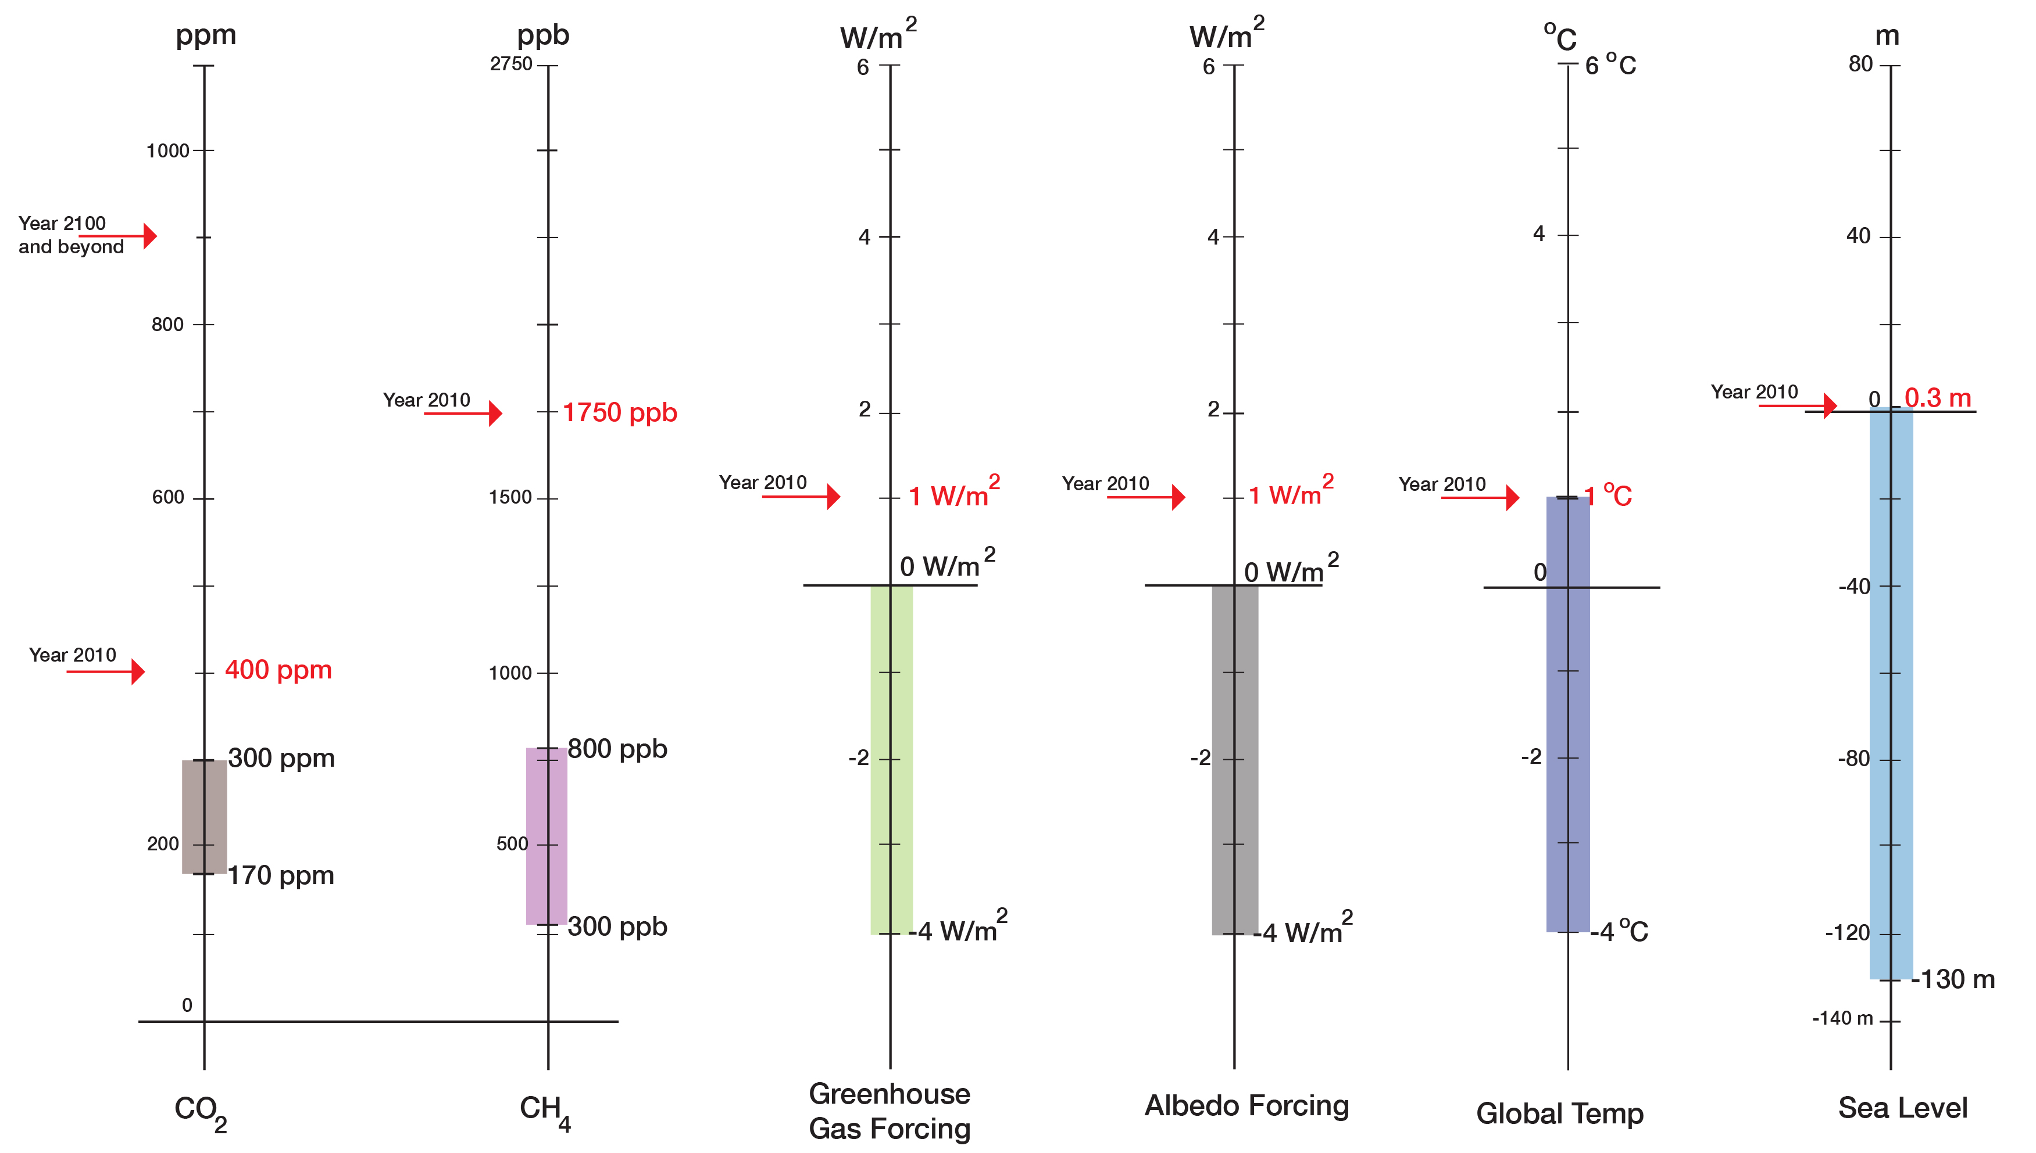
The Syndrome: Modern Climate and Global Change
The Lab Results for “Patient Earth”
“Current State”
“Normal Range”
(800,000 years)

Slide 10
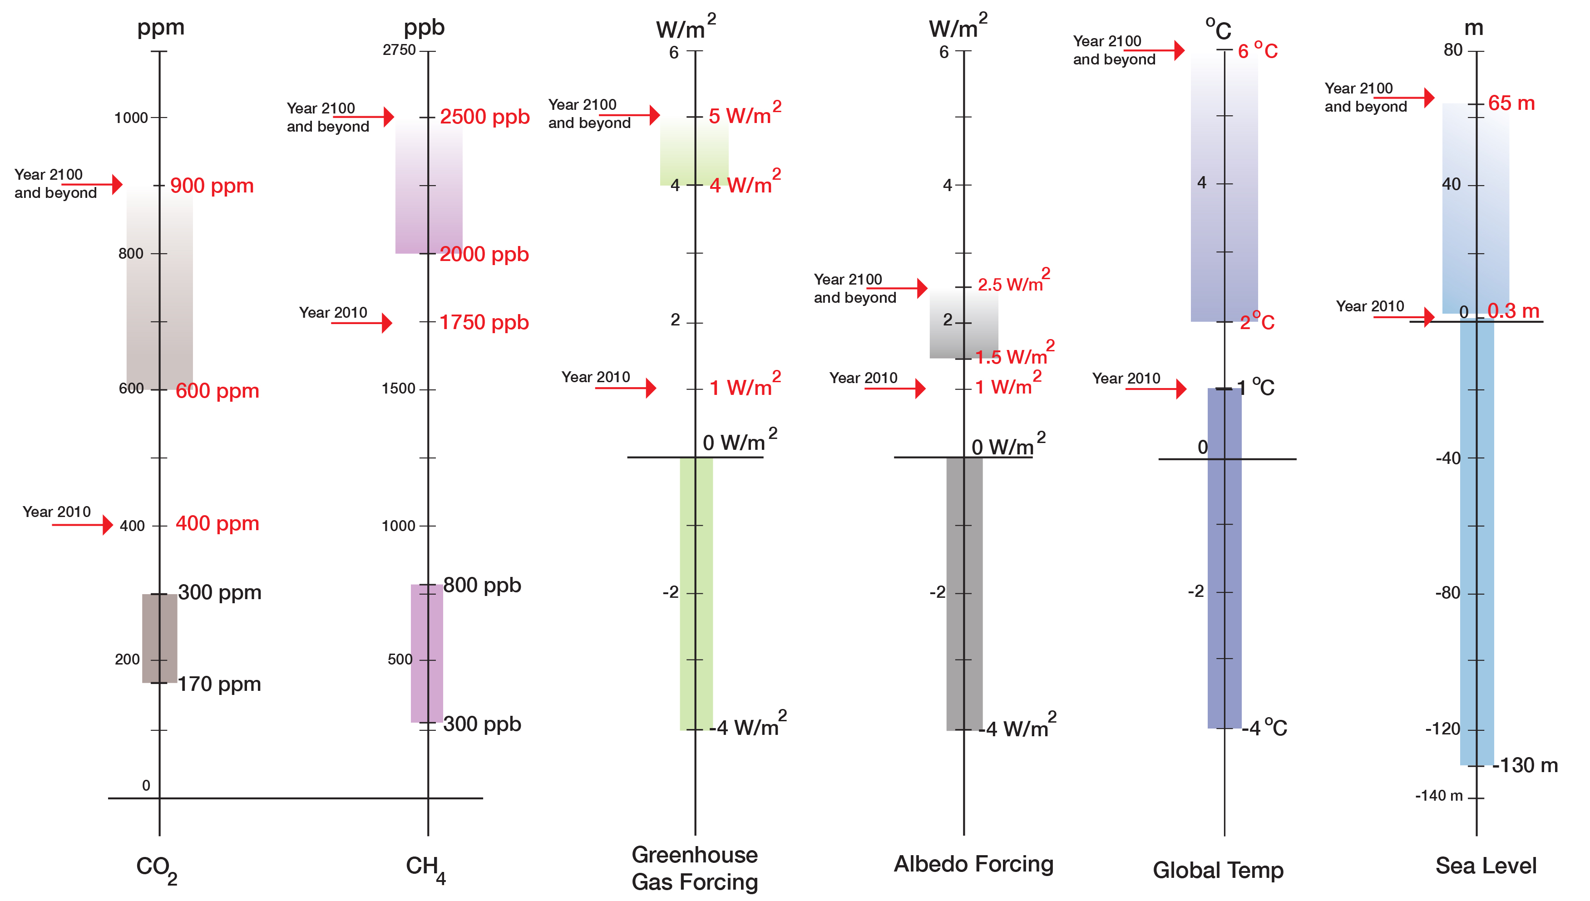
Prognosis: Leaving the “Safe Operating Space” and into the Unknown
“Prognosis”
“Current State”
“Normal Range”
(800,000 years)

Slide 11
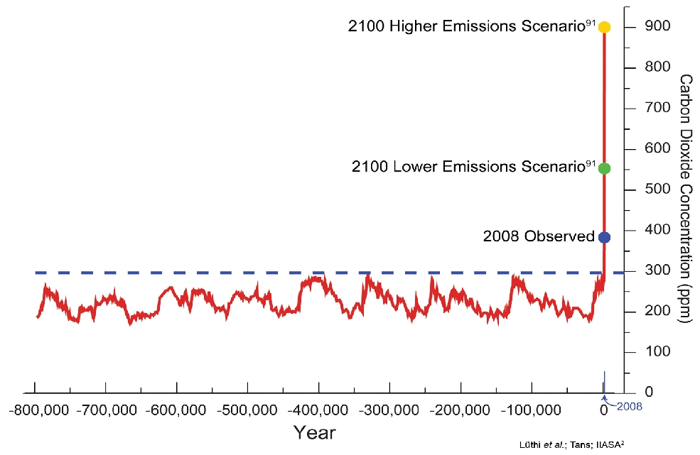
The Syndrome: Modern Climate and Global Change
Two Points:
The increase of atmospheric CO2 increased the EEI by 1 to 10 million times
We are not experiencing the full impact of this dramatic increase because of the ocean storing the heat
2022
{
120 ppm
{
130 ppm
Notes:
I can fix this, I also want to add methane (I have it)

Slide 12
The Syndrome: Modern Climate and Global Change
Greenhouse Gases: Example CO2
}
180 ppm: 20,000 years ago (glacial maximum)
270 ppm: 10,000 years ago (transition to agriculture)
280 ppm: At the start of industrialization in the 17th Century
Time since the last glacial maximum
}
312 ppm: My Birth
320 ppm: Started as carpenter
331 ppm: Started at university
350 ppm: PhD
373 ppm: Married
423 ppm: Today (November 2022)
~ 440 ppm: My 80-ties birthday
Time of my life
My “age” in CO2 increase: 111 ppm (1.5 ppm/year)
Increase over the last 20,000 before industrialization: 120 ppm (0.006 ppm/year)
The increase in my life-time was 260 times faster than on average during the pre-industrial 20,000 years.

Slide 13
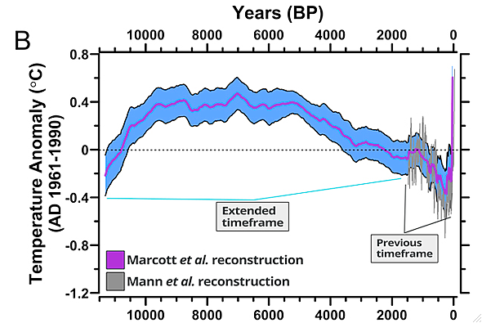
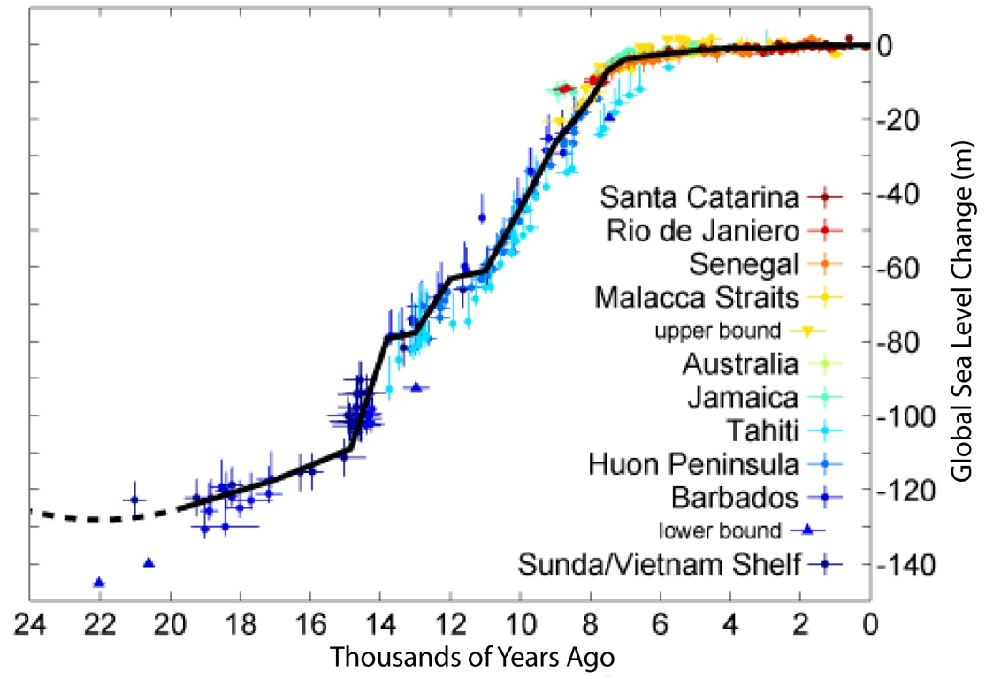
The Baseline: Past Climate and Global Change
Normalcy Bias: Climate variations are small and sea level is stable — a result of the Holocene
Global Temperature Changes
Global Sea Level Changes
Settlements in river deltas
<--Holocene-->
<------------Holocene------------>
Marcott et al., 2013
With stable climate and sea level, the Holocene was a safe operating space for humanity.

Slide 14
Our Ecological Footprint keeps growing, despite many efforts being made
2022:
COP 27: No Actions to mitigate climate change
1973:
Oil crisis
1972:
Club of Rome:
“Limits of Growth”

Slide 15
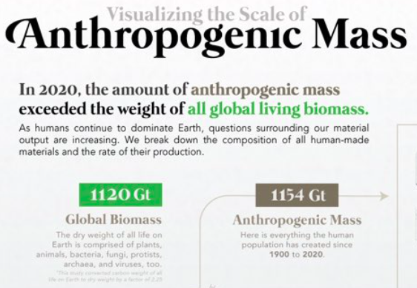
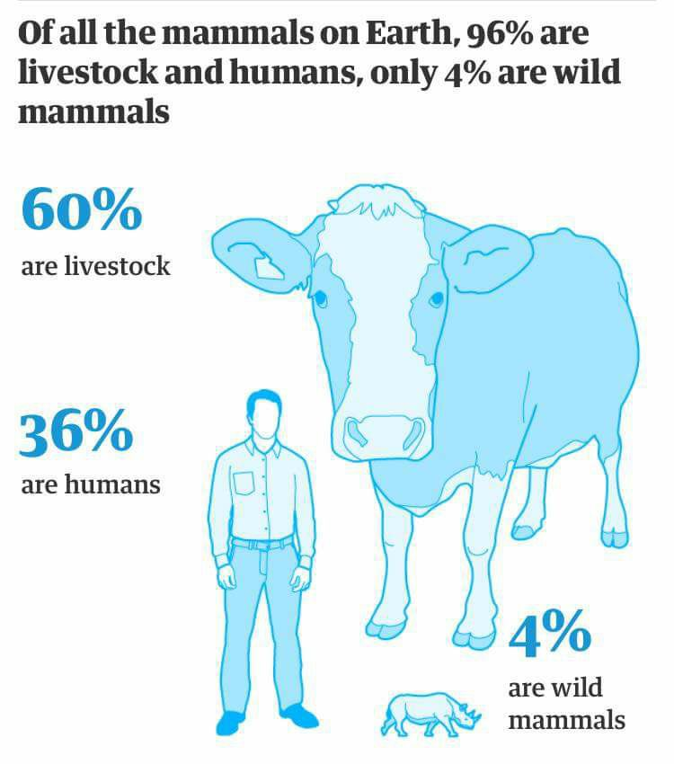
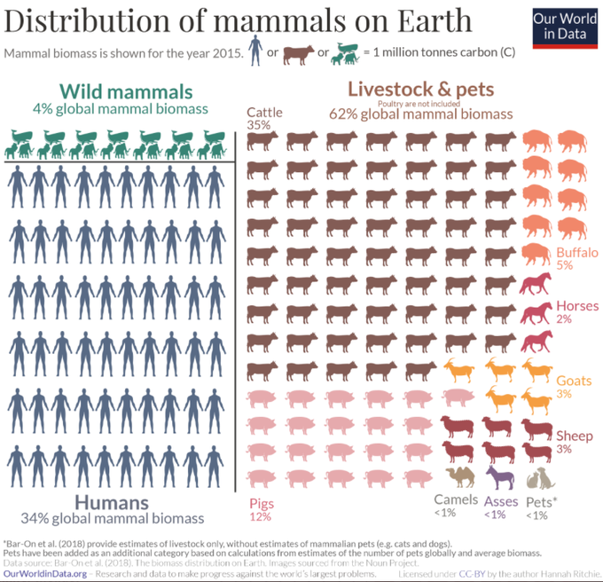
Humans: The most successful invasive species?
1900: ~90% of biomass of mammals were wild animals, ~10% humans and livestock
2015:
From 90% to 4%
From 90% to 4%

Slide 16
Humans: A major hazard?
22
2 km
impactor
“Single-Species
Cataclysm”
21
Homo sapiens
2.10¹³ W
VEI 8
Toba-Type
Eruption
10¹⁶ W lasting 10⁵ s
20
19
Energy Log (Joules)
VEI 7
Tambora-Type
Eruption
18
M = 9.5
Earthquake
10¹⁷ W lasting
100 s
17
16
The Homo sapiens: Cataclysmic Virus (HCV) in the Earth’s Life-Support System
15
Can the “virus” transform itself into the “healer”?
0
1
2
3
4
5
6
7
Recurrence Log (Years)

Slide 17
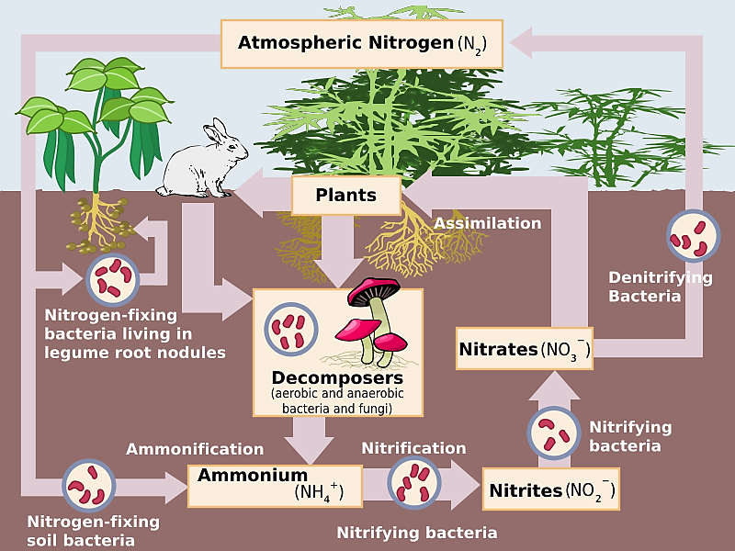
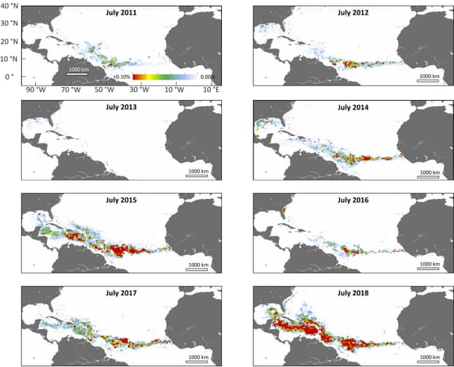
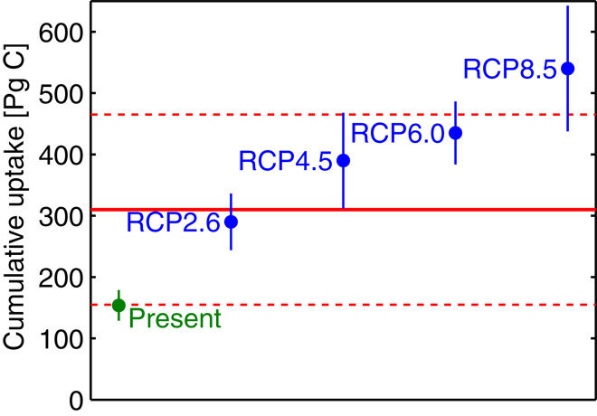
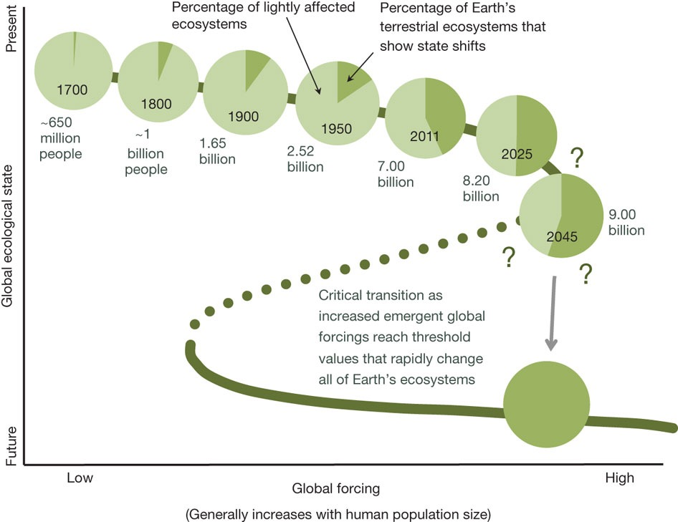
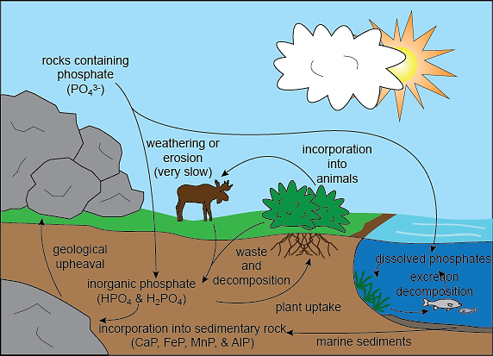
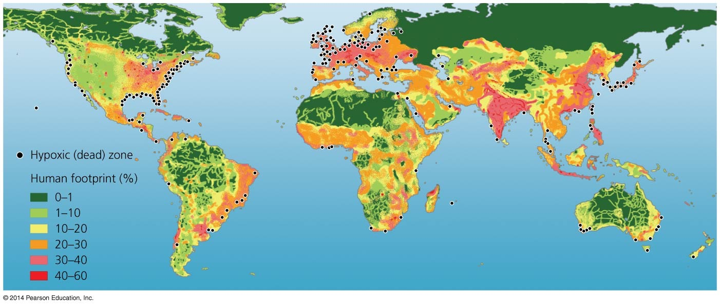
“We are the asteroid …”
From a “Safe Operating Space” into the Unknown
The Holocene was a “safe operating space for humanity”
Sargassum
“We are the asteroid …”
https://www.youtube.com/watch?v=gPq9YAg9mfc&feature=youtu.be
Current extinction rates:
300 times background rate for birds
80,000 times background rate for mammals
The urgent challenge of plastics
448 Million tons in 2015
Average use time: 5 years
Average lifetime: 1000-5000 years
Rothman, 2017
Rockstrom and Klum, 2015

Slide 18
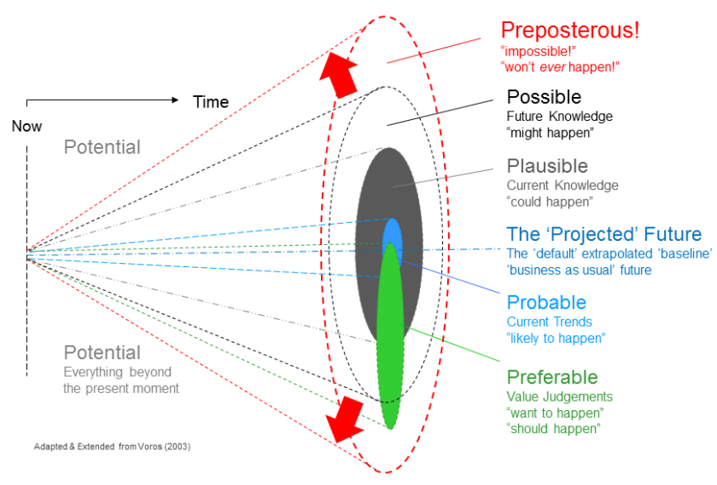
Understanding the Spectrum of Possible Future
Spectrum of Possible Futures
Archetypal futures
Collapse
Continue
Past
Discipline
Transformation
Dator, 2009;
Bengtson, 2018
Voros, 2003, 2012

Slide 19
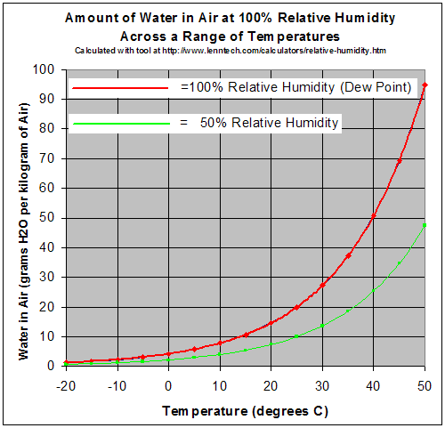
A Warmer Atmosphere Can Store Far More Water
Specific heat capacity:
Water: 4200 Jkg⁻¹K⁻¹
Air: 993 Jkg⁻¹K⁻¹
Water has 4.23 times higher specific heat capacity.
Density:
Water: 1000 kg/m³
Air: 1.275 kg/m³
Water is about 785 times denser than air.
Volumetric heat capacity:
Water compared to air:
About 3300 time higher volumetric heat capacity

Slide 20
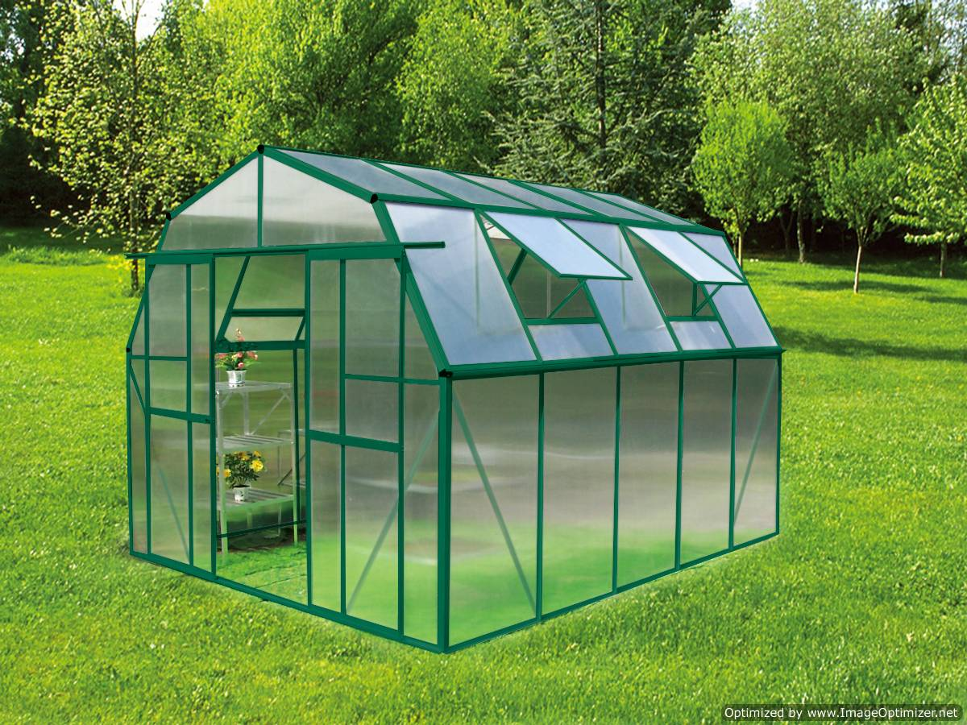
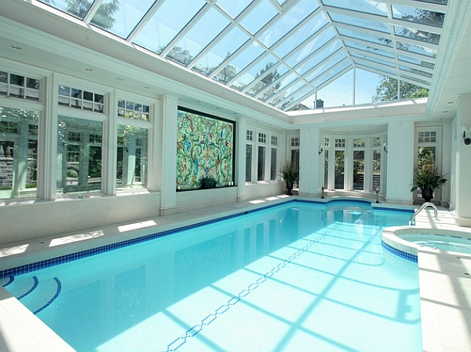
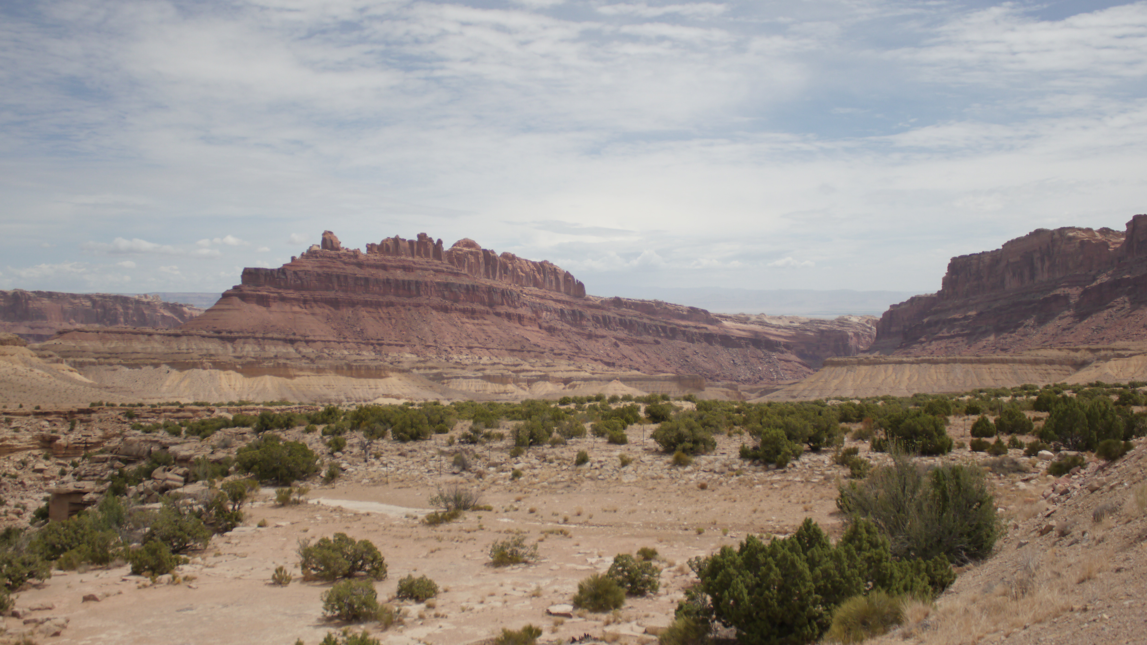
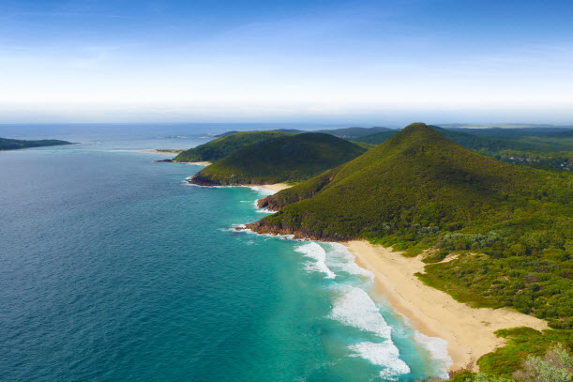
The Syndrome: Recent Climate and Global Change
Greenhouse
Poolhouse
Volumetric heat capacity of water compared to air: About 3300 time higher

Slide 21
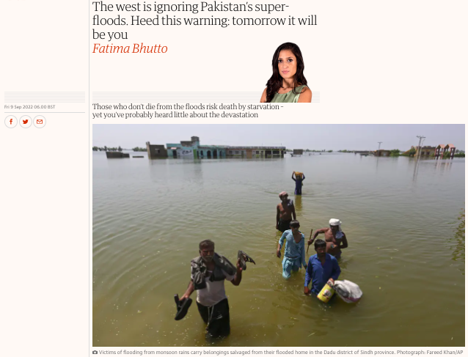
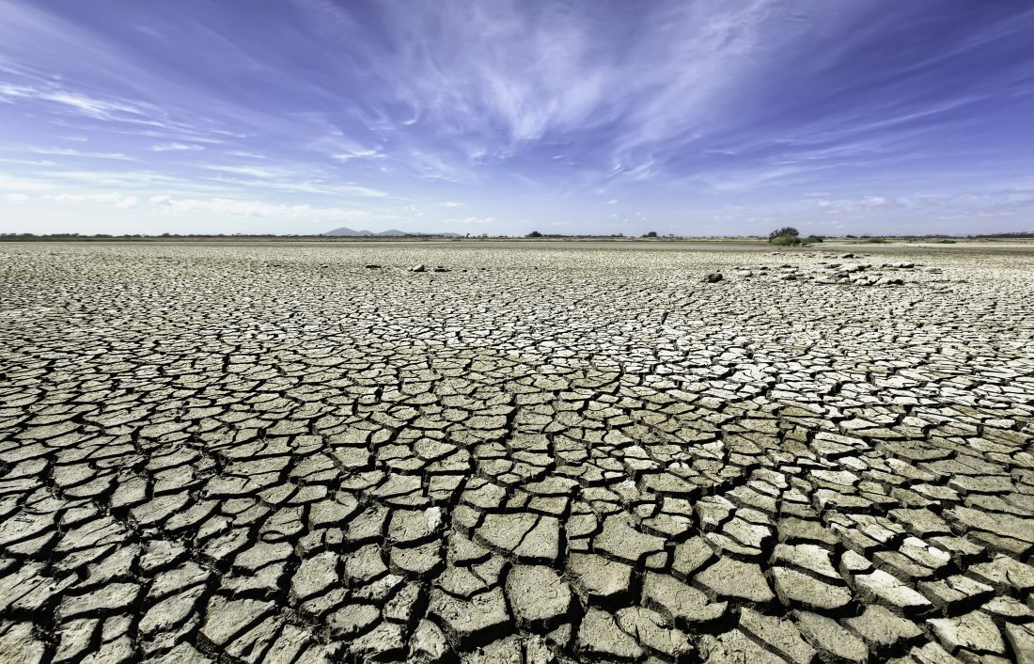
Extreme Events are getting more extreme
Hurricane Dorian
September 1, 2019
Rainfall and floods
Cyclones and storms
Cyclone Idai,
March 15, 2019
Heat waves and droughts
Extreme weather-related disasters are increasing
Cyclone Kenneth,
April 22, 2019

Slide 22
Humans have to find new Homes
Involuntary Migration is Causing Massive Harm

Slide 23
Wildfires are more frequent and more intense
Wildfires are impacting both humans and other animals
Anthropocene or Pyrocene?

Slide 24
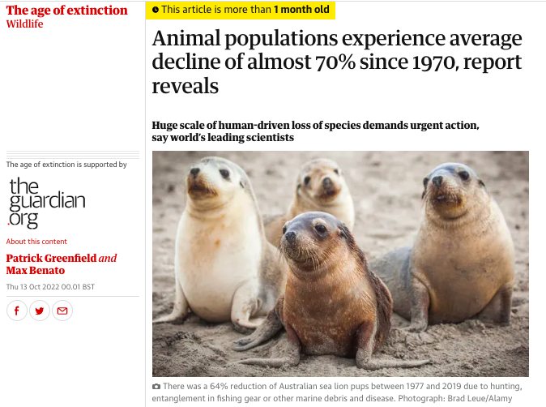
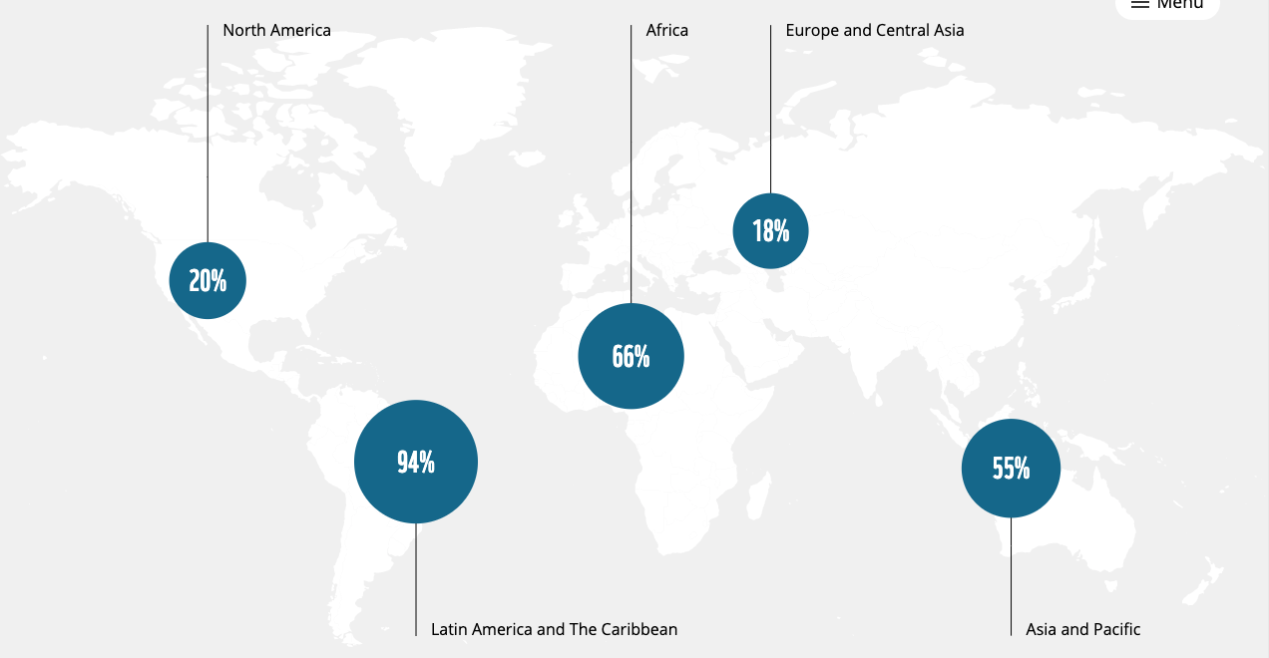
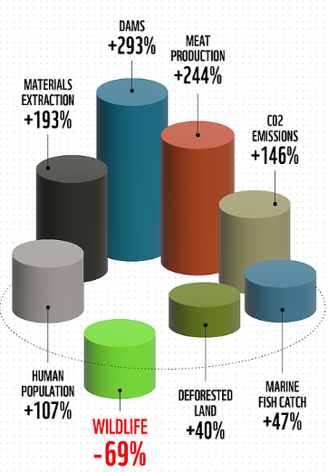
Elimination of Wildlife and Extinction

Slide 25
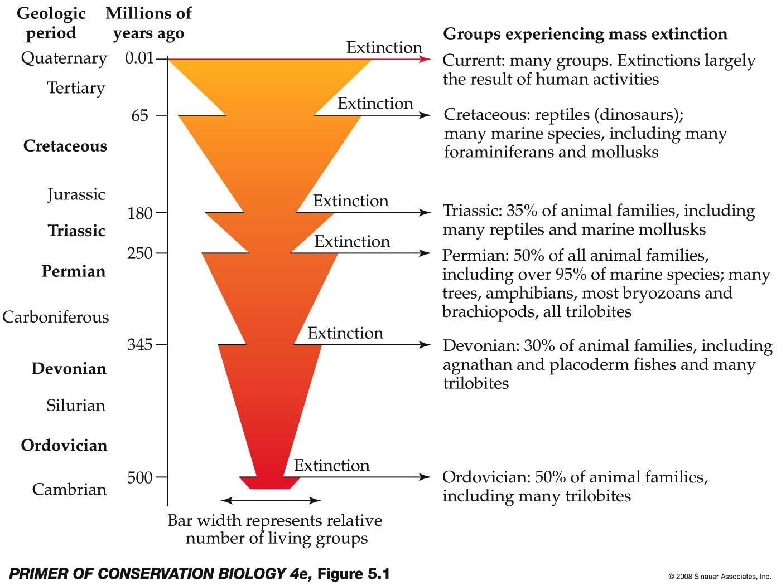
Extinction
Extinctions have happened before
?
End of Permian:
50% of all animal families
95% of marine species
more that 5 million years before recovery started

Slide 26
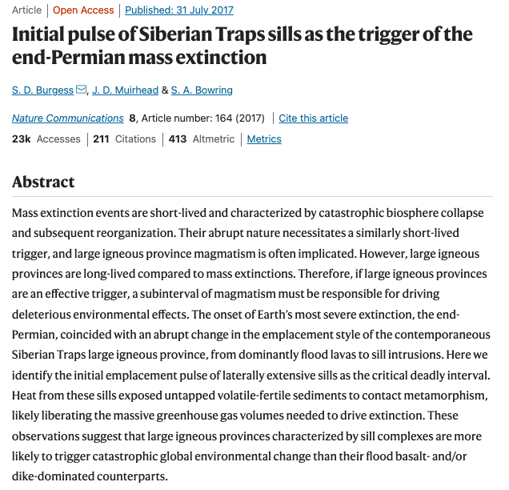
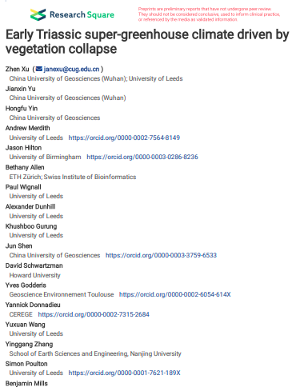
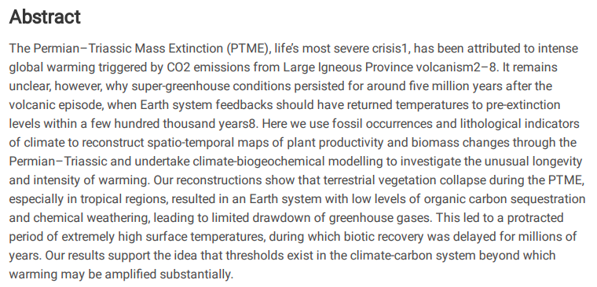
What Caused the Largest and Longest-Lasting Mass Extinction?
Breakdown of flora delayed end of super-greenhouse
Source of second pulse: carbon-rich layers

Slide 27
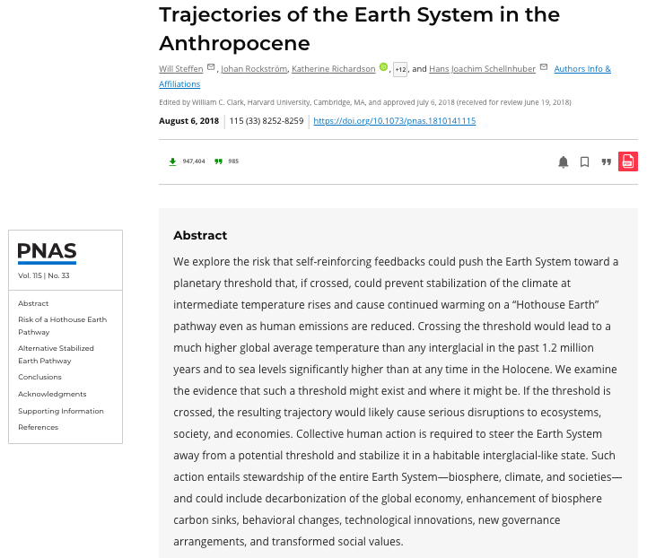
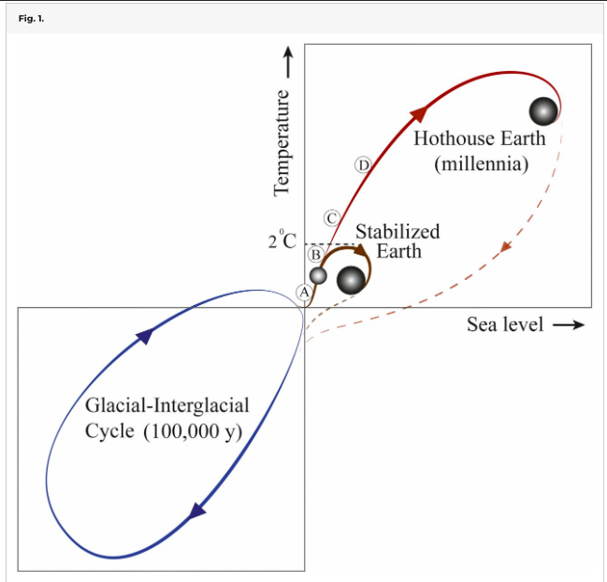
Could Earth Drift into a Hot-House Climate?
Our Hope
https://www.pnas.org/doi/10.1073/pnas.1810141115

Slide 28
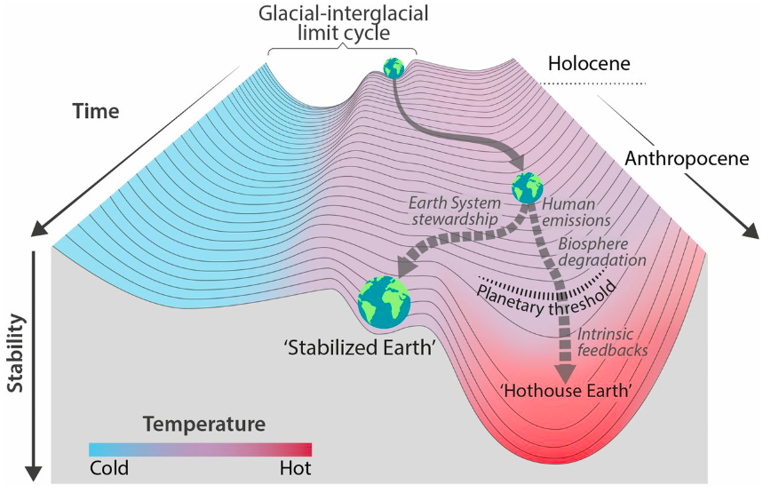
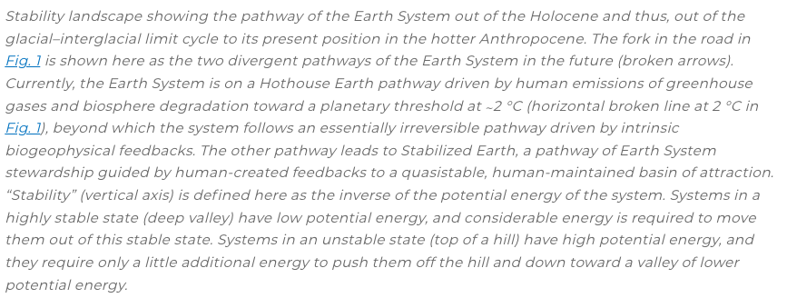
Could Earth Drift into a Hot-House Climate?
https://www.pnas.org/doi/10.1073/pnas.1810141115

Slide 29
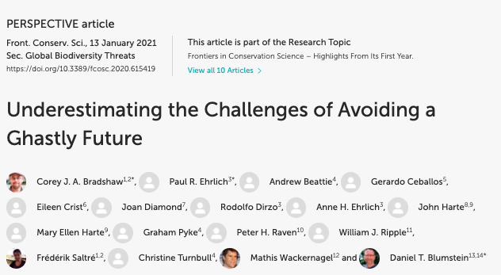
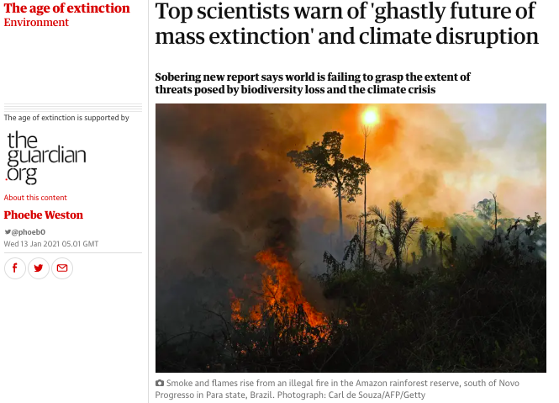
Is There Still a Desirable Future for us?

Slide 30
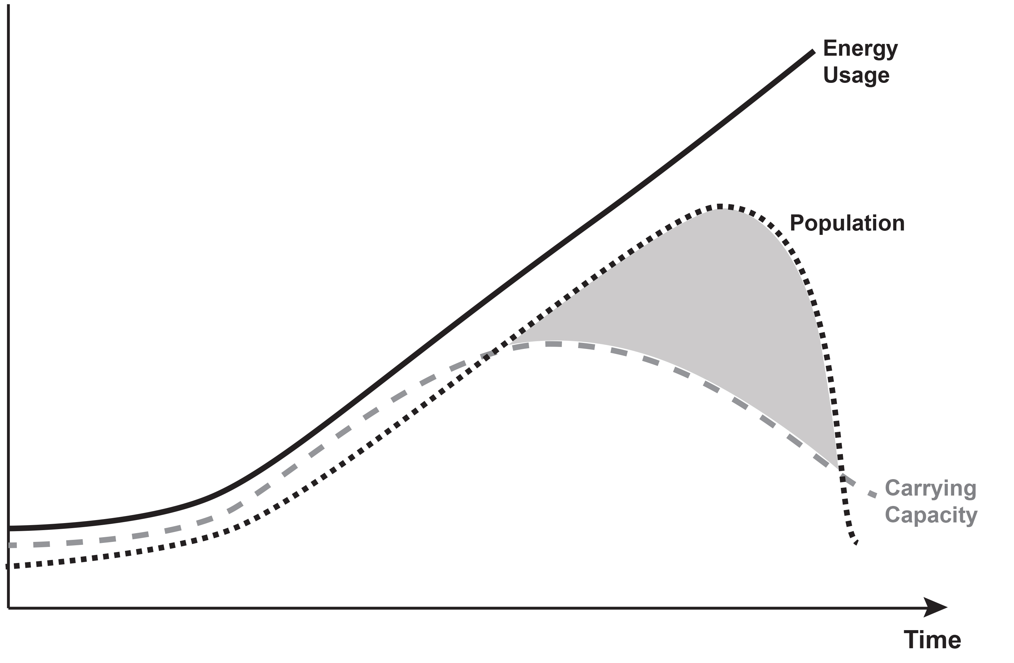
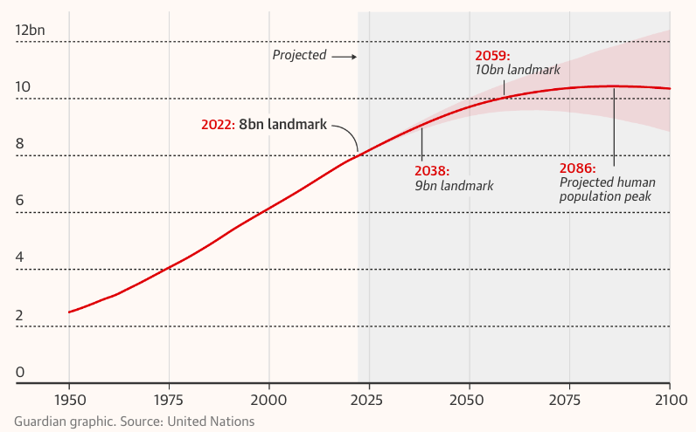
Towards a Population Collapse?
Tipping Point: Population growth and carrying capacity
The recent increase in carrying capacity could be transient
Increasing carrying capacity without self-limitation leads to population growth falling the carrying capacity
Plag, 2020

Slide 31
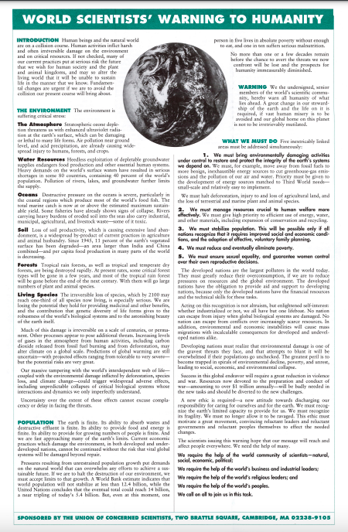
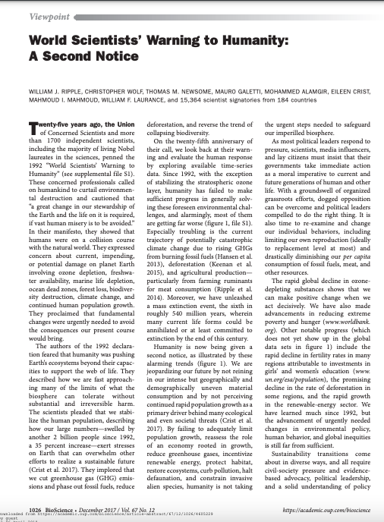
Scientists have been warning …
1992
2017
Ripple, W. J., Wolf, C., Newsome, T. M., Galetti, M., Alamgir, M., Crist, E., Mahmoud, M. I., Laurance, W. F., 15,364 scientist signatories from 184 countries, 2017. World Scientists’ Warning to Humanity: A Second Notice, BioScience, 67(12), 1026-1028, DOI: 10.1093/biosci/bix125
Union of Concerned Scientists, 1992. World Scientists’ Warning to Humanity

Slide 32
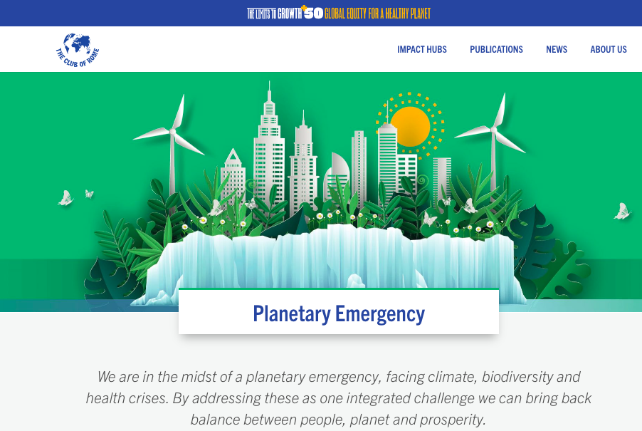
We are in a Planetary Emergency
https://www.place4us.net

Slide 33
Are we on a Path to a Collapse Future?
Have we crossed the threshold where we lost the option to bring the boat safely to the shore?

Slide 34
Preparing Grenada for an Unknown Future: Understanding the Hazards
Floods:
expect much larger extreme rainfall events
Heating: Impacts delayed/moderated by ocean; expect 2-3ºC in average, stronger extremes (heat waves)
Sea-Level Rise:
most likely very underestimated:
Greenland: 4-5 m
Antarctica: 3-7 m
Total range: 2-15 m
Droughts:
expect much longer drought periods
Heat waves:
expect much more frequent and extreme
Understand the spectrum of possible futures for Grenada, the region and globally
Ocean warming:
expect changes in marine biosphere
invasive species
more sargassum
Storms:
statistics and models indicate a slow trend to more frequent and stronger storms
Ocean acidification:
loss of marine life
Rothman (2017): total collapse by
2100 +- 50 years

Slide 35
Preparing Grenada for an Unknown Future: Being Anti-Fragile and Resilient
Involuntary Migration:
- expected to increase rapidly
- some expect billion to migrate
Food Security:
- global food security increasingly threatened
- ensure sufficient production on the islands
Social Stability:
- reduce inequality
- reduce injustice
Infrastructure and Built Environment:
- prepare for future climate
- build where it is safe
Public Services:
can be utilized for progress towards SDGs
Economic Instabilities:
- diversify
- strengthen local economy through training and funding
Build a resilient, anti-fragile community that is prepared for socio-economic and environmental-ecological changes in the region and globally
Sargassum:
- opportunity for fertilizers
E.g., Energy Service:
- SDG 1: No poverty
- SDG 3: Good Health
- SDG 4: Quality Education
- SDG 5: Gender Equality
- SDG 7: Clean Energy
- SDG 13: Climate Actions
Land use:
- Protect forests
- preserve agricultural land
- protect valuable ecosystems
Resource Usage:
- Reuse and recycling of waste
- No organics in landfills

Slide 36
Hydrogen
Hydrogen
Hydrogen
Hydrogen
Plag and Jules-Plag, 2019

Slide 37
What Could Transform the Virus into the Healer?
Importance of flows
Strategies for Sustainability:
To consume nature’s flows while conserving the stocks (that is, live off the ‘interest’ while conserving natural capital).
To increase society’s stocks (human resources, civil institutions) and limit the flow of materials and energy.
Brown et al. (2004)
A Species that has unparalleled power to grow and change the planetary physiology must exercise self limitation:
a small family ethics and responsible procreation;
limitation of wealth creation and accumulation
Importance of Mainstream Economic Model

Slide 38
Transforming the Virus into the Healer: A new Ethos and a new Economy
Purpose of economy is to increase human wealth;
Earth and its natural wealth is basically infinite.
Smith (1776)
Published in 1776

Slide 39
Transforming the Virus into the Healer: A new Ethos and a new Economy
Purpose of economy is to increase human wealth;
Earth and its natural wealth is basically infinite.
Smith (1776)
"Sustainable development is development that meets the needs of the present without compromising the ability of future generations to meet their own needs”.
WCED (1987)
Published in 1987

Slide 40
Transforming the Virus into the Healer: A new Ethos and a new Economy
Purpose of economy is to increase human wealth;
Earth and its natural wealth is basically infinite.
Smith (1776)
"Sustainable development is development that meets the needs of the present without compromising the ability of future generations to meet their own needs”.
WCED (1987)
“Sustainable Development is a development that meets the needs of the present while safeguarding Earth’s life support systems, on which the welfare of current and future generations depends.”
Griggs et al. (2013)
A supply system (“economy”) that meets the needs of the present while safeguarding Earth’s life support systems, on which the welfare of current and future generations of all life including humans depends.

